Slide 1
ACT III
Astrophysical Radiation Magnetohydrodynamics
Being an Opera in Three Acts
Lecture 2: Two Applications
Radiatively Driven Winds/Accretion
Local Magnetic Dynamo
With Words & Music By
Tom Bogdan
Paul Charbonneau
October 10, 2018

Slide 2
ACT III
Scene 1
Astrophysical Radiation Magnetohydrodynamics
Being an Opera in Three Acts
We at some times are minions of our theories,
The fault, dear Brutus, is not in ourselves,
But in our stars, that we are underlings.

Slide 3

Winds, Accretion Flows & Magnetoconvection
Gravitational Field
Entropy Production
Adiabatic (Reversible)
“An essential difference between the dynamics of radiating and non-radiating fluids is that because photons typically have much longer mean free paths than their material counterparts, they can introduce a fundamental global coupling between widely separated parts of the flow, which must be treated by a full transport theory.”
--Dimitri Mihalas
Internal Energy
Kinetic Energy
Matter
Turbulence
Electro-Magnetic Field
Radiation Field

Slide 4
Winds, Accretion Flows
Gravitational Field
Accretion Flows
Winds
“I've always enjoyed learning how things work. ... Simply endless puzzles and problems that come to light, some of them trivial, amusing, some of them very important and I take great pleasure in learning them.”
--Eugene Parker
Internal Energy
Kinetic Energy
Matter
Turbulence
“We do not argue with the critic who urges that the stars are not hot enough for this process; we tell him to go and find a hotter place.”
--Arthur Eddington
Radiation Field
It is very hard to do one-dimensional MHD in spherical geometry. Sorry…

Slide 5
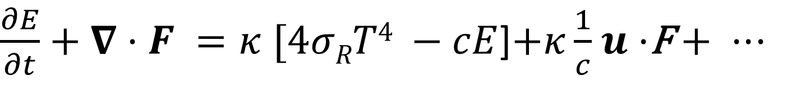

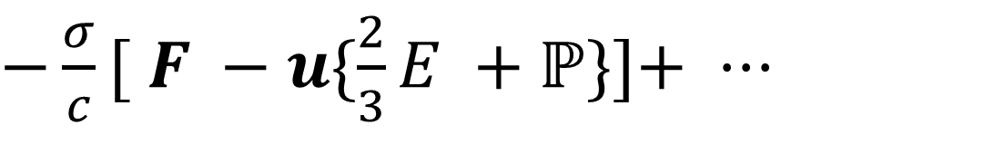
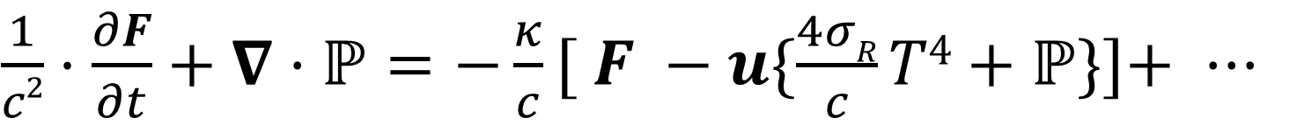
The Radiation Field
Matter Energy
+
+
Local Thermodynamic Equilibrium
$$\frac{1}{c}⋅\frac{∂I_{ν}}{∂t}+n·∇I_{ν}=η_{ν}−χ_{ν}I_{ν}$$
Gray Atmosphere Approximation
Thomson Scattering
Radiation Energy
$\frac{∂E}{∂t}+∇·F =κ [4σRT4 −cE$]$+κ\frac{1}{c}$ $u·$F + $···$
$\frac{1}{c2}⋅\frac{∂F}{∂t}+∇·ℙ=−\frac{κ}{c}[ F −u\{\frac{4σR}{c}T4+ℙ\}]$+ $···$
$−\frac{σ}{c}[ F −u\{\frac{2}{3}E +ℙ\}]$+ $···$
Someone still needs to tell us how to determine the radiation pressure tensor!
Higher-order terms in the ratio
of u/c live here.

Slide 6
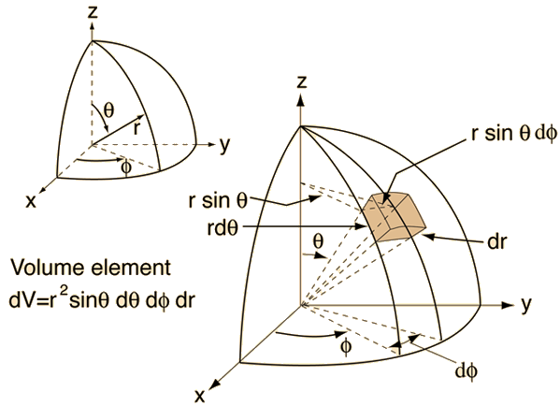
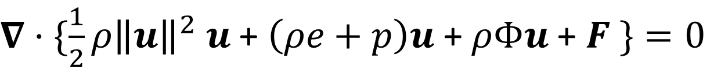
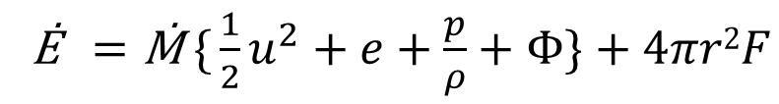

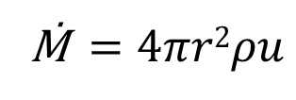
Steady Spherical Flows
Radiation
Mass
$∇·\{\frac{1}{2}ρ{\left\|u\right\|}^{2} u$ + $\left(ρe+p\right)u$ + $ρΦu$ + $F \}=0$
$$∇·ρu=0$$
Kinetic
Thermal
Gravitational
Ṁ$=4πr2ρu$
Ė$=\text{Ṁ} \text{\{}\frac{1}{2}u^{2}+e+\frac{p}{ρ}+Φ\}+4πr2F$
Nice---we have two constants from our conserved fluxes of energy and mass!!

Slide 7
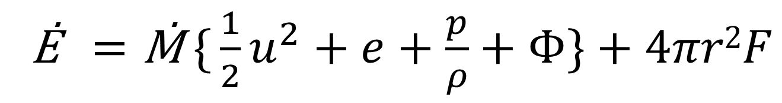
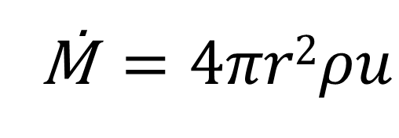
2 Integrals of the Motion
Ṁ$=4πr2ρu$
Ė$=\text{Ṁ} \text{\{}\frac{1}{2}u^{2}+e+\frac{p}{ρ}+Φ\}+4πr2F$

Slide 8
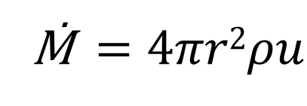
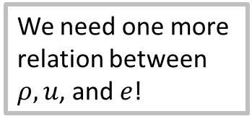
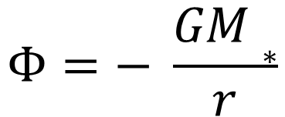
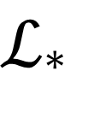
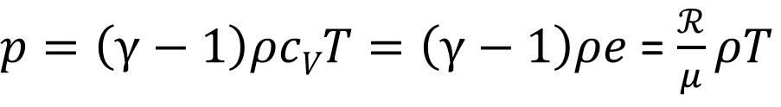
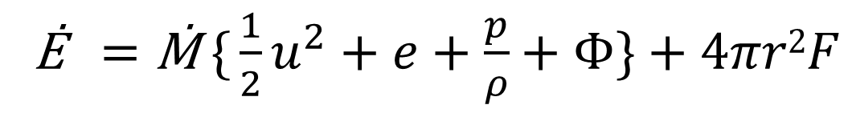
One Equation Short…
$p=\left(γ−1\right)ρcVT=\left(γ−1\right)ρe$ = $\frac{ℛ}{μ}ρT$
Ṁ$=4πr2ρu$
Ė$=\text{Ṁ} \text{\{}\frac{1}{2}u^{2}+e+\frac{p}{ρ}+Φ\}+4πr2F$
$ℒ$*
$$Φ=− \frac{GM∗}{r}$$
We need one more relation between $ρ, u$, and $e$!

Slide 9

One Equation Short…
$p=\left(γ−1\right)ρcVT=\left(γ−1\right)ρe$ = $\frac{ℛ}{μ}ρT$
Ṁ$=4πr2ρu$
Ė$=\text{Ṁ} \text{\{}\frac{1}{2}u^{2}+e+\frac{p}{ρ}+Φ\}+4πr2F$
$ℒ$*
$$Φ=− \frac{GM∗}{r}$$
We need one more relation between $ρ, u$, and $e$!
$u·∇u=−\frac{1}{ρ}∇p$ $− ∇Φ$ + $\frac{1}{ρ}$ f

Slide 10

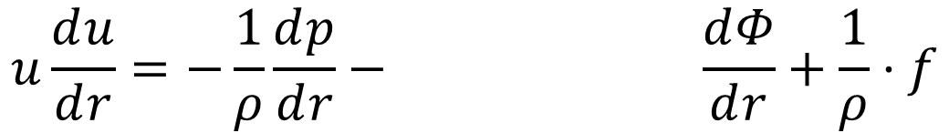
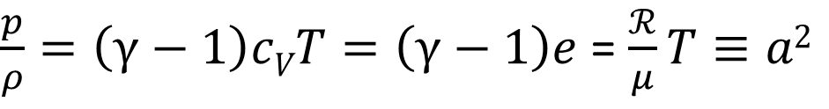
The Bondi/Parker Equation-I
$u·∇u=−\frac{1}{ρ}∇p$ $− ∇Φ$ + $\frac{1}{ρ}$ f
$$u\frac{ⅆu}{ⅆr}=−\frac{1}{ρ}\frac{ⅆp}{ⅆr}− \frac{ⅆΦ}{ⅆr}+\frac{1}{ρ}⋅f$$
Radiative Terms Enter Here!
$\frac{p}{ρ}=\left(γ−1\right)cVT=\left(γ−1\right)e$ = $\frac{ℛ}{μ}T≡a2$

Slide 11
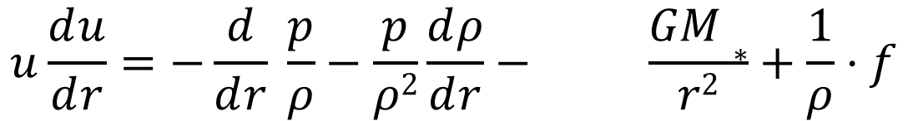
The Bondi/Parker Equation-II
$u·∇u=−\frac{1}{ρ}∇p$ $− ∇Φ$ + $\frac{1}{ρ}$ f
$$u\frac{ⅆu}{ⅆr}=−\frac{1}{ρ}\frac{ⅆp}{ⅆr}− \frac{ⅆΦ}{ⅆr}+\frac{1}{ρ}⋅f$$
Radiative Terms Enter Here!
$$u\frac{ⅆu}{ⅆr}=−\frac{ⅆ}{ⅆr} \frac{p}{ρ}−\frac{p}{ρ2}\frac{ⅆρ}{ⅆr}− \frac{GM∗}{r2}+\frac{1}{ρ}⋅f$$
$\frac{p}{ρ}=\left(γ−1\right)cVT=\left(γ−1\right)e$ = $\frac{ℛ}{μ}T≡a2$

Slide 12
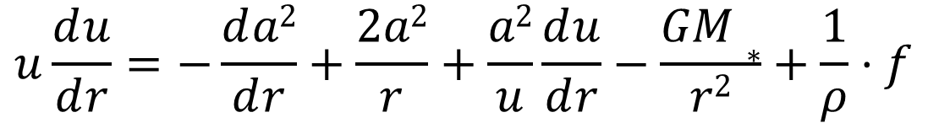
The Bondi/Parker Equation-III
$u·∇u=−\frac{1}{ρ}∇p$ $− ∇Φ$ + $\frac{1}{ρ}$ f
$$u\frac{ⅆu}{ⅆr}=−\frac{1}{ρ}\frac{ⅆp}{ⅆr}− \frac{ⅆΦ}{ⅆr}+\frac{1}{ρ}⋅f$$
Radiative Terms Enter Here!
$$u\frac{ⅆu}{ⅆr}=−\frac{ⅆ}{ⅆr} \frac{p}{ρ}−\frac{p}{ρ2}\frac{ⅆρ}{ⅆr}− \frac{GM∗}{r2}+\frac{1}{ρ}⋅f$$
$$u\frac{ⅆu}{ⅆr}=−\frac{ⅆa2}{ⅆr}+\frac{2a2}{r}+\frac{a2}{u}\frac{ⅆu}{ⅆr}−\frac{GM∗}{r2}+\frac{1}{ρ}⋅f$$
$\frac{p}{ρ}=\left(γ−1\right)cVT=\left(γ−1\right)e$ = $\frac{ℛ}{μ}T≡a2$

Slide 13
The Bondi/Parker Equation-IV
$u·∇u=−\frac{1}{ρ}∇p$ $− ∇Φ$ + $\frac{1}{ρ}$ f
$$u\frac{ⅆu}{ⅆr}=−\frac{1}{ρ}\frac{ⅆp}{ⅆr}− \frac{ⅆΦ}{ⅆr}+\frac{1}{ρ}⋅f$$
Radiative Terms Enter Here!
$$u\frac{ⅆu}{ⅆr}=−\frac{ⅆ}{ⅆr} \frac{p}{ρ}−\frac{p}{ρ2}\frac{ⅆρ}{ⅆr}− \frac{GM∗}{r2}+\frac{1}{ρ}⋅f$$
$$u\frac{ⅆu}{ⅆr}=−\frac{ⅆa2}{ⅆr}+\frac{2a2}{r}+\frac{a2}{u}\frac{ⅆu}{ⅆr}−\frac{GM∗}{r2}+\frac{1}{ρ}⋅f$$
Someone needs to tell us how to determine the isothermal sound speed!
$\frac{p}{ρ}=\left(γ−1\right)cVT=\left(γ−1\right)e$ = $\frac{ℛ}{μ}T≡a2$

Slide 14

The Bondi/Parker Equation-V
$u·∇u=−\frac{1}{ρ}∇p$ $− ∇Φ$ + $\frac{1}{ρ}$ f
$$u\frac{ⅆu}{ⅆr}=−\frac{1}{ρ}\frac{ⅆp}{ⅆr}− \frac{ⅆΦ}{ⅆr}+\frac{1}{ρ}⋅f$$
Radiative Terms Enter Here!
$$u\frac{ⅆu}{ⅆr}=−\frac{ⅆ}{ⅆr} \frac{p}{ρ}−\frac{p}{ρ2}\frac{ⅆρ}{ⅆr}− \frac{GM∗}{r2}+\frac{1}{ρ}⋅f$$
$$u\frac{ⅆu}{ⅆr}=−\frac{ⅆa2}{ⅆr}+\frac{2a2}{r}+\frac{a2}{u}\frac{ⅆu}{ⅆr}−\frac{GM∗}{r2}+\frac{1}{ρ}⋅f$$
We know how to determine the isothermal sound speed!
$\frac{p}{ρ}=\left(γ−1\right)cVT=\left(γ−1\right)e$ = $\frac{ℛ}{μ}T≡a2$
$$u·∇e+·\frac{p}{ρ}∇·u=T\dot{s}$$

Slide 15
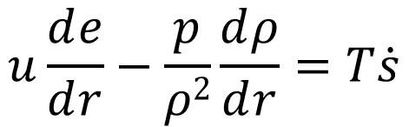

The Internal Energy Equation-I
$$u·∇e+·\frac{p}{ρ}∇·u=T\dot{s}$$
$$u\frac{ⅆe}{ⅆr}−\frac{p}{ρ2}\frac{ⅆρ}{ⅆr}=T\dot{s}$$
Radiative Terms Enter Here!

Slide 16
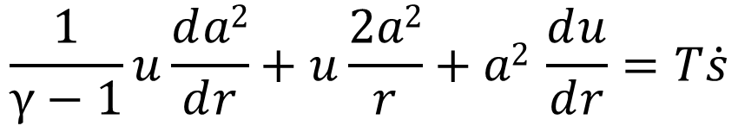
The Internal Energy Equation-II
$$u·∇e+·\frac{p}{ρ}∇·u=T\dot{s}$$
$$u\frac{ⅆe}{ⅆr}−\frac{p}{ρ2}\frac{ⅆρ}{ⅆr}=T\dot{s}$$
$$\frac{1}{γ−1}u\frac{ⅆa2}{ⅆr}+u\frac{2a2}{r}+a2 \frac{ⅆu}{ⅆr}=T\dot{s}$$
Radiative Terms Enter Here!
$\frac{p}{ρ}=\left(γ−1\right)cVT=\left(γ−1\right)e$ = $\frac{ℛ}{μ}T≡a2$

Slide 17
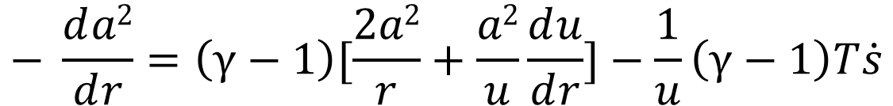
The Internal Energy Equation-III
$$u·∇e+·\frac{p}{ρ}∇·u=T\dot{s}$$
$$u\frac{ⅆe}{ⅆr}−\frac{p}{ρ2}\frac{ⅆρ}{ⅆr}=T\dot{s}$$
$$\frac{1}{γ−1}u\frac{ⅆa2}{ⅆr}+u\frac{2a2}{r}+a2 \frac{ⅆu}{ⅆr}=T\dot{s}$$
Radiative Terms Enter Here!
$$− \frac{ⅆa2}{ⅆr}=\left(γ−1\right)[\frac{2a2}{r}+\frac{a2}{u}\frac{ⅆu}{ⅆr}]−\frac{1}{u}\left(γ−1\right)T\dot{s}$$

Slide 18
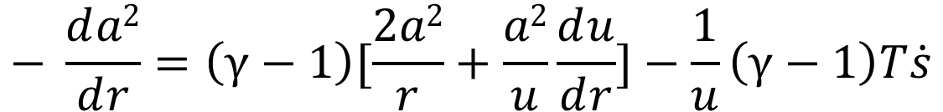
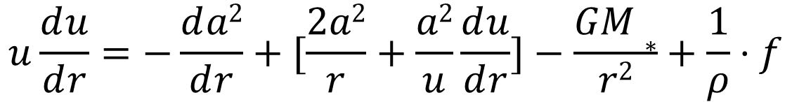
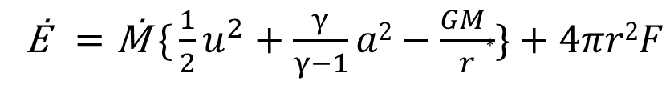
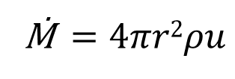
The Bondi/Parker Equation(s)
Kinetic
Thermal
Gravitational
Radiation
Ė$=\text{Ṁ} \text{\{}\frac{1}{2}u^{2}+\frac{γ}{γ−1}a2−\frac{GM∗}{r}\}+4πr2F$
Ṁ$=4πr2ρu$
I.
$$u\frac{ⅆu}{ⅆr}=−\frac{ⅆa2}{ⅆr}+[\frac{2a2}{r}+\frac{a2}{u}\frac{ⅆu}{ⅆr}]−\frac{GM∗}{r2}+\frac{1}{ρ}⋅f$$
Radiative Terms Enter Here!
II.
$$− \frac{ⅆa2}{ⅆr}=\left(γ−1\right)[\frac{2a2}{r}+\frac{a2}{u}\frac{ⅆu}{ⅆr}]−\frac{1}{u}\left(γ−1\right)T\dot{s}$$
Now all we need are the radiative terms!

Slide 19
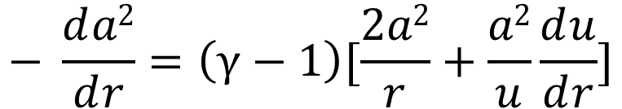
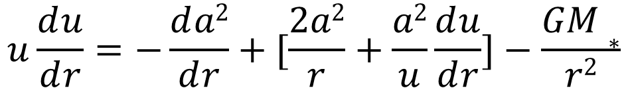
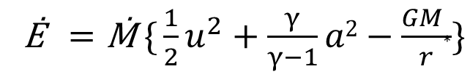
The Bondi/Parker Equation(s)
Kinetic
Thermal
Gravitational
Ė$=\text{Ṁ} \text{\{}\frac{1}{2}u^{2}+\frac{γ}{γ−1}a2−\frac{GM∗}{r}\}$
Ṁ$=4πr2ρu$
I.
$$u\frac{ⅆu}{ⅆr}=−\frac{ⅆa2}{ⅆr}+[\frac{2a2}{r}+\frac{a2}{u}\frac{ⅆu}{ⅆr}]−\frac{GM∗}{r2}$$
II.
$$− \frac{ⅆa2}{ⅆr}=\left(γ−1\right)[\frac{2a2}{r}+\frac{a2}{u}\frac{ⅆu}{ⅆr}]$$
…but first let’s do it without radiation…

Slide 20
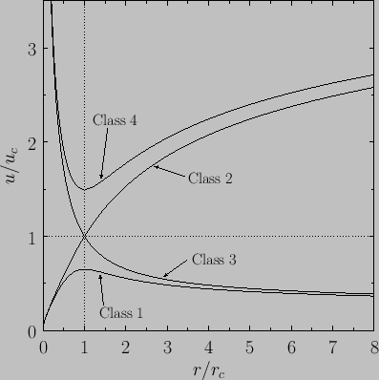

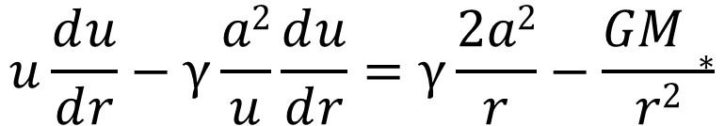
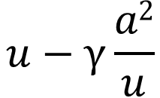
The Bondi/Parker Equation-No Radiation
Woops, what happens if γ=1?!
Kinetic
Thermal
Gravitational
Now evaluate the energy and the mass flux at the critical point where r=r_{c} and u=u_{c}. If you can also determine a(r_{c}) and ρ(r_{c}) by some means---voilà!!
Ė$=\text{Ṁ} \text{\{}\frac{1}{2}u^{2}+\frac{γ}{γ−1}a2−\frac{GM∗}{r}\}$
Ṁ$=4πr2ρu$
Pressure Wins
I.
$$u\frac{ⅆu}{ⅆr}−γ\frac{a2}{u}\frac{ⅆu}{ⅆr}=γ\frac{2a2}{r}−\frac{GM∗}{r2}$$
Parker
Supersonic
$$u−γ\frac{a2}{u}$$
$$\frac{ⅆu}{ⅆr}$$
Bondi
Subsonic
Gravity Wins

Slide 21
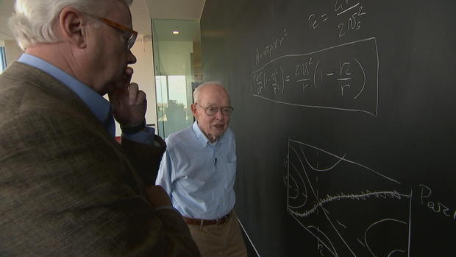

Slide 22
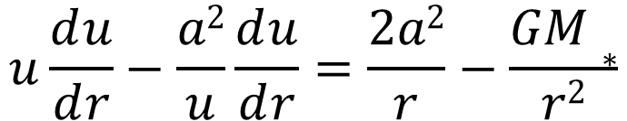
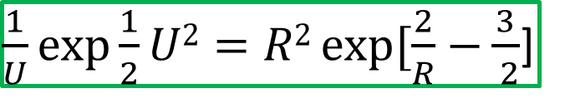
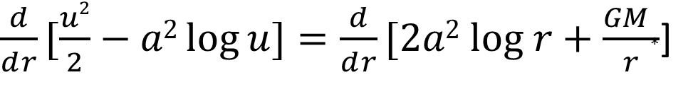
Isothermal Wind & Accretion
Now just some constant!
Ė$=\text{Ṁ} \text{\{}\frac{1}{2}u^{2}+\frac{γ}{γ−1}a2−\frac{GM∗}{r}\}$
Ṁ$=4πr2ρu$
Pressure Wins
$$u\frac{ⅆu}{ⅆr}−\frac{a2}{u}\frac{ⅆu}{ⅆr}=\frac{2a2}{r}−\frac{GM∗}{r2}$$
U
Supersonic
Parker
$\frac{ⅆ}{ⅆr}[\frac{u2}{2}−a2\log{u]}=\frac{ⅆ}{ⅆr}[2a2 log r+\frac{GM∗}{r}$]
Bondi
$\frac{1}{U}exp\frac{1}{2}U2=R2\exp{[\frac{2}{R}−}\frac{3}{ 2}$]
Subsonic
Gravity Wins
R

Slide 23
The Bondi/Parker Equation(s)
Kinetic
Thermal
Gravitational
Radiation
Ė$=\text{Ṁ} \text{\{}\frac{1}{2}u^{2}+\frac{γ}{γ−1}a2−\frac{GM∗}{r}\}+4πr2F$
Ṁ$=4πr2ρu$
I.
$$u\frac{ⅆu}{ⅆr}=−\frac{ⅆa2}{ⅆr}+[\frac{2a2}{r}+\frac{a2}{u}\frac{ⅆu}{ⅆr}]−\frac{GM∗}{r2}+\frac{1}{ρ}⋅f$$
Radiative Terms Enter Here!
II.
$$− \frac{ⅆa2}{ⅆr}=\left(γ−1\right)[\frac{2a2}{r}+\frac{a2}{u}\frac{ⅆu}{ⅆr}]−\frac{1}{u}\left(γ−1\right)T\dot{s}$$

Slide 24
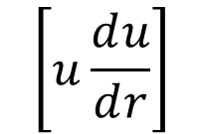
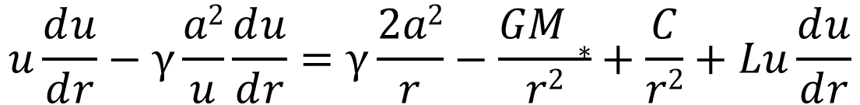
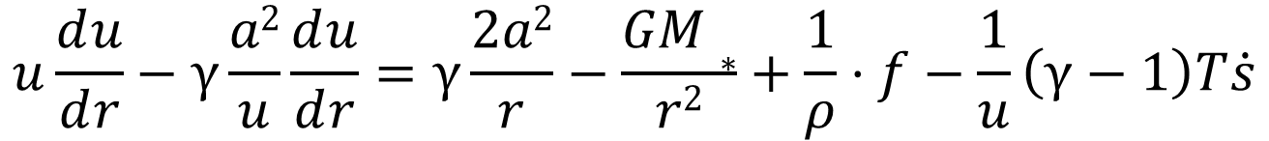
Radiatively Driven Winds-Phenomenology
Kinetic
Thermal
Gravitational
Radiation
Ė$=\text{Ṁ} \text{\{}\frac{1}{2}u^{2}+\frac{γ}{γ−1}a2−\frac{GM∗}{r}\}+4πr2F$
Ṁ$=4πr2ρu$
I.
$$u\frac{ⅆu}{ⅆr}−γ\frac{a2}{u}\frac{ⅆu}{ⅆr}=γ\frac{2a2}{r}−\frac{GM∗}{r2}+\frac{1}{ρ}⋅f−\frac{1}{u}\left(γ−1\right)T\dot{s}$$
𝛼
$$\left[u\frac{ⅆu}{ⅆr}\right]$$
CAK Theory of Stellar Winds
$$u\frac{ⅆu}{ⅆr}−γ\frac{a2}{u}\frac{ⅆu}{ⅆr}=γ\frac{2a2}{r}−\frac{GM∗}{r2}+\frac{C}{r2}+Lu\frac{ⅆu}{ⅆr}$$
Continuum Scattering
Resonance Line Absorption

Slide 25
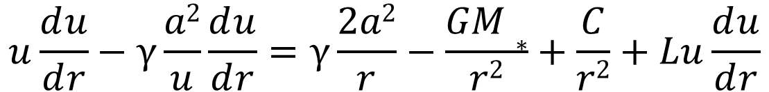
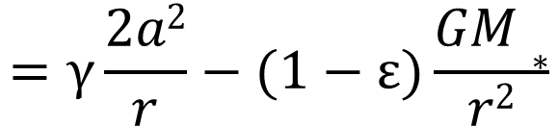

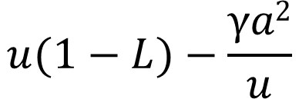
Radiatively Driven Winds-Phenomenology
As this approaches unity we reach the “Eddington Limit” for accretion.
Pressure Wins
I.
$$u\frac{ⅆu}{ⅆr}−γ\frac{a2}{u}\frac{ⅆu}{ⅆr}=γ\frac{2a2}{r}−\frac{GM∗}{r2}+\frac{C}{r2}+Lu\frac{ⅆu}{ⅆr}$$
Parker
Supersonic
$$u(1−L)−\frac{γa2}{u}$$
$$\frac{ⅆu}{ⅆr}$$
$$=γ\frac{2a2}{r}−(1−ε)\frac{GM∗}{r2}$$
Bondi
Line Absorption increases the critical speed.
Continuum Scattering reduces the critical radius.
Subsonic
Gravity Wins

Slide 26


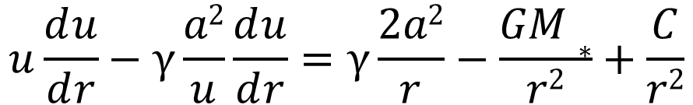
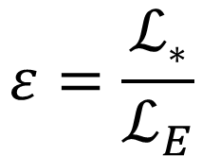
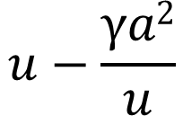
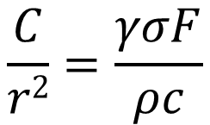
Flows with Thomson Scattering
…but what about the energy density in the radiation field?
$$σ=\frac{σTρ}{m}$$
$$F=\frac{ℒ\text{∗} }{4πr^{2}}$$
$$ε=\frac{ℒ\text{∗}}{ℒ_{E}}$$
$$\frac{C}{r2}=\frac{γσF}{ρc}$$
Pressure Wins
I.
$$u\frac{ⅆu}{ⅆr}−γ\frac{a2}{u}\frac{ⅆu}{ⅆr}=γ\frac{2a2}{r}−\frac{GM∗}{r2}+\frac{C}{r2}$$
Parker
Supersonic
$$u−\frac{γa2}{u}$$
$$\frac{ⅆu}{ⅆr}$$
$$=γ\frac{2a2}{r}−(1−ε)\frac{GM∗}{r2}$$
Bondi
Continuum Scattering reduces the critical radius.
Subsonic
Gravity Wins

Slide 27
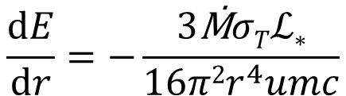
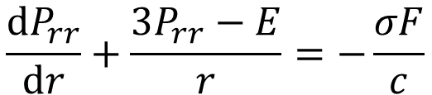






Thomson Scattering-The Rest of the Story
$∇·ℙ=−\frac{σ}{c} F$+ $···$
$\frac{1}{U}exp\frac{1}{2}U2=R2\exp{[\frac{2}{R}−}\frac{3}{ 2}$]
$$σ=\frac{σTρ}{m}$$
$$\frac{ⅆP_{rr}}{ⅆr}+\frac{3P_{rr}−E}{r}=−\frac{σF}{c}$$
$$F=\frac{ℒ\text{∗} }{4πr^{2}}$$
The Eddington Approximation
${E=P}_{rr}$+$P_{θθ}$+$P_{φφ }$ $=$ $3P_{rr}$
U
Parker U²≈4 log R E≈ R⁻³ /(log R)^{1/2}
$$\frac{ⅆE}{ⅆr}=−\frac{3ρσTℒ\text{∗}}{4πr^{2}mc}$$
For the Bondi Accretion Flow F/E = cH/J tends to zero as r goes to infinity.
For the Parker Wind F/E = cH/J tends to infinity as r goes to infinity…but cH/J cannot exceed c !!!! Now what???
Bondi U≈R⁻² E≈ R⁻¹
$$\frac{ⅆE}{ⅆr}=−\frac{3\text{Ṁ}σTℒ\text{∗}}{16π2r^{4}umc}$$
R

Slide 28







Radiatively Driven Winds-CAK Theory
P Cygni
$$u\frac{ⅆu}{ⅆr}−γ\frac{a2}{u}\frac{ⅆu}{ⅆr}−L[u\frac{ⅆu}{ⅆr}]α=γ\frac{2a2}{r}−\frac{GM∗}{r2}$$
$$α≈0.4$$
CAK Critical Point
Line Center
Parker Isothermal Wind Critical Point
$ν′$ = Γ_{u} $ν (1−\frac{1}{c}$ n$·u$ )

Slide 29
ACT III
Scene 2
Astrophysical Radiation Magnetohydrodynamics
Being an Opera in Three Acts
I will not lend thee a quadrature!
Why then the universe is my oyster---
Which I with computer shall open,
I will retort the knowledge in equipage.

Slide 30
Magnetoconvection
Gravitational Field
Entropy Production
Adiabatic (Reversible)
“It is nice to know that the computer understands the problem, but I would like to understand it too.”
--Eugene Wigner
Internal Energy
Kinetic Energy
Matter
Turbulence
“The first principle is that you must not fool yourself---and you are the easiest person to fool.”
--Richard Feynman
Electro-Magnetic Field
Radiation Field
“Das ist nicht nur nicht richtig; es ist nicht einmal falsch!”
--Wolfgang Pauli

Slide 31

Meet MURaM
Specs:
4 Mm x 6 Mm x 6 Mm x 30 min
15.7 km / pixel
F_{ǁ} = 6.3 x 10¹⁰ erg/cm²/sec
g_{ǁ} = 2.74 x 10⁴ cm/sec²
<B_{ǁ}> = 0
Chemical Composition:

Slide 32


Constant Temperature Gradient
Optically Thin
Optically Thin
Horizontal and Temporal Average
Optically Thick
Constant Temperature
How the Radiation “sees” MuRAM
How the MHD “sees” MuRAM

Slide 33


The Radiation Field
↗Ꝏ
↗Ꝏ
$\frac{∂E}{∂t}+∇·F =κ [4σRT4 −cE$]$+κ\frac{1}{c}$ $u·$F + $···$
$\frac{1}{c2}⋅\frac{∂F}{∂t}+∇·ℙ =−\frac{κ}{c}[ F −u\{\frac{4σR}{c}T4+ℙ\}]$+ $···$
↗Ꝏ
$$ℙ≈\frac{1}{3}E 𝕀$$

Slide 34






The Radiation Field: Radiation Diffusion
$$\frac{1}{c}⋅\frac{∂I_{ν}}{∂t}+n·∇I_{ν}=η_{ν}−χ_{ν}I_{ν}$$
Gray Atmosphere Approximation
$$ℙ≈\frac{1}{3}E 𝕀$$
constant
$$∇·ℙ≈−\frac{κ}{c}F$$
$F$ = $−\frac{4σRT3}{3κ}∇T$
$$≈$$
constant
$$4σRT4≈cE$$
$<F>$ = $<−\frac{4σRT3}{3κ}∇T>$

Slide 35


[<T⁴>]^{¼}
$<F>$ = $<−\frac{4σRT3}{3κ}∇T>$
Optically Thin
Horizontal and Temporal Average
[<T²>]^{½}
<T>
Optically Thick

Slide 36

[<T⁴>]^{¼}
$<F>$ = < $−\frac{4σRT3}{3κ}>∇<T>$
Optically Thin
Horizontal and Temporal Average
[<T²>]^{½}
<T>
Optically Thick

Slide 37
[<T⁴>]^{¼}
$<F>$ = $<−\frac{4σRT3}{3κ}∇T>$
Optically Thin
Horizontal and Temporal Average
[<T²>]^{½}
<T>
Optically Thick

Slide 38


The Radiation Field: “A Chromosphere”
Optically Thin
Optically Thick
How MURaM describes the Chromosphere!
How plane-parallel hydrostatic acolytes “describe” the Chromosphere…

Slide 39




The Material: Mass Flux
$$\frac{∂}{∂t}ρ+∇·ρu=0$$
$$\frac{∂}{∂t}<ρ>+∇·<ρu>=0$$
$$\frac{∂}{∂x\text{ǁ}}<ρu\text{ǁ}>=0$$
$<ρu\text{ǁ}>=F$_{ǁ}

Slide 40






|<ρ><u$⊥$>|
ρ(x,t) = <ρ>(x_{ǁ}) + ρ’(x,t) u(x,t) = <u>(x_{ǁ}) + u’(x,t)
|<ρu$⊥$>|
Optically Thick
$$\frac{∂}{∂t}ρ+∇·ρu=0$$
<ρ><u$ǁ$> = -< ρ’u’$ǁ> + <ρ\text{u}ǁ>$
Optically Thin
<ρu$ǁ$>

Slide 41

The Material: Mean Stratification
<ρ>

Slide 42



The Material: Mean Flows
<u$ǁ$>
|<u$⊥$>|

Slide 43

The Material: Turbulence
[<|u|²>]^{½}
|<u>|

Slide 44

The Material: Anisotropic Turbulence
ǁ
ꓕ
Isotropic
ꓕ
ǁ

Slide 45






The Magnetic Field
c$∇ ⤫E=−\frac{∂B}{∂t}$
$$∇·B=0$$
c$∇ ⤫B=4πJ$
$$∇·<B>=0$$
$$\frac{∂}{∂x\text{ǁ}}<B\text{ǁ}>=0$$
$Area·<B\text{ǁ}>=Φ$_{ǁ}

Slide 46





<|B|²/8πp>
High Beta
Low Beta
Optically Thin
$0=Φ$_{ǁ}
Optically Thick
<|B|²>^{½}
<B$ǁ$> ≈ 0
|<B$⊥$>|

Slide 47

The Magnetic Field: Local Dynamo
ǁ
ǁ
ꓕ
ꓕ
Isotropic

Slide 48
CURTAIN
CALL
Astrophysical Radiation Magnetohydrodynamics
Being an Opera in Three Acts

Slide 49





Momentum Conservation
Microphysics is required to relate these quantities back to things we know…
$\frac{∂}{∂t}ρu+∇·(p+ρuu)=−ρ ∇Φ$ + f
Newtonian gravity can not store any momentum…
$$∇·𝔾={ρ∇Φ}_{ }$$
$\frac{1}{c2}⋅\frac{∂S}{∂t}+∇·𝕄={−ρ}_{e }E−\frac{1}{c}$ $J⤫B$
$$\frac{1}{c2}⋅\frac{∂F}{∂t}+∇·ℙ=\frac{1}{c}\int_{0}^{∞}{dν}\int{dn n[}η_{ν}−χ_{ν}I_{ν}]$$
$$\frac{∂𝕻}{∂t}+∇⋅ℿ=0$$
Macrophysics is about conserving what needs to be conserved…

Slide 50





Energy Conservation
Microphysics is required to relate these quantities back to things we know…
$$\frac{∂}{∂t}\frac{1}{2}ρ{\left\|u\right\|}^{2}+∇·{\frac{1}{2}ρ{\left\|u\right\|}^{2} u=−u·∇p−ρu·∇Φ+u·f }^{}$$
$$\frac{∂}{∂t}ρe+∇·\left(ρe+p\right)u=+u·∇p+ρT\dot{s}$$
Newtonian gravity needs mass to store energy…
$$\frac{∂}{∂t}\frac{1}{2}ρΦ+∇·(ρΦu+G)=ρu·∇Φ$$
$$\frac{∂}{∂t}\frac{1}{8π}{( \left\|E\right\|}^{2}+{\left\|B\right\|}^{2})+∇·\frac{c}{4π}E⤫B=−J·E$$
$$\frac{∂E}{∂t}+∇·F = \int_{0}^{∞}{dν}\int{dn [}η_{ν}−χ_{ν}I_{ν}]$$
Macrophysics is about conserving what needs to be conserved…
$$\frac{∂𝔈}{∂t}+∇⋅𝕱=0$$

Slide 51
The “Golden Rule of RMHD”
“Always evaluate interactions between the matter and the classical fields in the comoving, e.g., rest-frame, of the material!!!”
but…
“Solve your equations in whatever is the most convenient frame of reference for your objectives.”

Slide 52
Corollary to the “Golden Rule of RMHD”
“You better know how to transform coordinates, physical quantities, fields, differential and integral operators (and anything else you can think of) between any two frames of reference, under all conditions.”

Slide 53

A Semi-Final Thought…!
Ouch!
Zut!…now did I use a Galilean Boost instead of a Lorentz Boost?!…I wonder what this will do to the MHD drive…

Slide 54



A Final Thought…!
c Δt
c Δt

Slide 55

The End!

