Slide 1
ACTS I & II
Astrophysical Radiation Magnetohydrodynamics
Being an Opera in Three Acts
Lecture 1: Basic Theory
With Words & Music By
Tom Bogdan
Paul Charbonneau
October 3, 2018

Slide 2
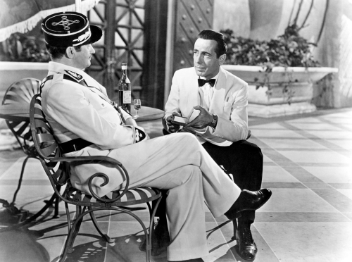

Slide 3
ACT I
Astrophysical Radiation Magnetohydrodynamics
Being an Opera in Three Acts
All the universe is a stage,
And all matter and fields are merely players;
They have their exits and entrances,
And each, in their time, plays several parts.

Slide 4
Macroscopic Viewpoint
Gravitational Field
Internal Energy
Kinetic Energy
Turbulence
Matter
Electro-Magnetic Field
Radiation Field

Slide 5
Impacts & Influence
Gravitational Field
Adiabatic (Reversible)
Internal Energy
Kinetic Energy
Matter
Turbulence
Electro-Magnetic Field
Radiation Field

Slide 6
Adding to Disorder
Gravitational Field
Entropy Production
Internal Energy
Kinetic Energy
Matter
Turbulence
Electro-Magnetic Field
Radiation Field

Slide 7
Full Cost Accounting
Gravitational Field
Entropy Production
Adiabatic (Reversible)
Internal Energy
Kinetic Energy
Matter
Turbulence
Electro-Magnetic Field
Radiation Field

Slide 8
Full Cost Accounting
Kinetic Energy
Matter

Slide 9
Conservation Laws
$$\frac{∂}{∂t}$$
Kinetic Energy Density
$$∇$$
Kinetic Energy Flux
$$+$$
$$=$$
Electro- Magnetic Energy
Internal Energy
Gravitational Energy
Radiation Energy
$$+$$
$$+$$
$$+$$
Kinetic Energy
Kinetic Energy
Kinetic Energy
Kinetic Energy

Slide 10
Full Cost Accounting
Internal Energy
Matter

Slide 11
Conservation Laws
$$\frac{∂}{∂t}$$
$$∇$$
Internal Energy Density
Internal Energy Flux
$$+$$
$$=$$
Electro- Magnetic Energy
Internal Energy
Radiation Energy
−
$$+$$
$$+$$
Kinetic Energy
Internal Energy
Internal Energy
Note the sign flips or the arrow flips!

Slide 12
Conservation Laws
$$\frac{∂}{∂t}$$
$$∇$$
Internal Energy Density
Internal Energy Flux
$$+$$
$$=$$
Electro- Magnetic Energy
Internal Energy
Radiation Energy
$$+$$
$$+$$
$$+$$
Kinetic Energy
Internal Energy
Internal Energy
Note the sign flips or the arrow flips!

Slide 13
The Matter
Note: Thermal conduction and viscous stresses can also be accommodated in these terms if desired.
$$\frac{∂}{∂t}ρ+∇·ρu=0$$
$\frac{∂}{∂t}u+u·∇u=−\frac{1}{ρ}∇p$ $− ∇Φ$ + $\frac{1}{ρ}$ f
$$\frac{∂}{∂t}e+u·∇e+\frac{p}{ρ}∇·u=T\dot{s}$$
Someone needs to tell us how to determine the gas pressure!

Slide 14
The Matter
Note: Thermal conduction and viscous stresses can also be accommodated in these terms if desired.
$$\frac{∂}{∂t}ρ+∇·ρu=0$$
$\frac{∂}{∂t}u+u·∇u=−\frac{1}{ρ}∇p$ $− ∇Φ$ + $\frac{1}{ρ}$ f
$$\frac{∂}{∂t}e+u·∇e+\frac{p}{ρ}∇·u=T\dot{s}$$
We will determine these two terms!

Slide 15
The Matter
$$\frac{∂}{∂t}ρ+∇·ρu=0$$
Note: Thermal conduction and viscous stresses can also be accommodated in these terms if desired.
$\frac{∂}{∂t}u+u·∇u=−\frac{1}{ρ}∇p$ $− ∇Φ$ + $\frac{1}{ρ}$ f
$$\frac{∂}{∂t}e+u·∇e+·\frac{p}{ρ}∇·u=T\dot{s}$$
$$\frac{∂}{∂t}\frac{1}{2}ρ{\left\|u\right\|}^{2}+∇·{\frac{1}{2}ρ{\left\|u\right\|}^{2} u=−u·∇p−u·ρ∇Φ+u·f }^{}$$
$$\frac{∂}{∂t}ρe+∇·\left(ρe+p\right) u=+u·∇p+ρT\dot{s}$$
$\frac{∂}{∂t}ρu+∇·(p+ρuu)=−ρ ∇Φ$ + f

Slide 16
The Matter
$$\frac{∂}{∂t}ρ+∇·ρu=0$$
Note: Thermal conduction and viscous stresses can also be accommodated in these terms if desired.
$\frac{∂}{∂t}u+u·∇u=−\frac{1}{ρ}∇p$ $− ∇Φ$ + $\frac{1}{ρ}$ f
$$\frac{∂}{∂t}e+u·∇e+·\frac{p}{ρ}∇·u=T\dot{s}$$
$$\frac{∂}{∂t}\frac{1}{2}ρ{\left\|u\right\|}^{2}+∇·{\frac{1}{2}ρ{\left\|u\right\|}^{2} u=−u·∇p−u·ρ∇Φ+u·f }^{}$$
$$\frac{∂}{∂t}ρe+∇·\left(ρe+p\right) u=+u·∇p+ρT\dot{s}$$
It remains to determine these terms through full cost accounting!
Someone needs to tell us how to determine the gas pressure!
$\frac{∂}{∂t}ρu+∇·(p+ρuu)=−ρ ∇Φ$ + f

Slide 17
Full Cost Accounting
Gravitational Field
Kinetic Energy

Slide 18
The Gravitational Field
All Other Energy
Note: All the gravity is provided by the material we are keeping track of via the continuity equation.
Gravitational Energy
$$∇^{2}Φ=4πGρ$$
$$\frac{∂}{∂t}ρ+∇·ρu=0$$

Slide 19
The Gravitational Field
All Other Energy
Note: All the gravity is provided by the material we are keeping track of via the continuity equation.
$$∇^{2}Φ=4πGρ$$
Gravitational Energy
$$\frac{∂}{∂t}ρ+∇·ρu=0$$
Coupling to matter
$$\frac{∂}{∂t}\frac{1}{2}ρΦ+∇·(ρΦu+G)=ρu·∇Φ$$
$$∇·𝔾={ρ∇Φ}_{ }$$

Slide 20
The Gravitational Field
All Other Energy
Note: None of the gravity is provided by the material we are keeping track of via the continuity equation.
$$∇^{2}Φ=4πGρ$$
Gravitational Energy
$$\frac{∂}{∂t}ρ+∇·ρu=0$$
$$\frac{∂}{∂t}\frac{1}{2}ρΦ+∇·(ρΦu+G)=ρu·∇Φ$$
Someone needs to tell us how to determine the gravitational potential!
$$∇·𝔾={ρ∇Φ}_{ }$$

Slide 21
Full Cost Accounting
Internal Energy
Kinetic Energy
Matter
Electro-Magnetic Field

Slide 22
The Electromagnetic Field
All Other Energy
Electro- Magnetic Energy
c$∇ ⤫E=−\frac{∂B}{∂t}$
$$∇·E=4πρ_{e}$$
c$∇ ⤫B=4πJ+\frac{∂E}{∂t}$
$$∇·B=0$$
Someone needs to tell us how to determine the electric current and charge density!
Note: Maxwell’s Equations written in Gaussian-cgs units.

Slide 23
The Electromagnetic Field
All Other Energy
$$∇·E=4πρ_{e}$$
c$∇ ⤫E=−\frac{∂B}{∂t}$
Electro- Magnetic Energy
Note: Maxwell’s Equations written in Gaussian-cgs units.
$$∇·B=0$$
c$∇ ⤫B=4πJ+\frac{∂E}{∂t}$
$$\frac{∂}{∂t}\frac{1}{8π}{( \left\|E\right\|}^{2}+{\left\|B\right\|}^{2})+∇·\frac{c}{4π}E⤫B=−J·E$$
$\frac{1}{c2}⋅\frac{∂S}{∂t}+∇·𝕄={−ρ}_{e }E−\frac{1}{c}$ $J⤫B$
Someone needs to tell us how to determine the electric current and charge density!
Coupling to matter

Slide 24
The Electromagnetic Field
All Other Energy
$$∇·E=4πρ_{e}$$
c$∇ ⤫E=−\frac{∂B}{∂t}$
Electro- Magnetic Energy
Note: Maxwell’s Equations written in Gaussian-cgs units.
$$∇·B=0$$
c$∇ ⤫B=4πJ+\frac{∂E}{∂t}$
MHD scalings:
u³B²/lc²
uB²/l
uB²/l
uB²/l
$$\frac{∂}{∂t}\frac{1}{8π}{( \left\|E\right\|}^{2}+{\left\|B\right\|}^{2})+∇·\frac{c}{4π}E⤫B=−J·E$$
$\frac{1}{c2}⋅\frac{∂S}{∂t}+∇·𝕄={−ρ}_{e }E−\frac{1}{c}$ $J⤫B$
Someone needs to tell us how to determine the electric current and charge density!

Slide 25
Full Cost Accounting
Internal Energy
Kinetic Energy
Matter
Radiation Field

Slide 26
The Radiation Field
All Other Energy
Radiation Energy
$$\frac{1}{c}⋅\frac{∂I_{ν}}{∂t}+n·∇I_{ν}=η_{ν}−χ_{ν}I_{ν}$$
Note: Extension to polarized radiative transfer is possible.
Someone needs to tell us how to determine the emissivity, and opacity!

Slide 27
The Radiation Field
All Other Energy
Note: Extension to polarized radiative transfer is possible.
$$\frac{1}{c}⋅\frac{∂I_{ν}}{∂t}+n·∇I_{ν}=η_{ν}−χ_{ν}I_{ν}$$
Radiation Energy
Coupling to matter
$$\frac{∂E}{∂t}+∇·F = \int_{0}^{∞}{dν}\int{dn [}η_{ν}−χ_{ν}I_{ν}]$$
Someone needs to tell us how to determine the radiation pressure tensor, emissivity, and opacity!
$$\frac{1}{c2}⋅\frac{∂F}{∂t}+∇·ℙ=\frac{1}{c}\int_{0}^{∞}{dν}\int{dn n[}η_{ν}−χ_{ν}I_{ν}]$$

Slide 28
The Radiation Field
All Other Energy
Note: Extension to polarized radiative transfer is possible.
$$\frac{1}{c}⋅\frac{∂I_{ν}}{∂t}+n·∇I_{ν}=η_{ν}−χ_{ν}I_{ν}$$
Radiation Energy
scalings:
u/lc
1/l
?
1/λ
$$\frac{∂E}{∂t}+∇·F = \int_{0}^{∞}{dν}\int{dn [}η_{ν}−χ_{ν}I_{ν}]$$
Someone needs to tell us how to determine the radiation pressure tensor, emissivity, and opacity!
$$\frac{1}{c2}⋅\frac{∂F}{∂t}+∇·ℙ=\frac{1}{c}\int_{0}^{∞}{dν}\int{dn n[}η_{ν}−χ_{ν}I_{ν}]$$

Slide 29
Momentum Conservation

Slide 30
Momentum Conservation
$\frac{∂}{∂t}ρu+∇·(p+ρuu)=−ρ ∇Φ$ + f
$$∇·𝔾={ρ∇Φ}_{ }$$
$\frac{1}{c2}⋅\frac{∂S}{∂t}+∇·𝕄={−ρ}_{e }E−\frac{1}{c}$ $J⤫B$
$$\frac{1}{c2}⋅\frac{∂F}{∂t}+∇·ℙ=\frac{1}{c}\int_{0}^{∞}{dν}\int{dn n[}η_{ν}−χ_{ν}I_{ν}]$$
$$\frac{∂𝕻}{∂t}+∇⋅ℿ=0$$

Slide 31
Momentum Conservation
Now we can determine the force density!
$\frac{∂}{∂t}ρu+∇·(p+ρuu)=−ρ ∇Φ$ + f
$$∇·𝔾={ρ∇Φ}_{ }$$
$\frac{1}{c2}⋅\frac{∂S}{∂t}+∇·𝕄={−ρ}_{e }E−\frac{1}{c}$ $J⤫B$
$$\frac{1}{c2}⋅\frac{∂F}{∂t}+∇·ℙ=\frac{1}{c}\int_{0}^{∞}{dν}\int{dn n[}η_{ν}−χ_{ν}I_{ν}]$$
$$\frac{∂𝕻}{∂t}+∇⋅ℿ=0$$

Slide 32
Energy Conservation

Slide 33
Energy Conservation
$$\frac{∂}{∂t}\frac{1}{2}ρ{\left\|u\right\|}^{2}+∇·{\frac{1}{2}ρ{\left\|u\right\|}^{2} u=−u·∇p−ρu·∇Φ+u·f }^{}$$
$$\frac{∂}{∂t}ρe+∇·\left(ρe+p\right)u=+u·∇p+ρT\dot{s}$$
$$\frac{∂}{∂t}\frac{1}{2}ρΦ+∇·(ρΦu+G)=ρu·∇Φ$$
$$\frac{∂}{∂t}\frac{1}{8π}{( \left\|E\right\|}^{2}+{\left\|B\right\|}^{2})+∇·\frac{c}{4π}E⤫B=−J·E$$
$$\frac{∂E}{∂t}+∇·F = \int_{0}^{∞}{dν}\int{dn [}η_{ν}−χ_{ν}I_{ν}]$$
$$\frac{∂𝔈}{∂t}+∇⋅𝕱=0$$

Slide 34
Energy Conservation
$$\frac{∂}{∂t}\frac{1}{2}ρ{\left\|u\right\|}^{2}+∇·{\frac{1}{2}ρ{\left\|u\right\|}^{2} u=−u·∇p−ρu·∇Φ+u·f }^{}$$
$$\frac{∂}{∂t}ρe+∇·\left(ρe+p\right)u=+u·∇p+ρT\dot{s}$$
Now we can determine the heat addition to the material!
$$\frac{∂}{∂t}\frac{1}{2}ρΦ+∇·(ρΦu+G)=ρu·∇Φ$$
$$\frac{∂}{∂t}\frac{1}{8π}{( \left\|E\right\|}^{2}+{\left\|B\right\|}^{2})+∇·\frac{c}{4π}E⤫B=−J·E$$
$$\frac{∂E}{∂t}+∇·F = \int_{0}^{∞}{dν}\int{dn [}η_{ν}−χ_{ν}I_{ν}]$$
$$\frac{∂𝔈}{∂t}+∇⋅𝕱=0$$

Slide 35
Full Cost Accounting
$$f=ρ_{e }E+\frac{1}{c} J⤫B−\frac{1}{c}\int_{0}^{∞}{dν}\int{dn n[}η_{ν}−χ_{ν}I_{ν}]$$
$$ρT\dot{s} =J·E−u·f−\int_{0}^{∞}{dν}\int{dn [}η_{ν}−χ_{ν}I_{ν}]$$
It remains to determine these terms through the geometry of space-time!
This slide is the essential objective of RMHD---we have now constructed a set of equations that not only conserve total energy and momentum, but also describe how energy and momentum are exchanged between matter and the radiation, gravitational and electromagnetic fields!

Slide 36
The “Golden Rule of RMHD”
“Always evaluate interactions between the matter and the classical fields in the comoving, e.g., rest-frame, of the material!!!”
but…
“Solve your equations in whatever is the most convenient frame of reference for your objectives.”
Can I get an AMEN, people!!!

Slide 37
Corollary to the “Golden Rule of RMHD”
“You better know how to transform coordinates, physical quantities, fields, differential and integral operators (and anything else you can think of) between any two frames of reference, under all conditions.”
Abandon hope, all ye who fail to heed the Corollary!

Slide 38
ACT II
Astrophysical Radiation Magnetohydrodynamics
Being an Opera in Three Acts
Now is the geometry of our discontent,
Made gloriously invariant by this Sun of France;
And all the aether that lowered upon our house,
In the deep bosom of obscurity is buried.

Slide 39
Better Living Through Geometry
V
z’
Event 2
z
t'
Another Observer
t
x'
One Observer
y'
y
Event 1
x
V’

Slide 40
Galileo & Newton
V
z’
Event 2
z
t'
Another Observer
t
x'
One Observer
y'
y
Event 1
x
|t₁ – t₂| = |t’₁ – t’₂|
This is a Galilean Space-Time of 4 dimensions.
V’
‖x₁ – x₂‖ = ‖x’₁ – x’₂‖

Slide 41
Poincaré, Lorentz & Einstein
V
z’
Event 2
z
t'
Another Observer
t
x'
One Observer
y'
y
Event 1
x
This is a Minkowski Space-Time of 4 dimensions.
‖x₁ – x₂‖² – c² |t₁ – t₂|² = ‖x’₁ – x’₂‖² – c² |t’₁ – t’₂|²
V’

Slide 42
Invent Your Own Space-Time
V
z’
Event 2
z
t'
Another Observer
t
x'
One Observer
y'
y
Event 1
x
This is a Some Other Space-Time of 4 dimensions.
V’
……blah blah blah…..

Slide 43
Invariants
Minkowski Space-Time
Galilean Space-Time
‖x₁ – x₂‖² – c² |t₁ – t₂|² = ‖x’₁ – x’₂‖² – c² |t’₁ – t’₂|²
|t₁ – t₂| = |t’₁ – t’₂|
‖x₁ – x₂‖ = ‖x’₁ – x’₂‖
1
Pick a different origin for marking off time.
The Translation Group T(1)
Translations
3
Pick a different origin for marking off space.
The Translation Group T(3)
Translations
Pick a different orientation for your coordinate axes.
The Special Orthogonal Group SO(3)
Proper Rotations
3
Move through the space at a constant rectilinear velocity.
Boosts
3
The Lorentz “Group”
10 Parameters
The Poincaré Group
The Galilean Group

Slide 44
Group Action on 4-Vectors
L
L⁻¹
Lorentz “Group”
$$\left[\begin{matrix}ct′ \\ x′\end{matrix}\right]$$
$$\left[\begin{matrix}ct′′ \\ x′′\end{matrix}\right]$$
$$\left[\begin{matrix}ct′ \\ x′\end{matrix}\right]$$
G
G⁻¹
Galilean Group
$$\left[\begin{matrix}cρe′ \\ J′\end{matrix}\right]$$
Bonus: These 4-vectors live in the tangent space to each point in the space-time, and they transform in the same fashion as the space-time itself!
The electric and magnetic fields are components of a 4-tensor and therefore transform appropriately!
H o w e v e r, the specific intensity, the opacity and the emissivity are entirely different 4-animals…
$$\left[\begin{matrix}ν′ \\ ν^{′}n′\end{matrix}\right]$$

Slide 45
Count Your Lucky Photons
V
A “swarm” of photons
z’
z
t'
Another Observer
t
x'
One Observer
y'
y
x
These observers do not agree about much of anything regarding these photons, but, they do agree that there are five of them.
V’

Slide 46
Lorentz Transformations of the Radiation
$$\frac{I_{ν}}{ν3}=\frac{{I′}_{ν′}}{ν′3}$$
$ν$ = Γ_{u} $ν′ (1+\frac{1}{c}$ n$′·$u )
$ν′$ = Γ_{u} $ν (1−\frac{1}{c}$ n$·$u )
$$\frac{χ_{ν}}{ν′}=\frac{{χ′}_{ν′}}{ν}$$
These equations expresses the Doppler Shift of photons. The corresponding equations for n and n’ (aberration) are more complicated, but, fortunately, we don’t need them here.
$$\frac{η_{ν}}{ν2}=\frac{η′_{ν′}}{ν^{′}2}$$
This part is tricky. However, the radiation energy density, energy flux and pressure tensor are components of a 4-tensor.

Slide 47
Gray Approximation in the Comoving Frame
$ν$ = Γ_{u} $ν′ (1+\frac{1}{c}$ n$′·$u )
$ν′$ = Γ_{u} $ν (1−\frac{1}{c}$ n$·$u )
$$\frac{χ_{ν}}{ν′}=\frac{κ}{ν}$$
A constant, frequency-independent opacity, and the isotropic Planck Function (but frequency dependent) constitutes the “gray atmosphere” approximation in the comoving frame.
$$\frac{η_{ν}}{ν2}=\frac{κB_{ν′}}{ν^{′}2}$$
Notice that in the laboratory frame the emissivity and the opacity are not isotropic because of the Doppler-shifted frequency!

Slide 48
Gray Approximation in the Laboratory Frame
$η_{ν}$ = $κ$ [$(1+\frac{3}{c}$ n$·$u ) $B_{ν}$ $−\frac{1}{c}$ n$·$u $\frac{∂}{ ∂ν}$ $νB_{ν}]\text{+}···$
$χ_{ν}$ = $κ (1−\frac{1}{c}$ n$·$u ) + $···$
We can now carry out the two integrals we need to describe the exchange of energy and momentum between the material and the radiation field in the laboratory frame.
This part is subtle. We want the Planck Function evaluated at the laboratory frequency not the comoving frame frequency.
$$\frac{∂E}{∂t}+∇·F = \int_{0}^{∞}{dν}\int{dn [}η_{ν}−χ_{ν}I_{ν}]$$

Slide 49
Gray Approximation in the Laboratory Frame
$η_{ν}$ = $κ$ [$(1+\frac{3}{c}$ n$·$u ) $B_{ν}$ $−\frac{1}{c}$ n$·$u $\frac{∂}{ ∂ν}$ $νB_{ν}]\text{+}···$
$χ_{ν}$ = $κ (1−\frac{1}{c}$ n$·$u ) + $···$
We can now carry out the two integrals we need to describe the exchange of energy and momentum between the material and the radiation field in the laboratory frame.
Higher-order terms in the ratio
of u/c live here.
$\frac{∂E}{∂t}+∇·F =κ [4σRT4 −cE$]$+κ\frac{1}{c}$ $u·$F + $···$

Slide 50
Gray Approximation in the Laboratory Frame
$η_{ν}$ = $κ$ [$(1+\frac{3}{c}$ n$·$u ) $B_{ν}$ $−\frac{1}{c}$ n$·$u $\frac{∂}{ ∂ν}$ $νB_{ν}]\text{+}···$
$χ_{ν}$ = $κ (1−\frac{1}{c}$ n$·$u ) + $···$
We can now carry out the two integrals we need to describe the exchange of energy and momentum between the material and the radiation field in the laboratory frame.
$$\frac{1}{c2}⋅\frac{∂F}{∂t}+∇·ℙ=\frac{1}{c}\int_{0}^{∞}{dν}\int{dn n[}η_{ν}−χ_{ν}I_{ν}]$$

Slide 51
Gray Approximation in the Laboratory Frame
$η_{ν}$ = $κ$ [$(1+\frac{3}{c}$ n$·$u ) $B_{ν}$ $−\frac{1}{c}$ n$·$u $\frac{∂}{ ∂ν}$ $νB_{ν}]\text{+}···$
$χ_{ν}$ = $κ (1−\frac{1}{c}$ n$·$u ) + $···$
We can now carry out the two integrals we need to describe the exchange of energy and momentum between the material and the radiation field in the laboratory frame.
Higher-order terms in the ratio
of u/c live here.
$\frac{1}{c2}⋅\frac{∂F}{∂t}+∇·ℙ=−\frac{κ}{c}[ F −u\{\frac{4σR}{c}T4+ℙ\}]$+ $···$

Slide 52
Full Cost Accounting
$$f=ρ_{e }E+\frac{1}{c} J⤫B−\frac{1}{c}\int_{0}^{∞}{dν}\int{dn n[}η_{ν}−χ_{ν}I_{ν}]$$
$$ρT\dot{s} =J·E−u·f−\int_{0}^{∞}{dν}\int{dn [}η_{ν}−χ_{ν}I_{ν}]$$
It remains to determine these terms through the geometry of space-time!
This slide is the essential objective of RMHD---we have now constructed a set of equations that not only conserve total energy and momentum, but also describe how energy and momentum are exchanged between matter and the radiation, gravitational and electromagnetic fields!

Slide 53
Full Cost Accounting (Gray Atmosphere)
Higher-order terms in the ratio
of u/c live here.
$$f=ρ_{e }E+\frac{1}{c} J⤫B$$
$+\frac{κ}{c}[ F −u\{\frac{4σR}{c}T4+ℙ\}]$+ $···$
$κ [4σRT4 −cE$]$+κ\frac{1}{c}$ $u·$F + $···$
$$ρT\dot{s} =J·E−u·f−$$
This slide is the essential objective of RMHD---we have now constructed a set of equations that not only conserve total energy and momentum, but also describe how energy and momentum are exchanged between matter and the radiation, gravitational and electromagnetic fields!

Slide 54
Full Cost Accounting (Gray Atmosphere)
Higher-order terms in the ratio
of u/c live here.
$$f=ρ_{e }E+\frac{1}{c} J⤫B$$
$+\frac{κ}{c}[ F −u\{\frac{4σR}{c}T4+ℙ\}]$+ $···$
$κ [4σRT4 −cE$]$+κ\frac{1}{c}$ $u·$F + $···$
$$ρT\dot{s} =J·E−u·f−$$
This slide is the essential objective of RMHD---we have now constructed a set of equations that not only conserve total energy and momentum, but also describe how energy and momentum are exchanged between matter and the radiation, gravitational and electromagnetic fields!

Slide 55
Thomson Scattering in the Comoving Frame
$$\frac{I_{ν}}{ν3}=\frac{{I′}_{ν′}}{ν′3}$$
$ν$ = Γ_{u} $ν′ (1+\frac{1}{c}$ n$′·$u )
$ν′$ = Γ_{u} $ν (1−\frac{1}{c}$ n$·$u )
$$\frac{χ_{ν}}{ν′}=\frac{σ}{ν}$$
A constant, frequency-independent opacity, and the mean intensity (but frequency dependent) as source function constitutes the limit of pure Thomson Scattering off electrons in the comoving frame.
$$\frac{η_{ν}}{ν2}=\frac{σ{J′}_{ν′}}{ν^{′}2}$$
Notice that in the laboratory frame the emissivity and the opacity are not isotropic because of the Doppler shifted frequency!

Slide 56
Thomson Scattering in the Comoving Frame
$$\frac{I_{ν}}{ν3}=\frac{{I′}_{ν′}}{ν′3}$$
$ν$ = Γ_{u} $ν′ (1+\frac{1}{c}$ n$′·$u )
$ν′$ = Γ_{u} $ν (1−\frac{1}{c}$ n$·$u )
$$\frac{χ_{ν}}{ν′}=\frac{σ}{ν}$$
Your HOMEWORK Assignment!
$$\frac{η_{ν}}{ν2}=\frac{σ{J′}_{ν′}}{ν^{′}2}$$
$$\frac{∂E}{∂t}+∇·F = \int_{0}^{∞}{dν}\int{dn [}η_{ν}−χ_{ν}I_{ν}]$$
$$\frac{1}{c2}⋅\frac{∂F}{∂t}+∇·ℙ=\frac{1}{c}\int_{0}^{∞}{dν}\int{dn n[}η_{ν}−χ_{ν}I_{ν}]$$

Slide 57
Summary
Gravitational Field
Entropy Production
Adiabatic (Reversible)
We worked really hard to get these two arrows correct to order u/c ---it is actually quite easy to get them wrong, as well as everything else that follows…
Internal Energy
Kinetic Energy
Turbulence
Matter
Electro-Magnetic Field
Radiation Field

Slide 58
Next Lecture
Gravitational Field
Entropy Production
Adiabatic (Reversible)
Some Astrophysical Applications of RMHD
Internal Energy
Kinetic Energy
Matter
Turbulence
Electro-Magnetic Field
Radiation Field

Slide 59
A Semi-Final Thought…!
Merde!…I sure hope I computed those radiation terms in the comoving frame of the fluid…
Ouch!

Slide 60
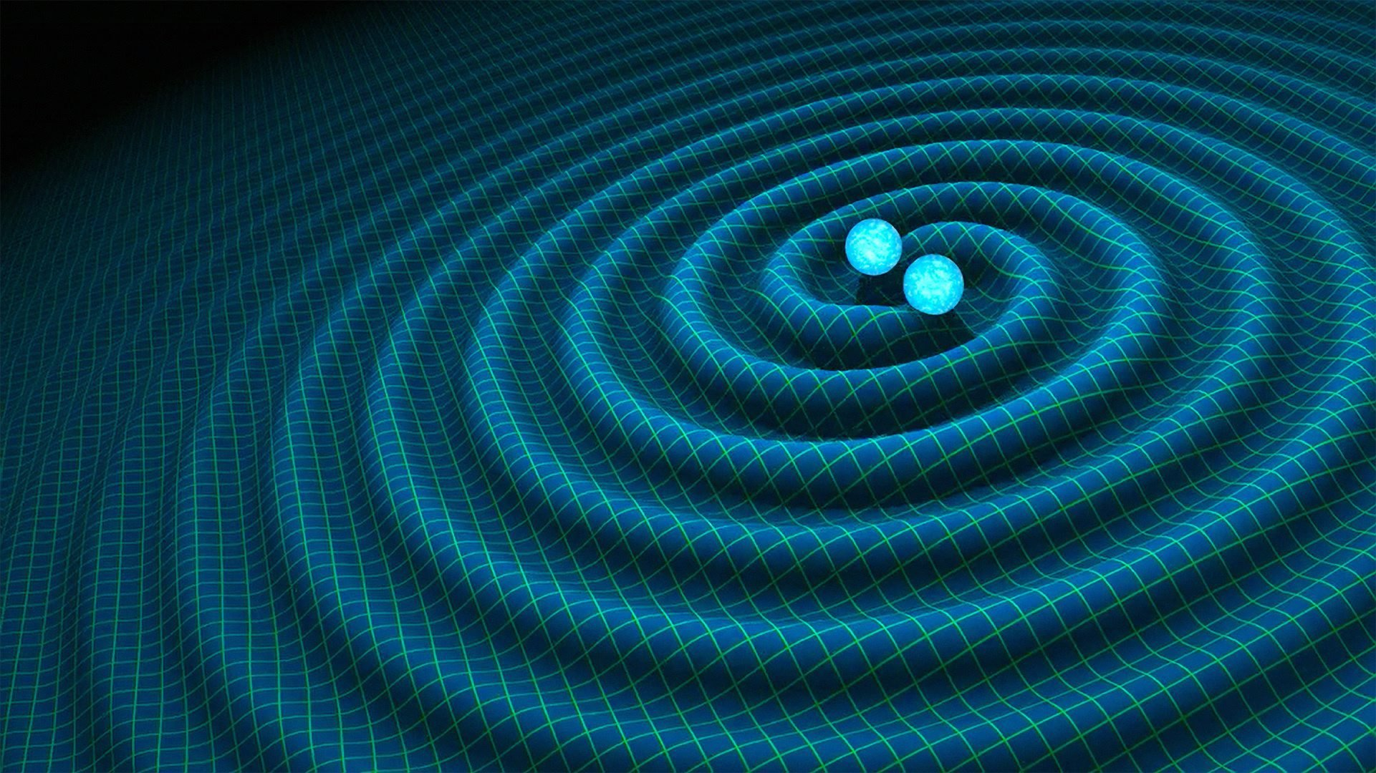
A Final Thought…!
[Gravitational] Radiation Field
Gravitational Field
Internal Energy
Kinetic Energy
Turbulence
Matter
Electro-Magnetic Field
[Electromagnetic] Radiation Field

Slide 61
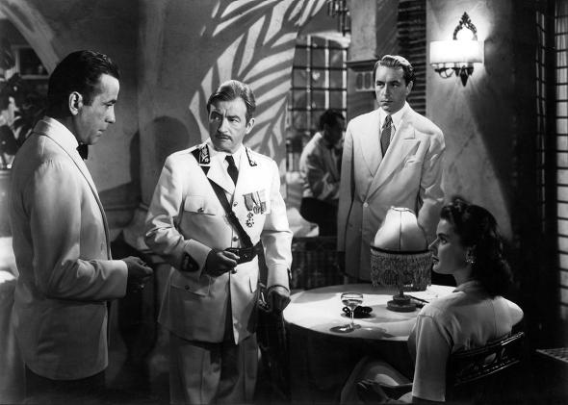
To be continued…

