Slide 1
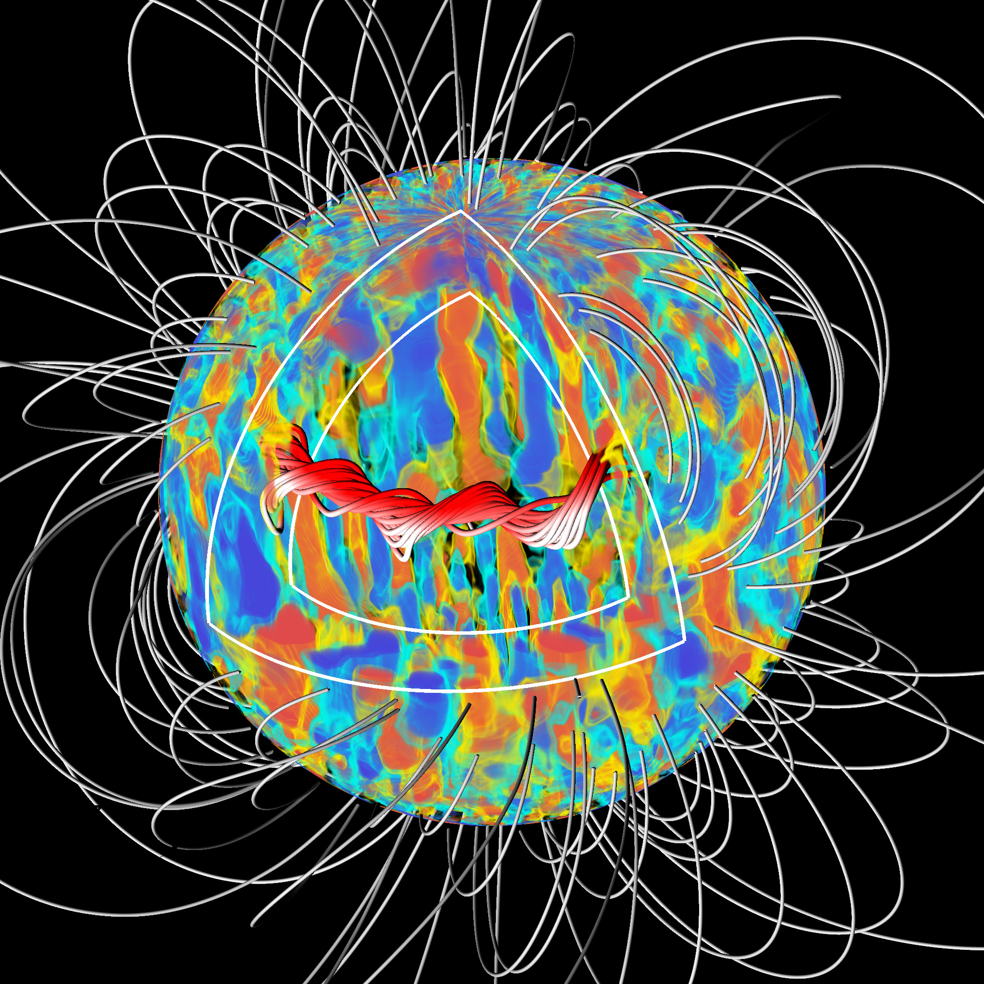
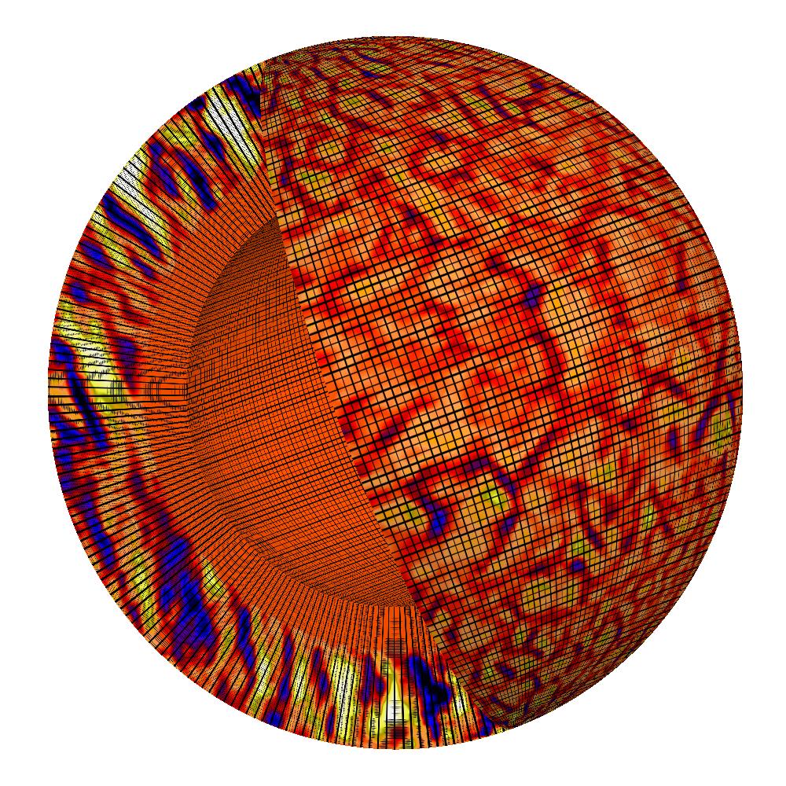
Global simulations of MHD solar convection
Anelastic MHD in a thick, rotating and
stratified shell of thermally forced
magnetized conducting fluid.
ILES simulation protocole based on
EULAG-MHD code, developed at UdeM
from HD version of EULAG
Based on minimally diffusive MPDATA
NFT advection scheme, allowing to reach
strongly turbulent regimes on relatively
coase grids
www.astro.umontreal.ca/~paulchar/grps

Slide 2
Large-scale solar-like magnetic cycles
Simulations generate regular large-scale magnetic cycles with multidecadal
periods, good hemispheric synchrony, kG-strengh magnetic fields, and
cycle-driven rotational oscillations: all solar-like, and as yet unsurpassed!
Dynamically cosnsistent on all resolved spatial and temporal scales; thus
allows to identify and quantify mechanisms leading to cycle variability,
irradiance modulation, torsional oscillations, etc.

