Slide 1
Solar and stellar dynamos : convergences and divergences Paul Charbonneau Département de Physique, Université de Montréal
Induction and fluid dynamos
Mean field dynamo models
Babcock-Leighton dynamo models
Global MHD simulations
How to converge to concensus ?
Collaborators: Piotr Smolarkiewicz, Mihai Ghizaru, Dario Passos,
Antoine Strugarek, Jean-François Cossette, Patrice Beaudoin,
Corinne Simard, Alexandre Lemerle, Caroline Dubé, Nicolas Lawson,
Melinda Nagy, Amélie Bouchat, Étienne Racine, Gustavo Guerrero.
Deniz Ölçek, François Labonville, Kristof Petrovay, Sacha Brun, Mark Miesch

Slide 2
Dynamo = kinetic to magnetic energy
Magnetohydrodynamical induction: flow of electrically conducting
fluid across magnetic fields, in collisionnally-dominated plasma regime:
Form magnetic energy equation by dotting B into above, and integrating
over volume of the sun/star:
Poynting flux
Current density
Lorentz force
Concensus

Slide 3
Mechanisms of MHD induction
Extant solar dynamo models based on a variety of
inductive mechanisms:
1. Shearing of large-scale poloidal magnetic field
by differential rotation;
2. Turbulent electromotive force associated with the action
of cyclonic convection on large-scale magnetic field
(alpha-effect, turbulent diffusivity);
3. Turbulent electromotive force associated with Coriolis
force imparting helicity to HD/MHD instability planforms;
4. Large-scale dipole regeneration by emergence and decay
of sunspot-forming buoyant magnetic flux tubes twisted
by Coriolis force (Babcock-Leighton mechanism)
Convergence
Divergence

Slide 4
Mean-field dynamo models

Slide 5
Mean-field electrodynamics (1)
Scale separation: Assume that the total flow u and magnetic
field B can be decomposed into a large-scale average and a
small-scale fluctuating component (not a linearization!):
Substitute into the induction equation and average:
A new source term, the mean electromotive force:
Closure: expand emf as tensorial development in mean field:

Slide 6
Mean-field electrodynamics (2)
NO
For stratified rotating MHD turbulence that is homogeneous
and isotropic but lacks reflectional symmetry and is only
weakly influenced by the magnetic field, the alpha-tensor
becomes diagonal, with coefficient proportional to the fluid’s
kinetic helicity:
Where is the correlation time of the turbulent eddies.
Likewise, the isotropic part of the beta-tensor becomes:
NO
NO
This result is expected to hold also in mildly anisotropic, mildly inhomogeneous turbulence. In general,

Slide 7
Babcock-Leighton solar dynamos (1) [ see talks by Nandi, Karak and Schunker later in this session ]
Mean-field-like models, include a turbulent diffusivity but no
alpha-effect. Require magnetic flux transport between surface
and interior (meridional flow, diffusion, turbulent pumping…)
[ Wang et al. 1991, ApJ 383:431 ; Choudhuri et al. 1995, A&A 303:L29 ;
Durney 1995, SoPh 160:213 ; Dikpati & Charbonneau 1999, ApJ 518:508 ]
Buildup and reversal of solar dipole driven by emergence and
decay of BMRs; well-constrained observationally and well
modelled by surface flux transport simulations.
[ Wang et al. 1989, Science 245:712; Upton & Hathaway 2014, ApJ 780:5 ]
Cycle fluctuations due to scatter in properties (EW tilt, flux, etc.)
of emerging active regions.
[ Cameron et al. 2017, ApJ 843:111 ; Nagy et al. 2017 SoPh 292:167 ]
Used succesfully for solar cycle prediction (last 4 cycles!)
[ Schatten et al. 1978, GRL 5:411 ; Jiang et al. 2007, MNRAS 381:1527 ]

Slide 8
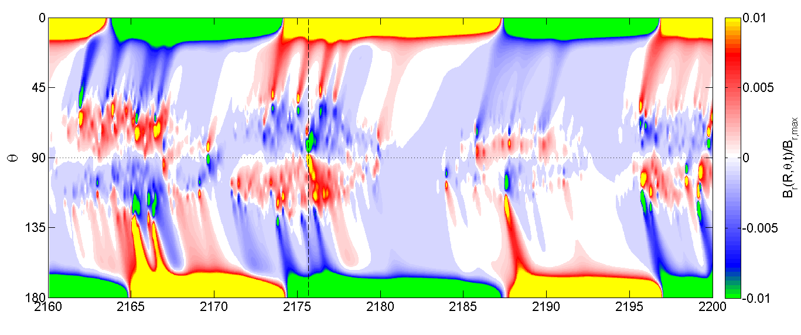
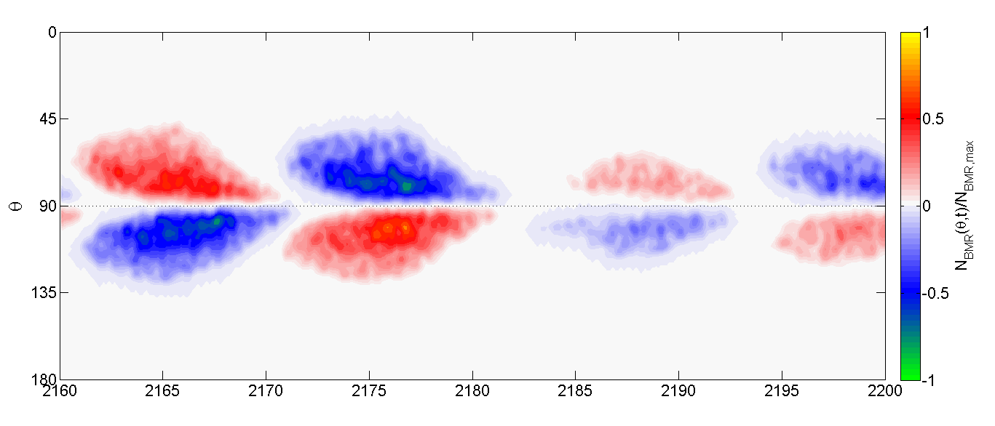
Babcock-Leighton solar dynamos (2) [ Nagy et al. 2017, SolP, 292, id167 ]
Time-latitude of surface Br and Emergences
Convergence
Years

Slide 9
Problems and divergences
Until recently, almost all axisymmetric (2D)
[ Yeates & Munoz-Jaramillo 2013, MNRAS 436:3366 ;
Lemerle et al. 2017, ApJ 834:133 ; Karak & Miesch 2017, ApJ 847: 69 ;
Kumar et al. 2019, A&A 623:A54 ]
Mostly kinematic (imposed, temporally steady large-scale flows)
true also of surface flux transport simulations used to model
the Babcock-Leighton mechanism
[ Rempel 2006, ApJ 647:662; Hazra & Choudhuri 2017, MNRAS 472:2728]
When present at all, very simplistic treatment of nonlinear
backreaction on small-scale inductive flows.
[ e.g., Munoz-Jaramillo et al. 2011, ApJL 727:L23 ]
Good precursor value of polar field often taken to imply sun
is a Babcock-Leighton dynamo: not necessarily so !
[ Charbonneau & Barlet 2011, JASTP 73:198 ]

Slide 10
Magnetohydrodynamical simulations of solar and stellar dynamos

Slide 11
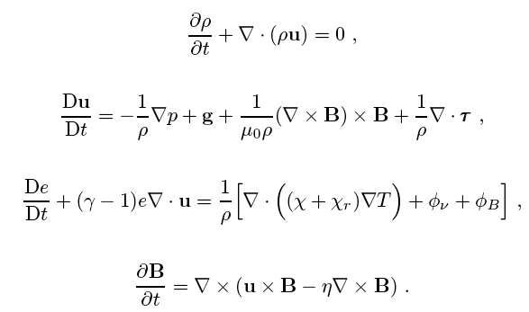
The MHD equations

Slide 12
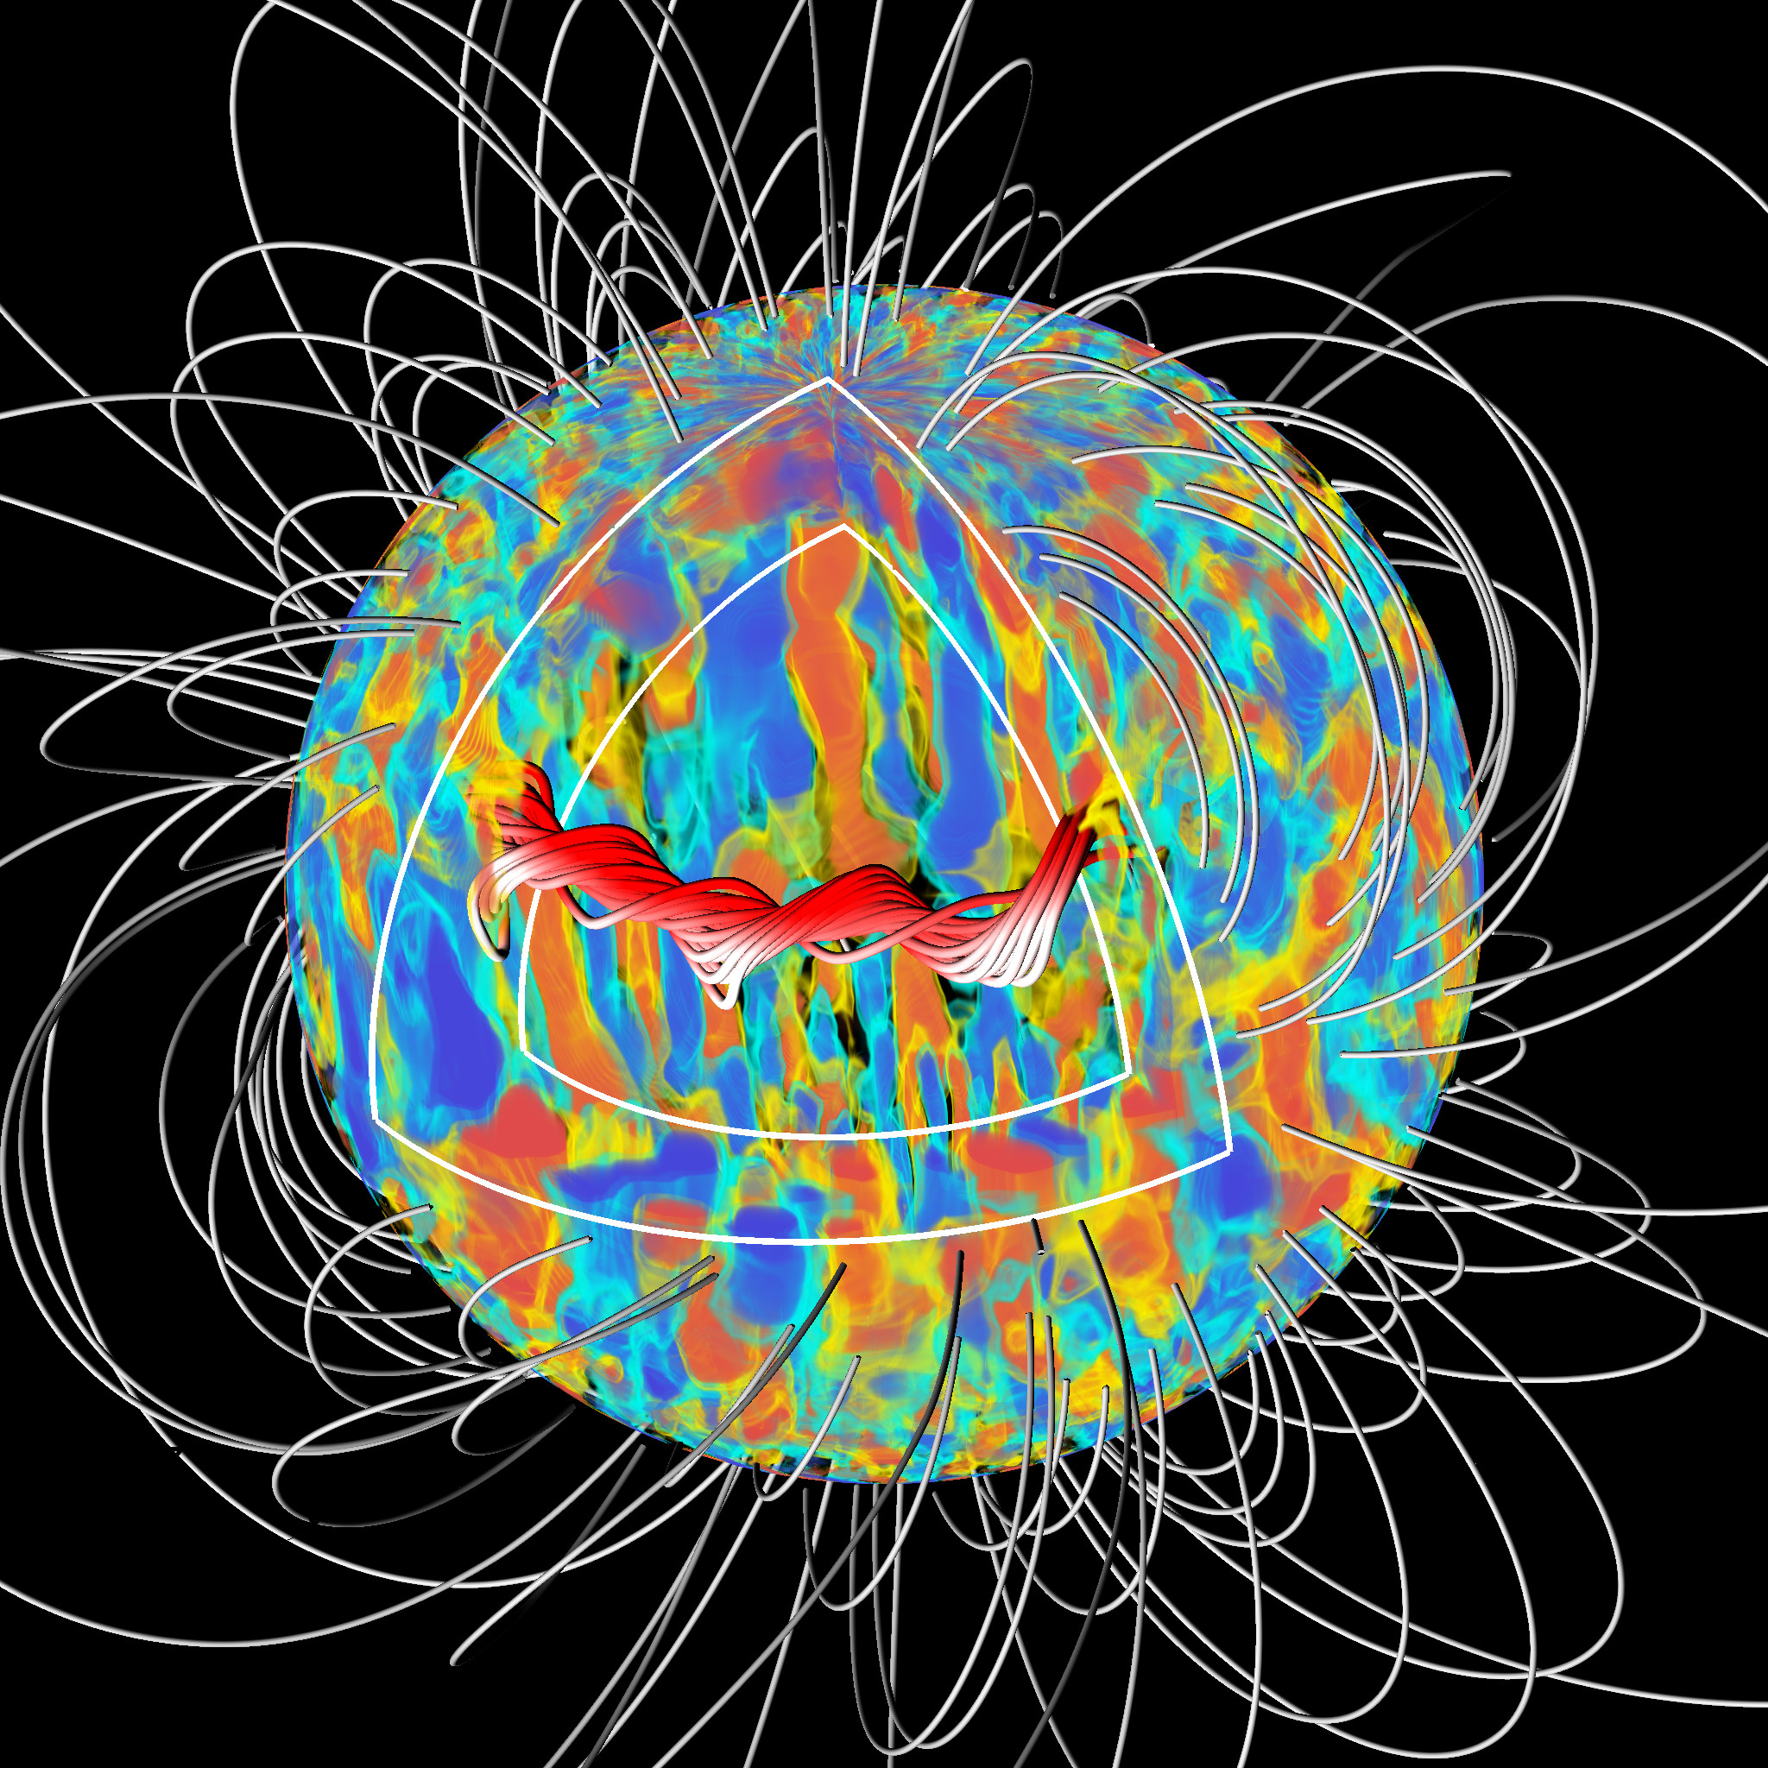
Magnetic cycles (1)

Slide 13
Magnetic cycles (1)
Convergence

Slide 14
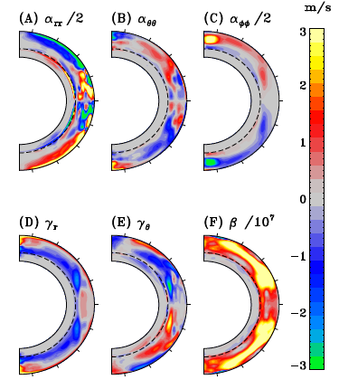
MHD: extracting the turbulent EMF [ Simard et al., Adv. Sp. Res. 58, 1522 (2016) ]
Get these from simulation
Compute this
Get these by least-squares fit
See also Augustson et al. 2015,
ApJ 809, id149; Warnecke et al.
2018, A&A 609, A51.

Slide 15
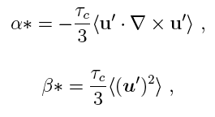
Low coherence time turbulence ?
( / 4.5 )
( / 5.5 )
Simulations and analytical (SOCA) theory match, but with
an amplitude error by a factor of ~5; can be « explained »
if coherence time of turbulent eddies is smaller than
turnover time by a comparable factor.
Conjecture: the scale-dependent implicit dissipation
operating within this specific EULAG simulation leads to
low correlation time turbulence in the physical regime
of our solar simulations.

Slide 16
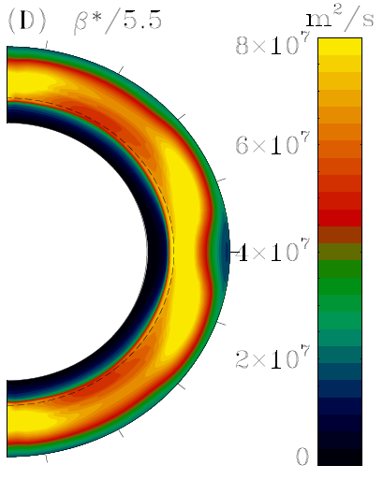
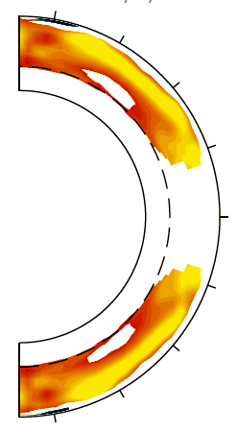
MHD: beta vs turbulent intensity [ Simard et al., Adv. Sp. Res. 58, 1522 (2016) ]
Convergence

Slide 17
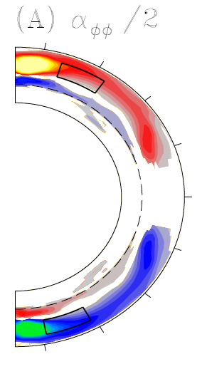
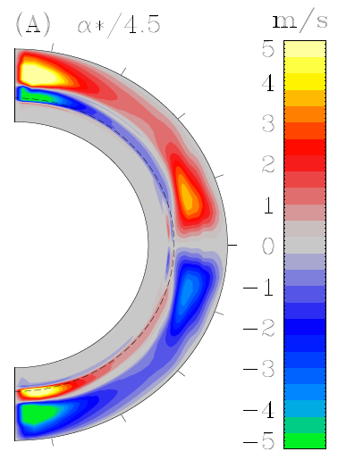
MHD: alpha vs kinetic helicity [ Simard et al., Adv. Sp. Res. 58, 1522 (2016) ]
Convergence

Slide 18
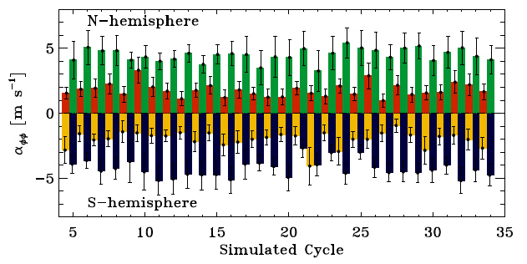
Quenching of alpha-effect (1) [ Simard et al., Adv. Sp. Res. 58, 1522 (2016) ]
SVD fit on individual cycles, subdivided into « maximum » and « minimum » phases separately in each hemisphere.

Slide 19
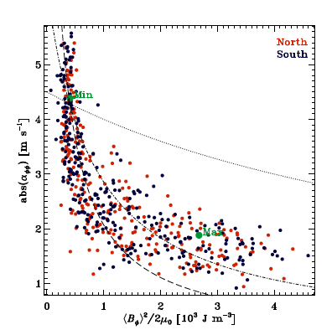
Quenching of alpha-effect (2) [ Simard et al., Adv. Sp. Res. 58, 1522 (2016) ]
« weak »
quenching
« strong »
quenching
Convergence

Slide 20
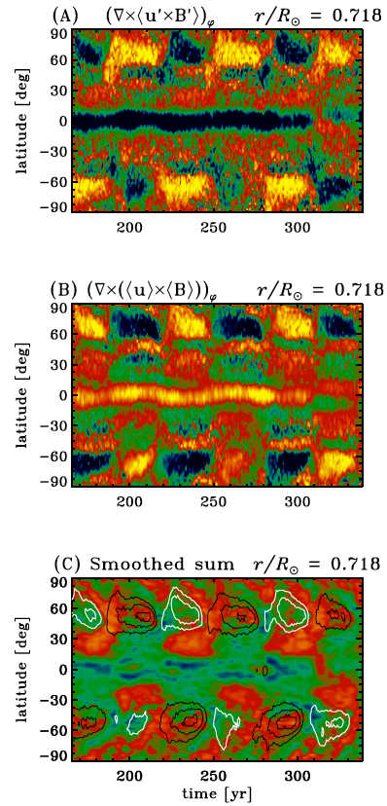
Dynamo saturation (Racine et al. 2011, ApJ, 735)
Divergence
…then these two terms must nearly cancel each other out in a
statistically stationary
state…
…if this is
small

Slide 21
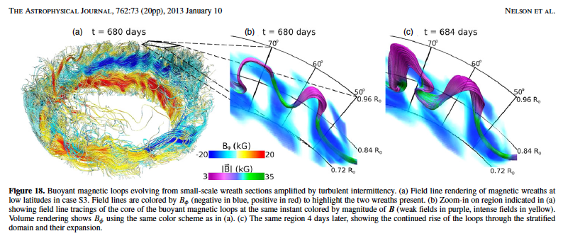
Buoyant « magnetic flux ropes » (1)
[ Nelson et al. 2013, ApJ 762, 73 ]
Convergence
Divergence

Slide 22
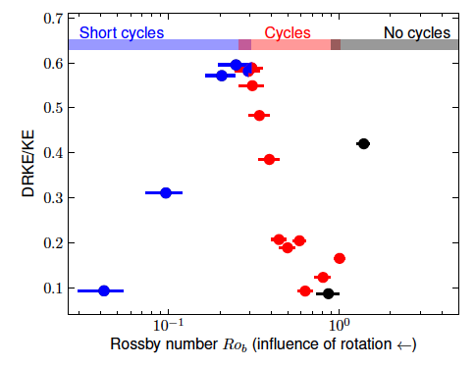
Stellar magnetic cycles [ Strugarek et al., Astrophys. J. 863(1), 2018 ]
Mixing length theory
+ alpha-quenching
in mean-field
theory suggests:
P_{cyc} ~ Ro1.25
MHD simulations
yield:
P_{cyc} ~ 1 / Ro1.6
Divergence
[ See also: Warnecke 2018, A&A 616, A72 ]

Slide 23
Problems and divergences
Physical regime very far from solar/stellar interior conditions
( dissipation too high, Re, Rm ~103 instead of ~1010 ! )
[ Hotta et al. 2016, Science 351:1427 ]
Very crude (if any) representation of photosphere ;
no sunspots, no Babcock-Leighton mechanism…
[ Nelson et al 2014, SoPh 289:441 ; Chen et al. 2017, ApJ 846:149 ]
Wide variety of cyclic behavior in different simulations
that supposedly simulate the « same thing ».
[ Charbonneau et al. 2020, LRSP 17:4 Sect. 6 ]
Empirically presence of a tachocline seems very important,
even if rotational shear therein does not dominate induction.
[ e.g. Guerrero et al. 2016, ApJ 819:104 ]
Often extreme sensitivity to numerical « details » : due to
influence of developing HD/MHD instabilities ? Or subtleties
of inverse turbulent cascades ?
[ e.g., Lawson et al. 2015, ApJ 813:95 ]

Slide 24
How to converge to a consensus ?
Need to understand what sets the magnetic cycle period(s)
in the sun and stars ; « easy » in kinematic mean-field-type
dynamos, much harder in MHD simulations.
Helioseismic measurements of nonlinear backreaction on
large-scale flows in interior: differential rotation and meridional
circulation
Magnetic flux budget of solar polar caps as potentiel
discriminant of different classes of dynamo models
Understand role of tachocline (and in situ dynamics,
instabilities, etc) in solar cycle dynamo loop, especially
with regards to long term modulation of primary 22-yr cycle

Slide 25
FIN

Slide 26
Backup slides

Slide 27
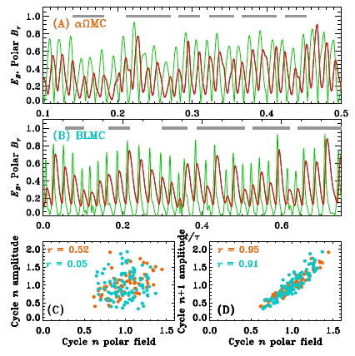
Surface dipole as precursor (5)
In itself, does not
imply that the sun is
necessarily
a Babcock-Leighton
dynamo !
What it does imply
is that the surface
magnetic field feeds
back into the
dynamo loop
Charbonneau & Barlet 2011, JASTP 73,206Z

Slide 28
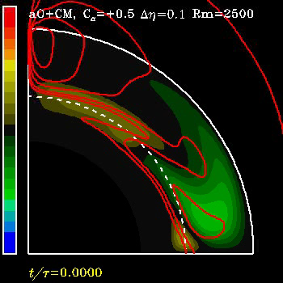
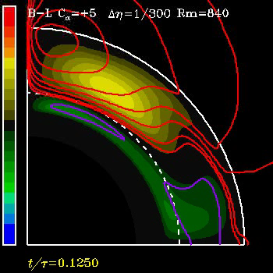
Surface dipole as precursor (4)
Consider the following two kinematic axisymmetric mean-field like dynamo
models, using a solar-like differential rotation and quadrupolar meridional
flow, and a simple algebraic quenching nonlinearity.
T > P : alpha-effect
T > P : Babcock-Leighton

Slide 29
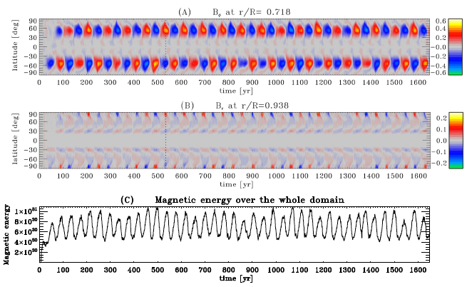
The « millenium simulation » [ Passos & Charbonneau 2014, Astron. & Ap., 568, 113 ]
Define a SSN proxy, measure cycle characteristics (period, amplitude…) and compare to observational record.

Slide 30
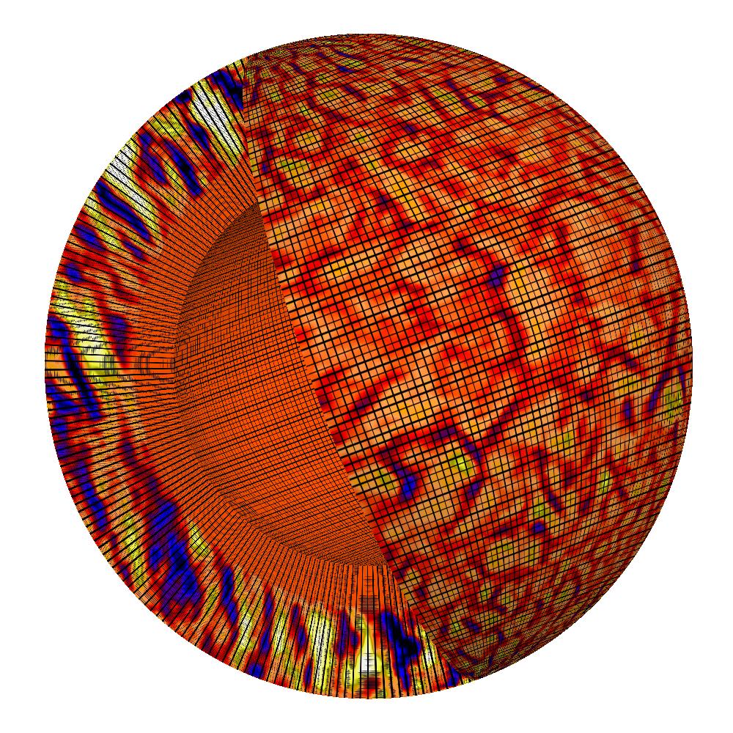
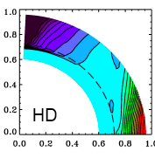
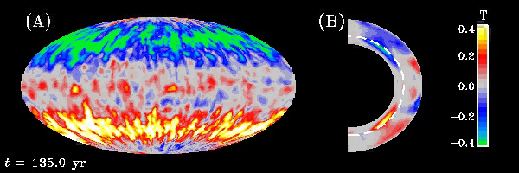
Magnetic cycles (1)
EULAG-MHD solves anelastic MHD
equations in a thick, rotating stratified
fluid shell; includes stable fluid layer
underneath convectively unstable layer.
Despite strongly turbulent nature of induction, simulation develops a strong
and spatially well-organized axisymmetric magnetic field, antisymmetric about
equatorial plane and undergoing regular and hemispherically synchronized
polarity reversals.

Slide 31
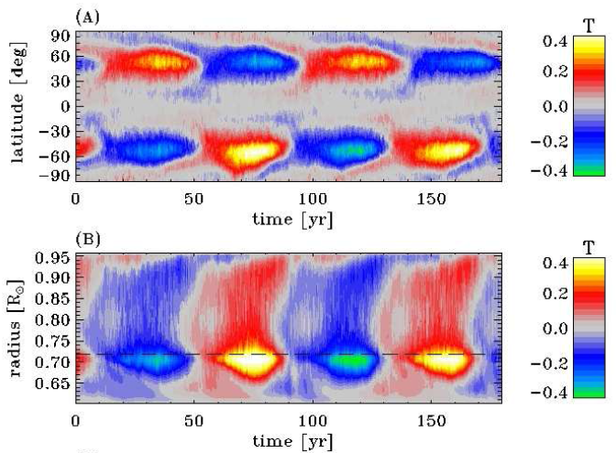
Magnetic cycles (1)
Zonally-averaged B_{phi} at r/R =0.718
Zonally-averaged B_{phi} at -58o latitude

Slide 32
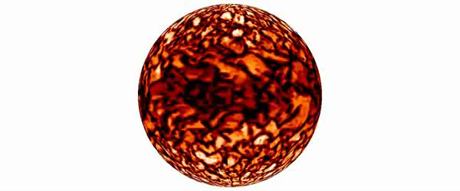
Simulated magnetic cycles
Large-scale organisation of the magnetic field takes place primarily
at and immediately below the base of the convecting fluid layers.
Magnetic field amplification through a dynamo mechanism:
converting flow kinetic energy into (electro)magnetic energy.

