Slide 1
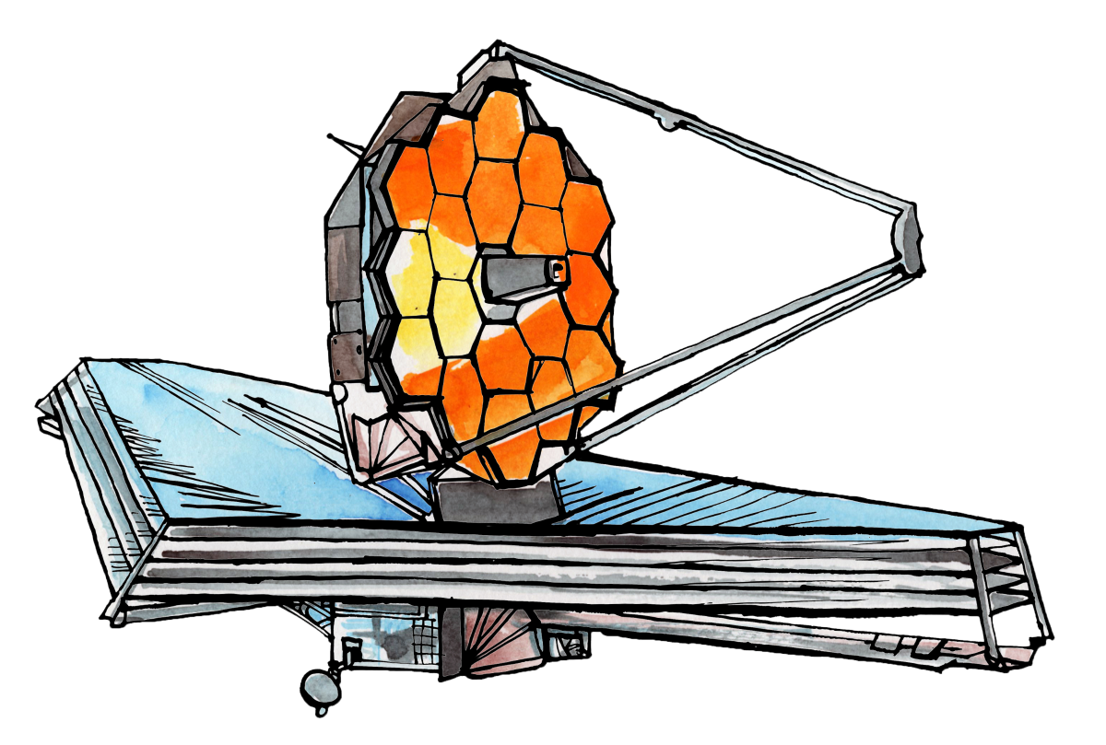
Université de Montréal
JWST Proposal Training Workshop
Local organizers
Geert Jan Talens, Neil Cook, Loïc Albert, Nathalie Ouellette, René Doyon, David Lafrenière
Co-organizer from University of Western Ontario
Alexandros Maragkoudakis

Slide 2
OVERVIEW
Morning sessions
JWST observing modes and details of Call for Proposals
Telescope
Instruments / Observing modes
Call for Proposals
Policies
Resources and proposing tools
JWST User Documentation (JDOX)
Exposure Time Calculator
Astronomer's Proposal Tool
Afternoon sessions
Mode Presentations
Time Series Observations (TSO)
Long-Slit Spectroscopy
Integral Field Spectroscopy (IFU)
Home Hands-on Exercises and Live Q and A.

Slide 3
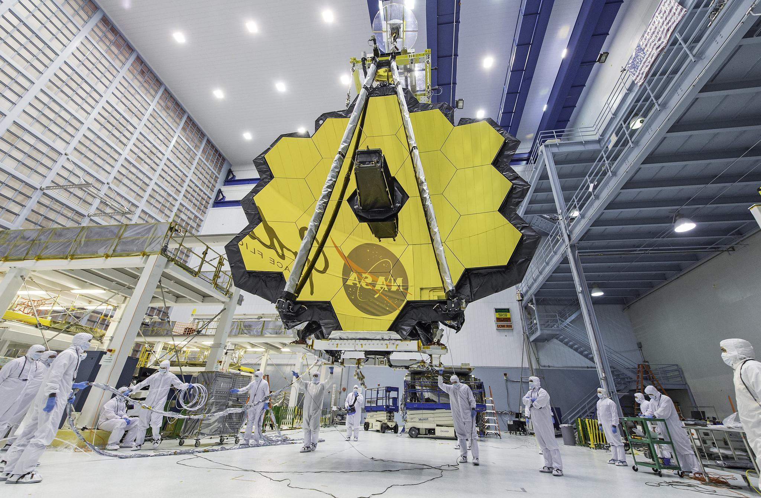
The James Webb Space Telescope (JWST)

Slide 4
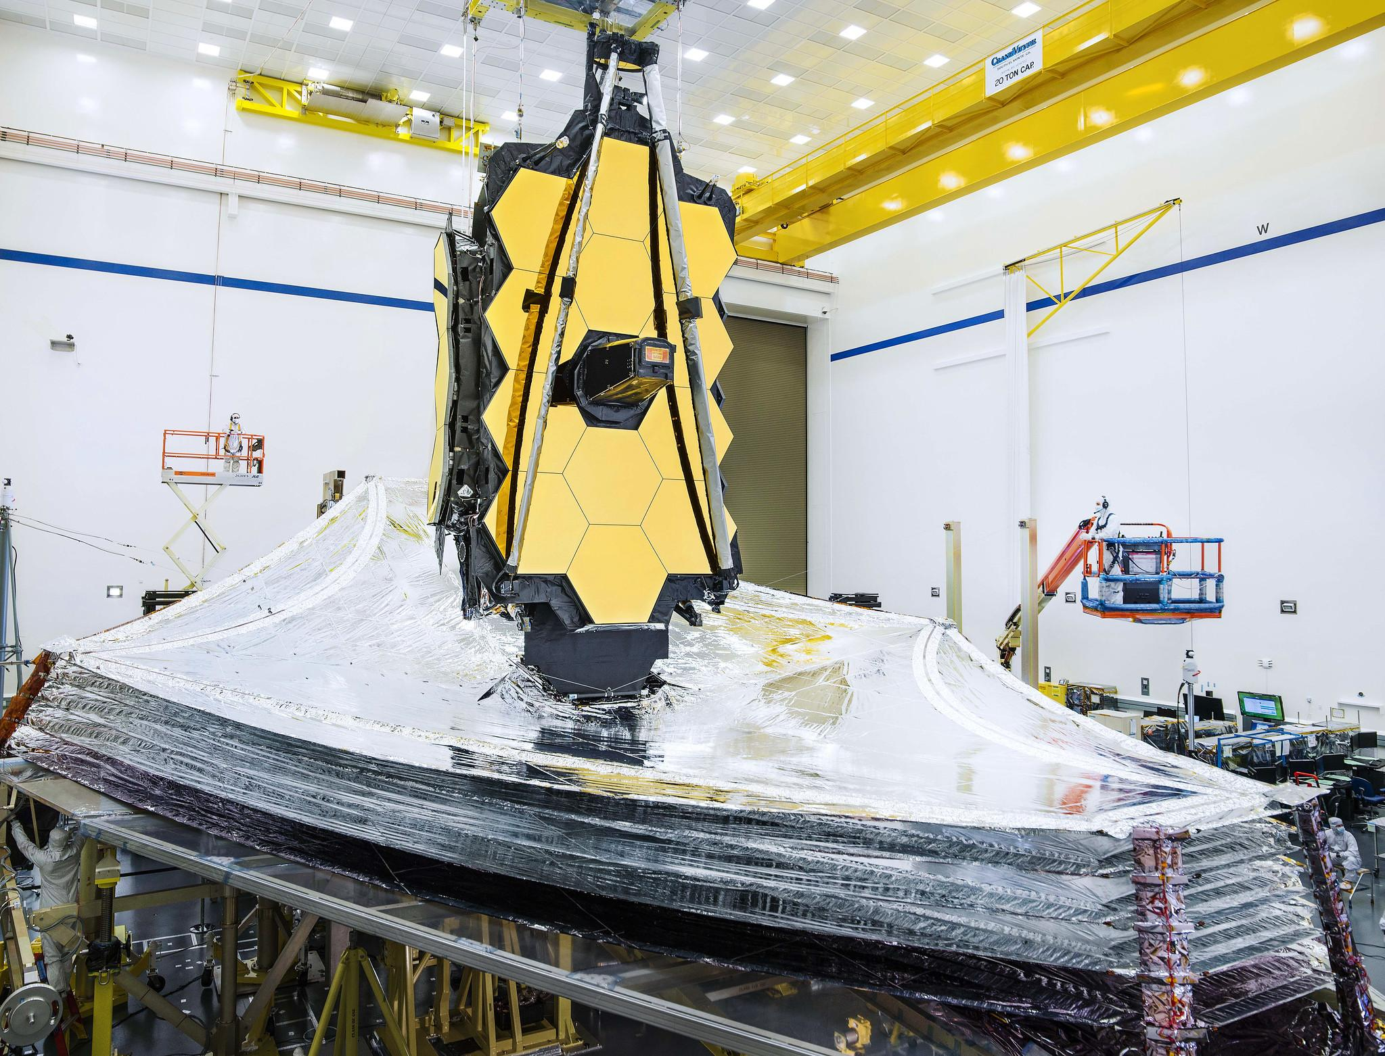
JWST Key Facts
Proposed Launch Date: March 2021
Mission Duration: 5 - 10 years
Primary mirror: 18 hexagonal segments
Diameter of primary Mirror: ~6.5 m (21.3 ft)
Clear aperture of primary mirror: 25 m²
Angular resolution: ~0.1” at 2 μm
Wavelength coverage: 0.6 - 28.5 microns
Orbit: 1.5 million km from Earth orbiting the L2 Point

Slide 5
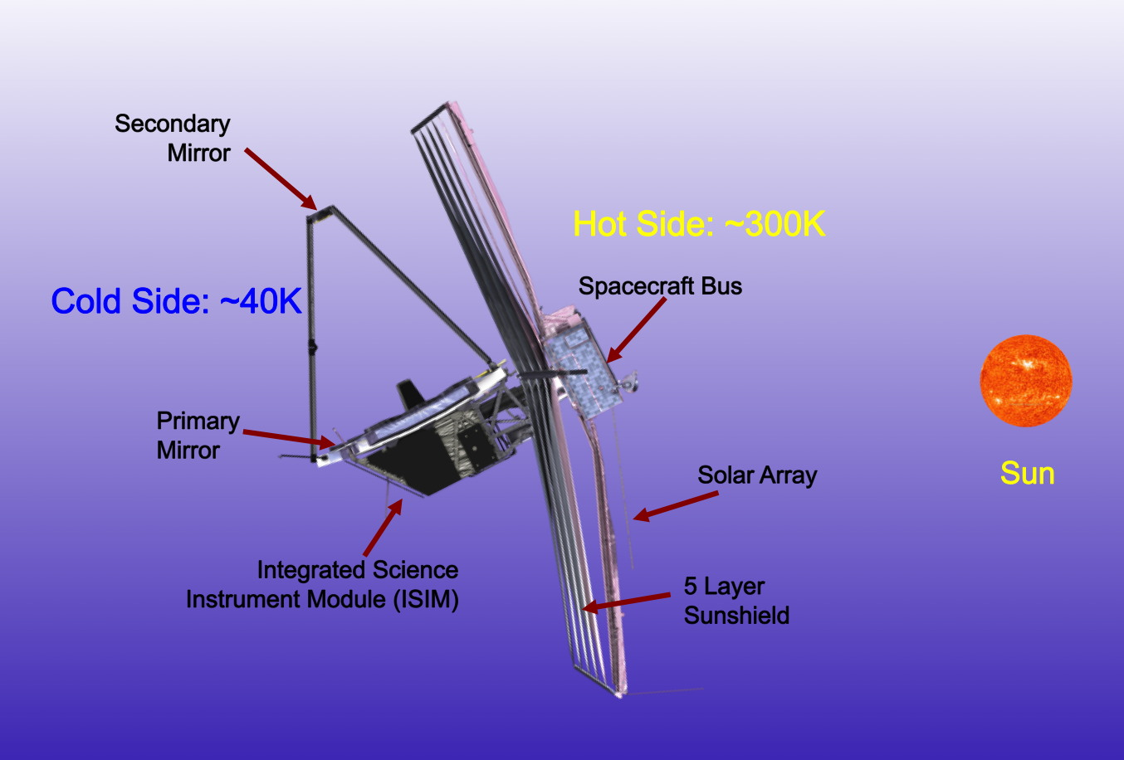
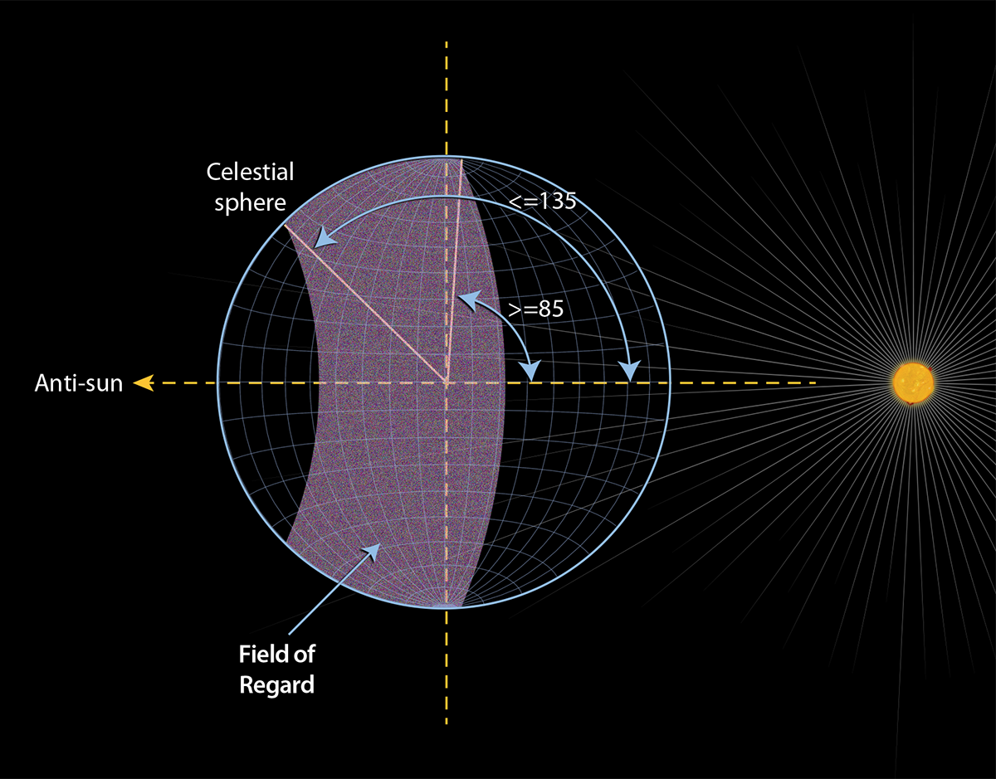
JWST Observatory and pointing

Slide 6
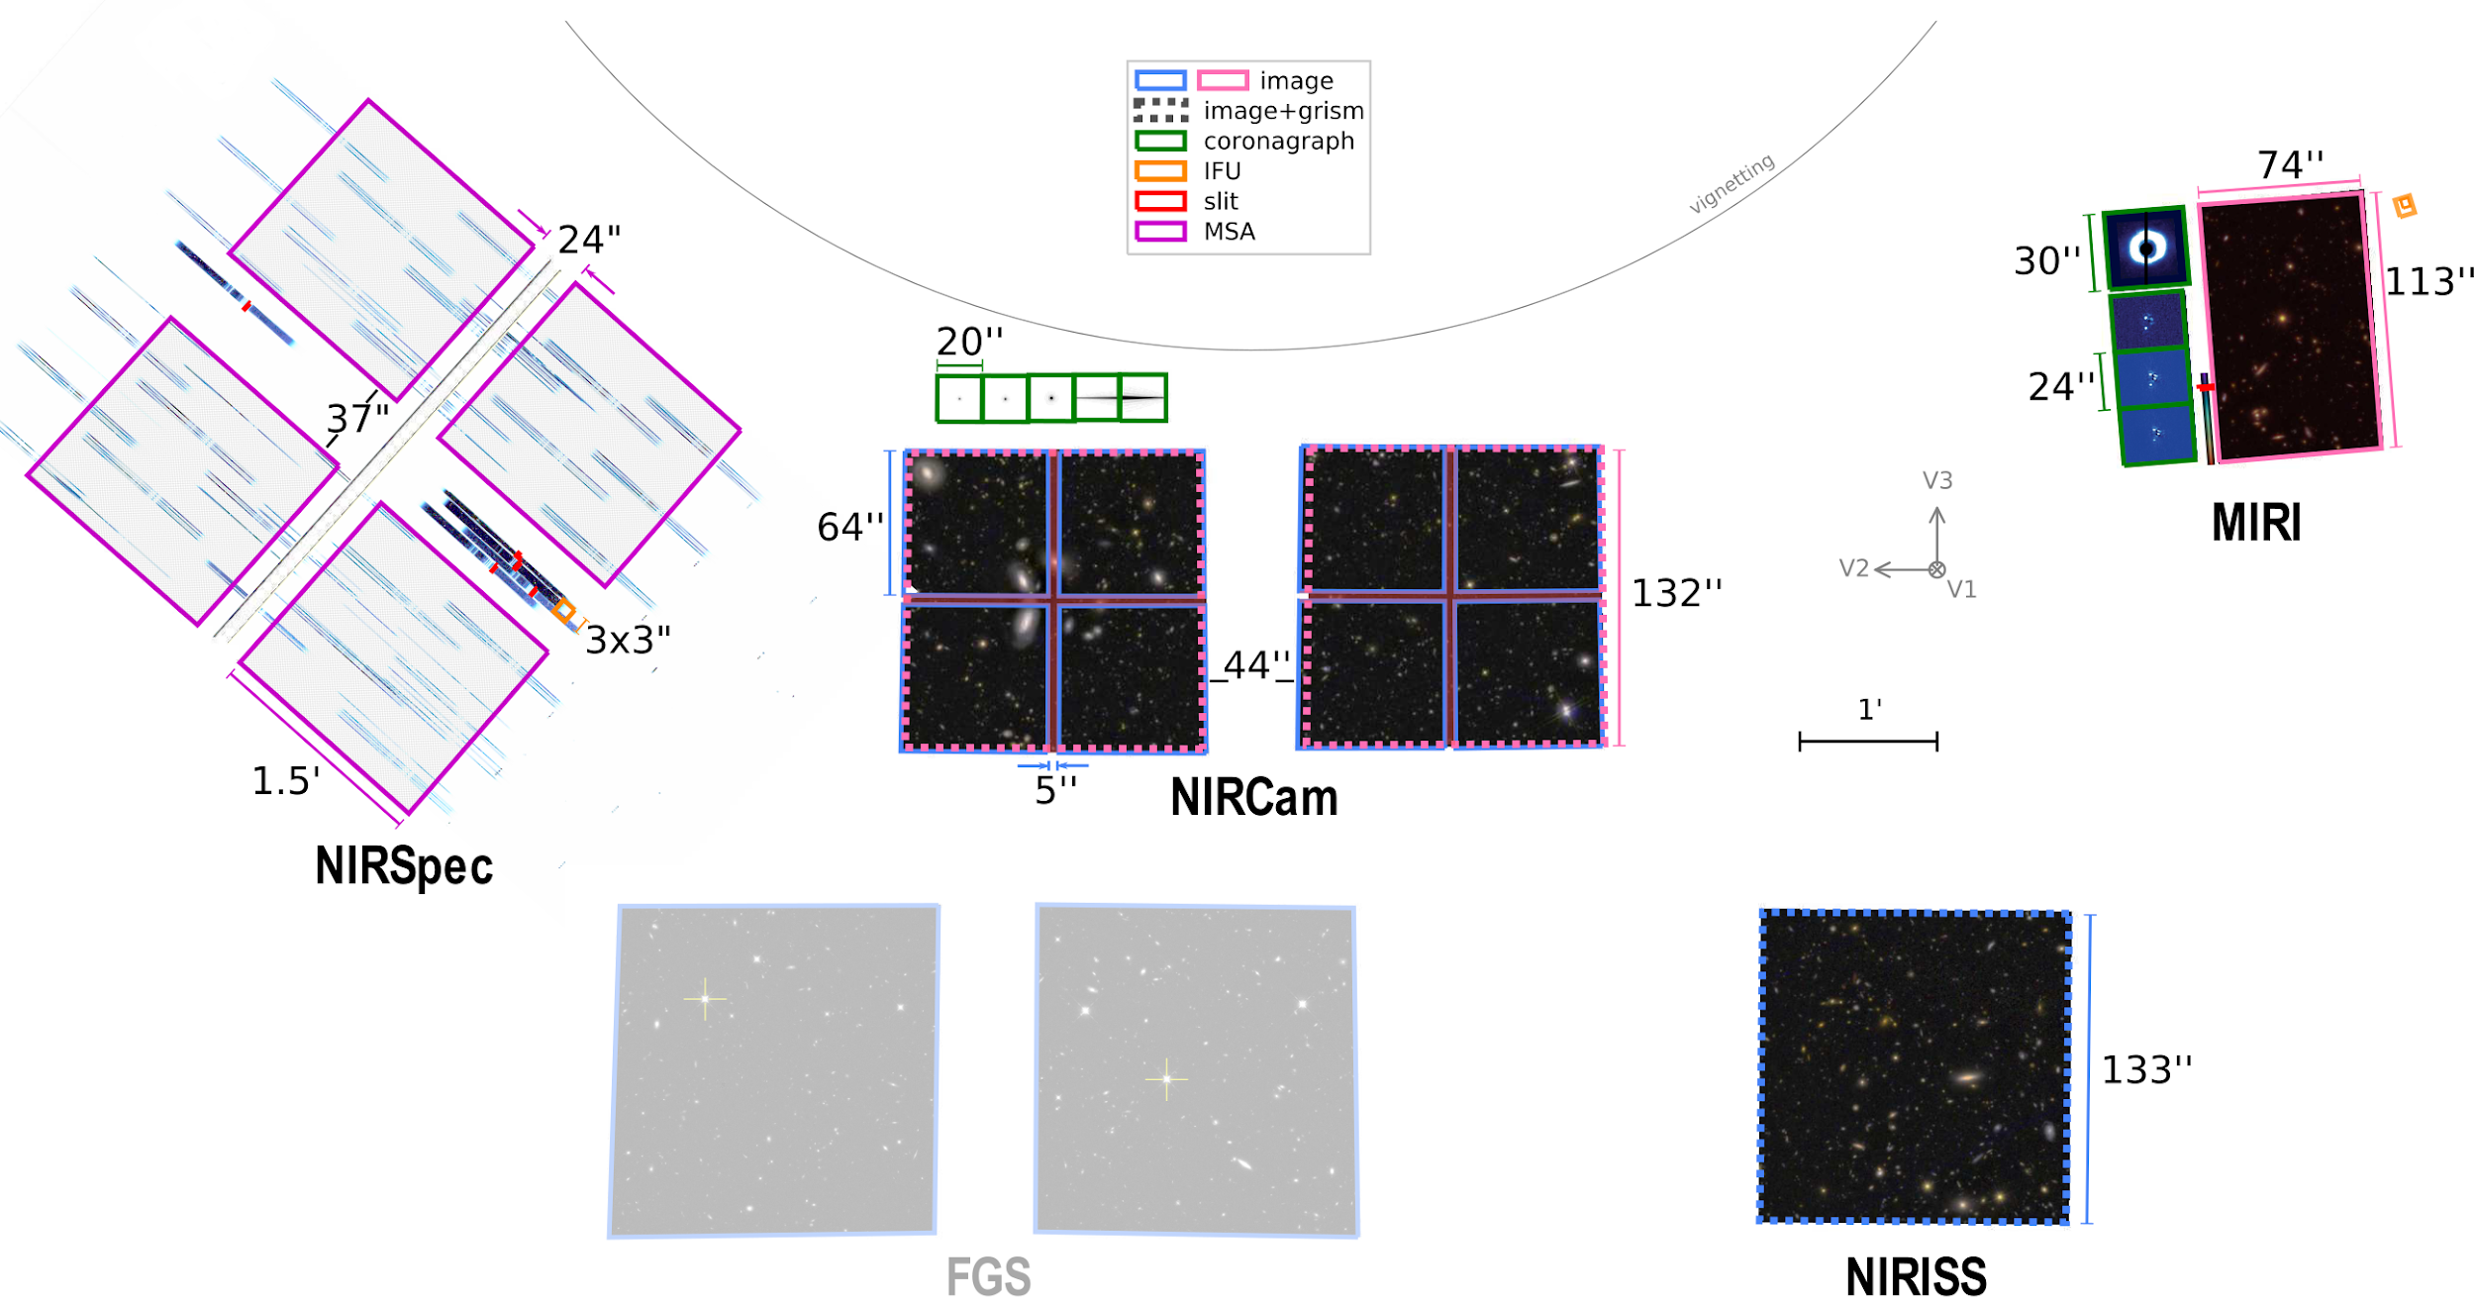
JWST Instruments

Slide 7
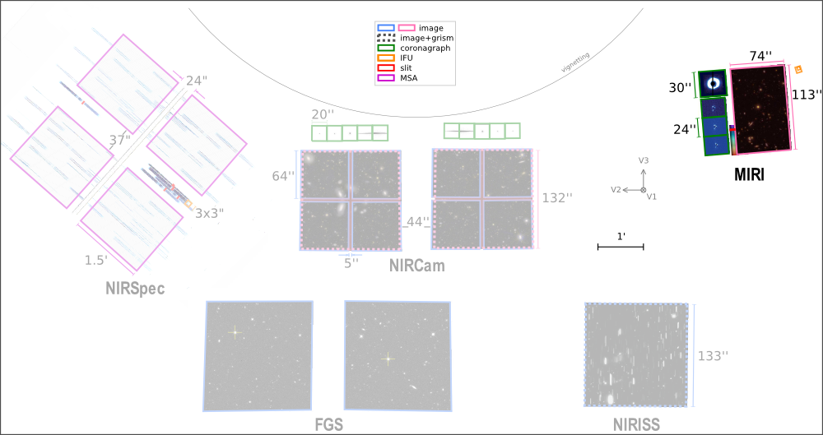
Mid-Infrared Instrument (MIRI)
MIRI provides imaging and spectroscopic observing modes from 4.9 to 28.8 μm
Imaging with 10 filters ranging from 5.6 to 25.5 μm.
Low-resolution slitted and slitless spectroscopy from 5 to 12 μm, (R = λ/Δλ) of ~100 at 7.5 µm
Medium-resolution integral field unit (IFU) spectroscopy from 4.9 to 28.8 μm, R from 1,500 to 3,500
Coronagraphy one Lyot and three 4-quadrant phase masks (4QPM) coronographs

Slide 8
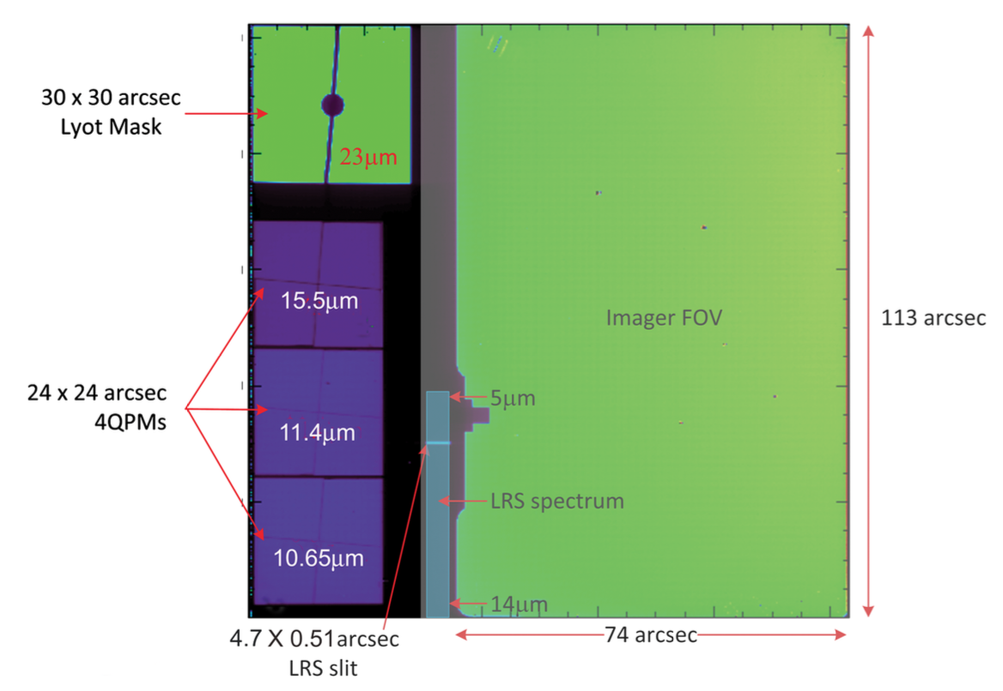
Mid-Infrared Instrument (MIRI)
MIRI provides imaging and spectroscopic observing modes from 4.9 to 28.8 μm
Imaging with 10 filters ranging from 5.6 to 25.5 μm.
Low-resolution slitted and slitless spectroscopy from 5 to 12 μm, (R = λ/Δλ) of ~100 at 7.5 µm
Medium-resolution integral field unit (IFU) spectroscopy from 4.9 to 28.8 μm, R from 1,500 to 3,500
Coronagraphy one Lyot and three 4-quadrant phase masks (4QPM) coronographs
MRS
FOV

Slide 9
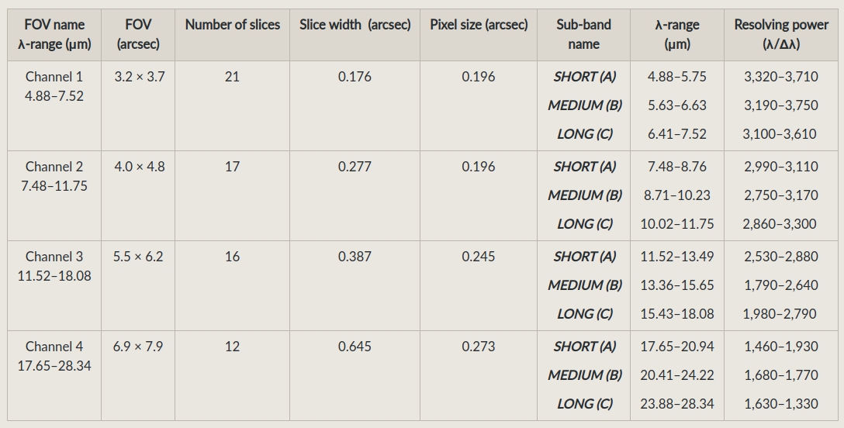
Mid-Infrared Instrument (MIRI)
MRS
FOV

Slide 10
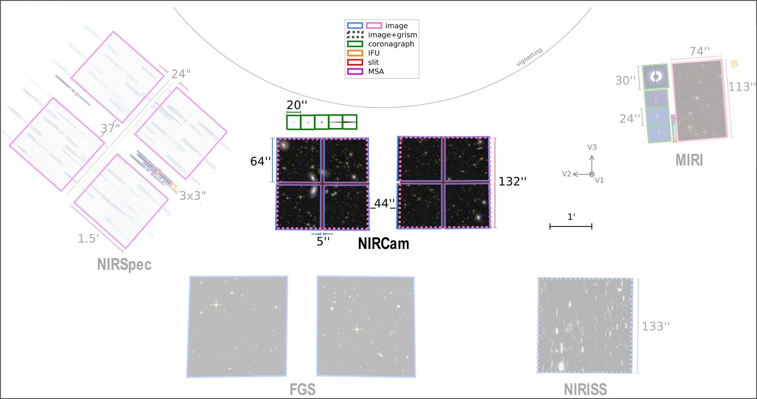
Near Infrared Camera (NIRCam)
NIRCam offers imaging, coronagraphy, and grism slitless spectroscopy from 0.6 to 5.0 μm
Imaging at 0.6–2.3 μm and 2.4–5.0 μm simultaneously – 29 filters
Wide field slitless spectroscopy (2.4–5.0 µm) using grisms with resolving power
R = λ/Δλ ~1,600 at 4 µm
Coronagraphic imaging
Spectrophotometric time-series monitoring

Slide 11
Near Infrared Camera (NIRCam)
NIRCam offers imaging, coronagraphy, and grism slitless spectroscopy from 0.6 to 5.0 μm
Imaging at 0.6–2.3 μm and 2.4–5.0 μm simultaneously – 29 filters
Wide field slitless spectroscopy (2.4–5.0 µm) using grisms with resolving power
R = λ/Δλ ~1,600 at 4 µm
Coronagraphic imaging
Spectrophotometric time-series monitoring

Slide 12
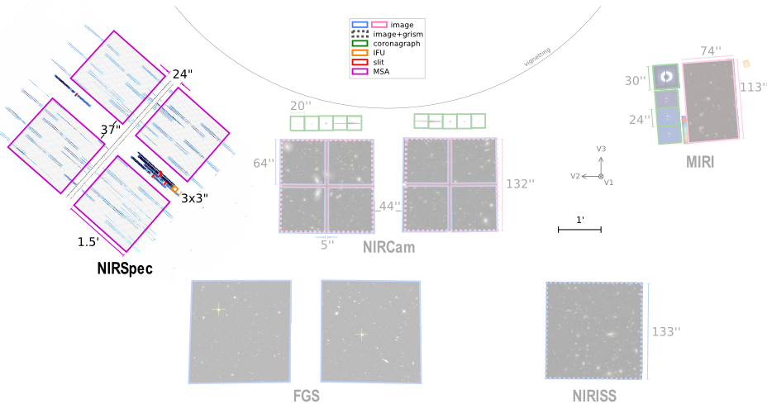
Near Infrared Spectrograph (NIRSpec)
NIRSpec provides near-IR spectroscopy from 0.6–5.3 μm
Multi-object spectroscopy with the Micro-Shutter Assembly (MSA)
Imaging spectroscopy with the Integral Field Unit (IFU)
High contrast single object spectroscopy with fixed slits
Bright object time-series (BOTS) spectroscopy with the NIRSpec wide aperture

Slide 13
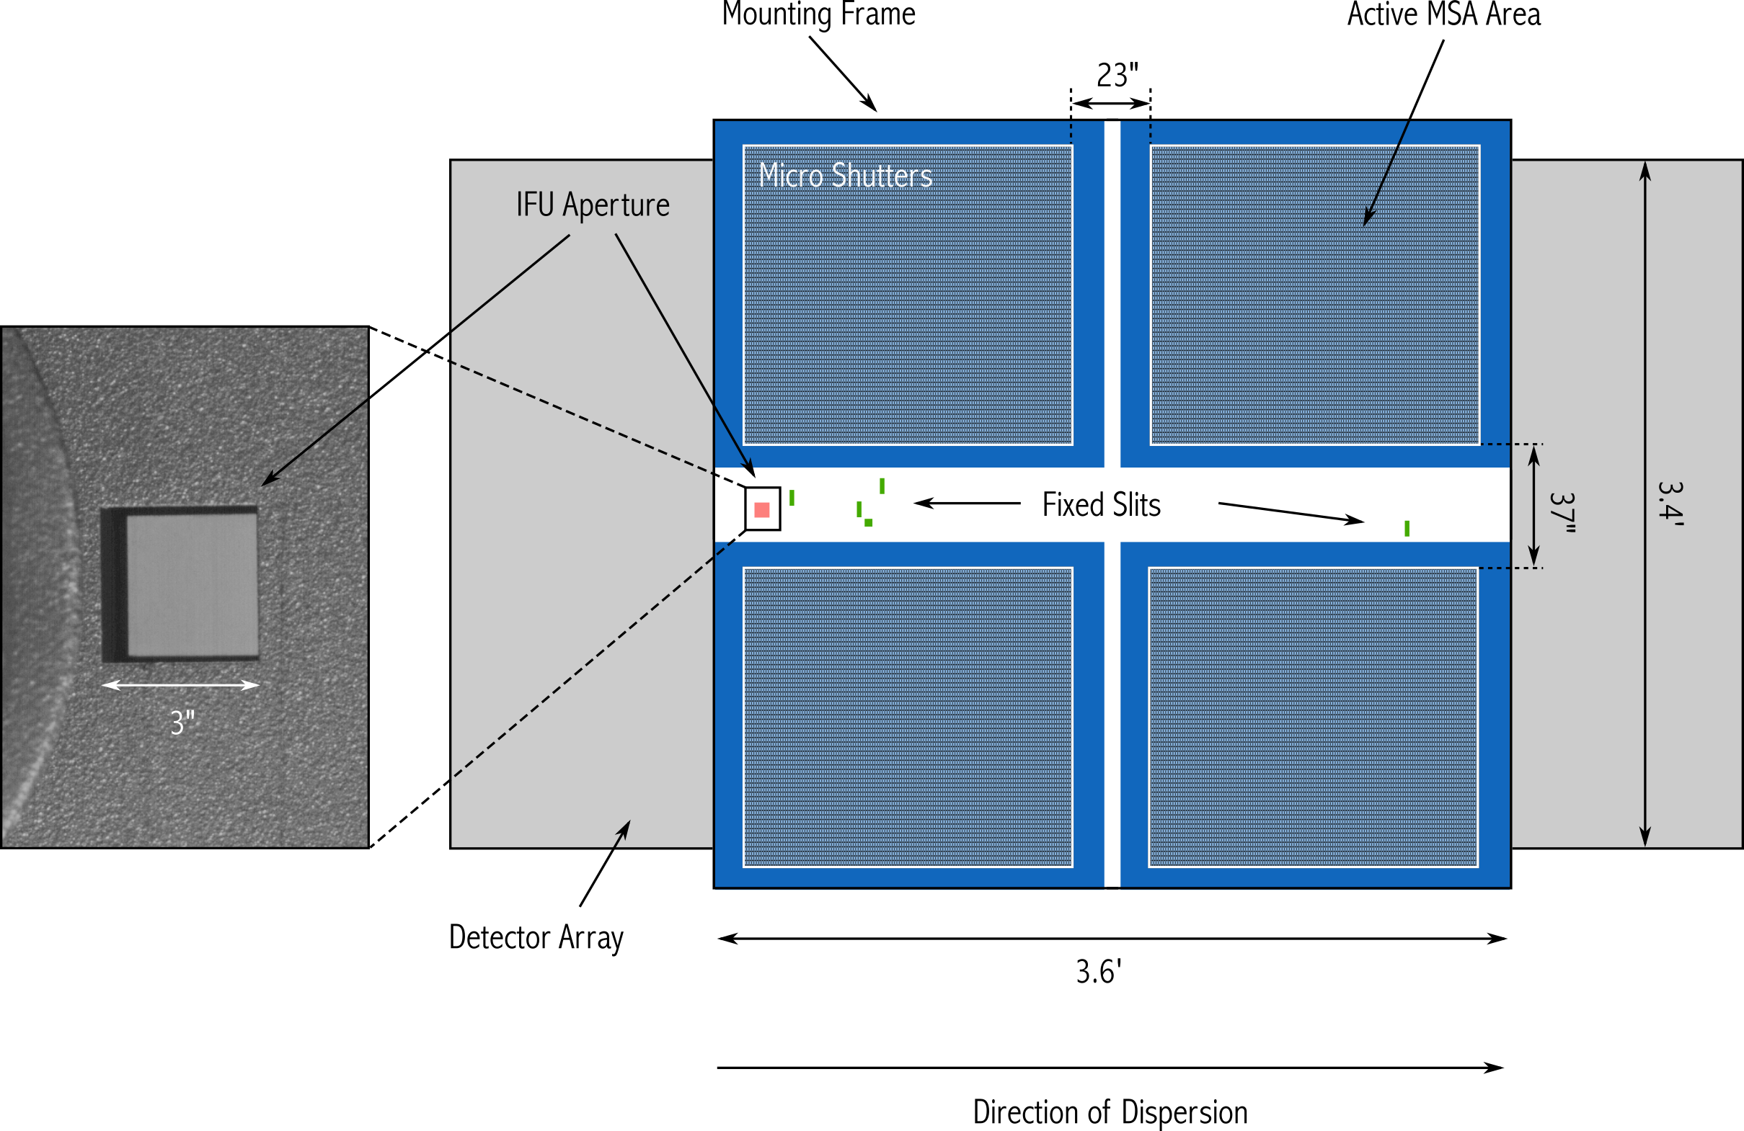
Near Infrared Spectrograph (NIRSpec)
NIRSpec provides near-IR spectroscopy from 0.6–5.3 μm
Multi-object spectroscopy with the Micro-Shutter Assembly (MSA)
Imaging spectroscopy with the Integral Field Unit (IFU)
High contrast single object spectroscopy with fixed slits
Bright object time-series (BOTS) spectroscopy with the NIRSpec wide aperture
MSA contains 250,000 shutters.
Some of the shutters are defective and either permanently "failed open" or "failed closed."
The NIRSpec observation planning software will search for optimal MSA shutter science configurations and automatically plan around all failed shutters.

Slide 14
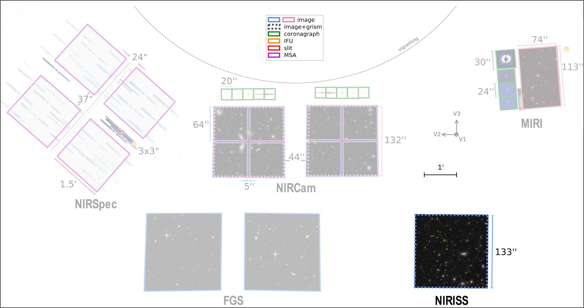
Near Infrared Imager and Slitless Spectrograph (NIRISS)
(NIRISS) provides slitless spectroscopy, high-contrast interferometric imaging, and imaging, between 0.6 and 5.0 μm
Wide field slitless spectroscopy (WFSS) low-resolution (R ≈ 150) spectroscopy between 0.8–2.2 μm
Single object slitless spectroscopy (SOSS) medium-resolution (R ≈ 700) spectroscopy at 0.6–2.8 μm
Aperture masking interferometry (AMI)
Imaging 12 filters covering the wavelength range 0.8–5.0 μm

Slide 15
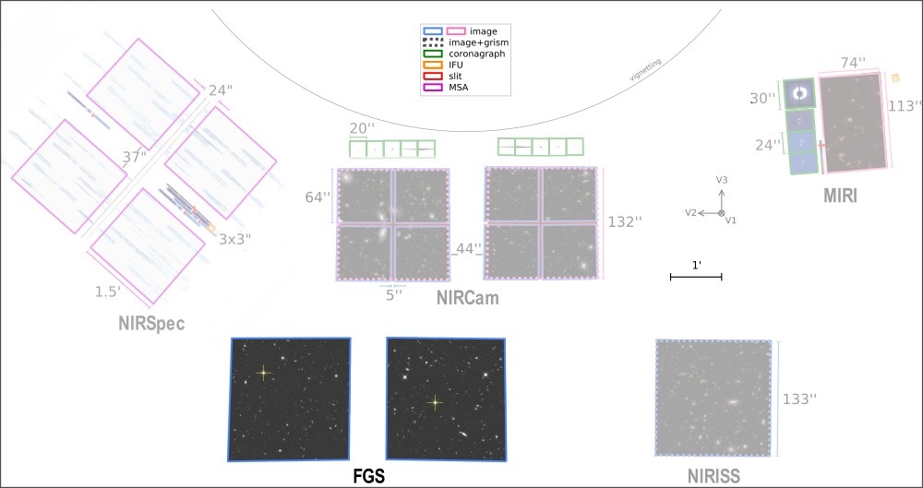
Fine Guidance Sensor
JWST's Fine Guidance Sensor (FGS) provides data for science attitude determination, fine pointing, and attitude stabilization using guide stars in the JWST focal plane.

Slide 16
Guiding and Visit Splitting Distance (VSD)
A visit is a set of exposures & associated overheads that can be executed, without interruption, using a single guidestar.
A typical visit includes:
Slew to guide star
Instrument overheads
Guide start acquisition
Target acquisition
Small Angle Maneuvers (SAMs, aka dithers)
Science exposures
FGS
V. S. D.
130 arcsec

Slide 17
Target Acquisition
Observatory slews are precise to ~ 10 arcsec.
For positioning on slits or on sweet spots, target acquisition is necessary.
NIRISS AMI and SOSS
NIRSpec MOS, long-slit, TSO, IFU. Can opt out from TA.
NIRCam coronagraphy, TSO
MIRI LRS, MRS, coronagraphy
No TA for NIRCam/MIRI Imaging, NIRISS/NIRCam WFSS

Slide 18
Overheads
Overheads come from instruments (filter wheel movements, dithers, target acquisition), slews to the targets, guiding.
An additional "tax" or indirect statistical overhead of 16% is added on top to account for calibrations, ground communication (data downloads), mirror phasing, etc: distributed over all observing programs.
Req. time = (slew time + instr. overhead + science integ.) x 1.16

Slide 19
JWST Parallel Observations
JWST allows simultaneously operating more than a single science instrument, each viewing a different area of the JWST focal plane.
2 basic modes of parallel operations:
coordinated parallels: are part of a primary program intended to support the science goals.
pure parallels: make use of parallel observing slots derived from other accepted proposals.

Slide 20
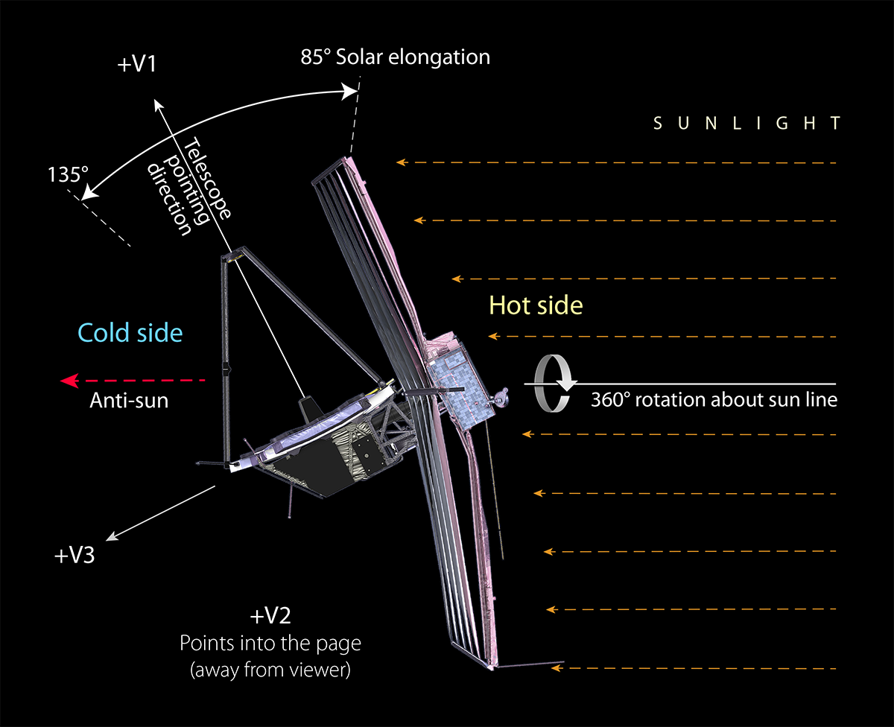
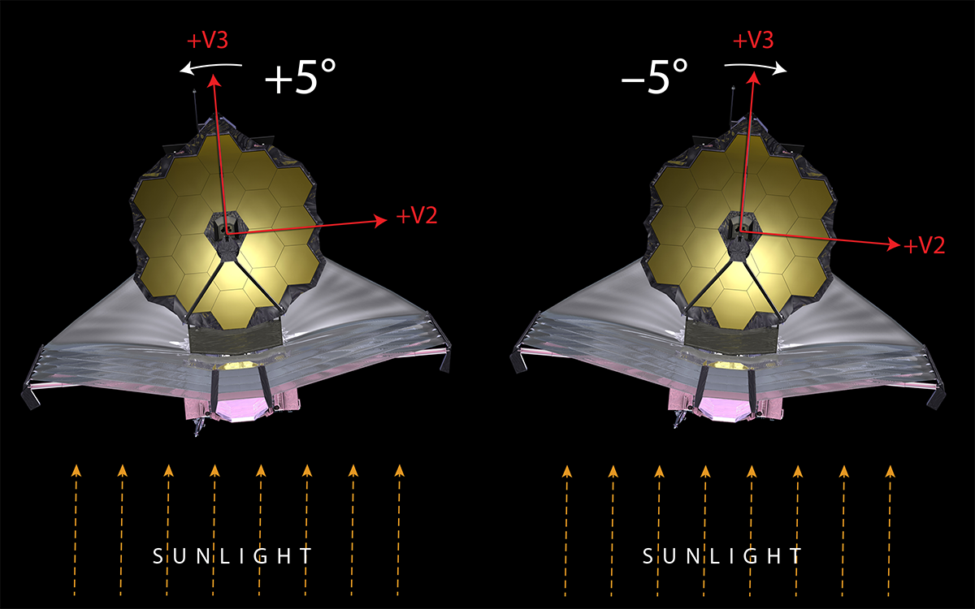
JWST Limited Tilt/Roll Capabilities
40 degrees of solar elongation
10 degrees of field rotation
The V3 axis is the relevant vector for science planning.

Slide 21
JWST Field of Regard (FOR)
FOR is the region of the sky where scientific observations can be conducted safely at a given time.
FOR is a large torus on the sky that moves roughly 1° per day in ecliptic longitude.
Over time, this annulus sweeps over the entire celestial sphere.
Observe about 39% of the full sky on any given day and can access 100% of the sky over 6 months.

Slide 22
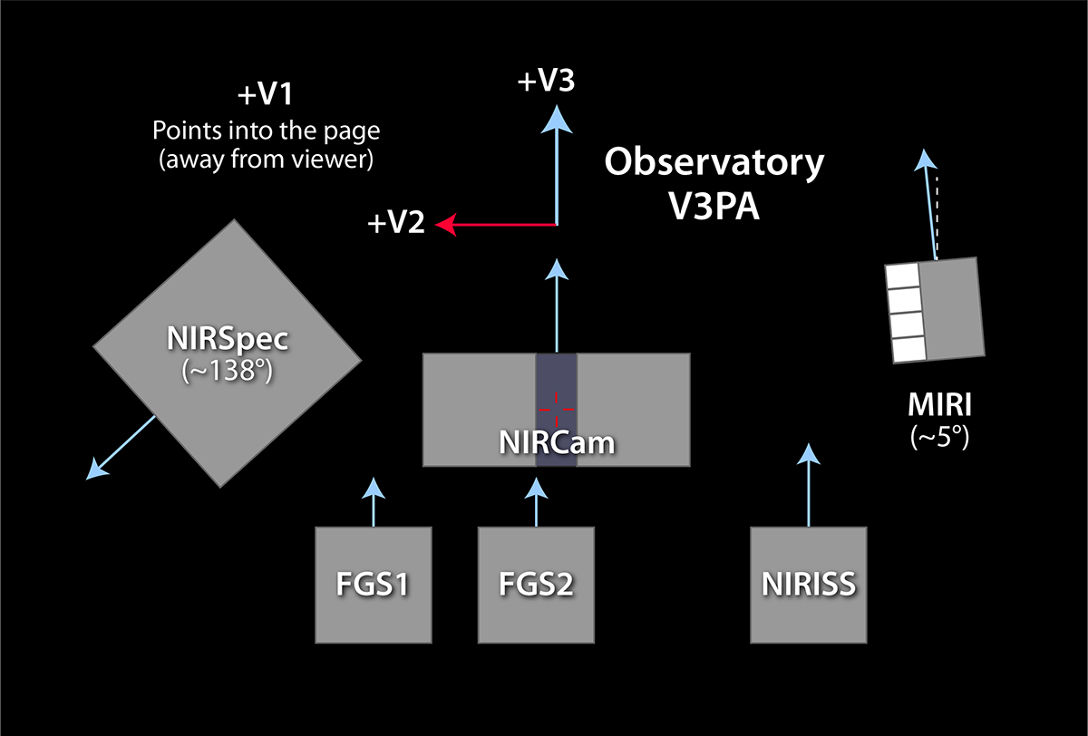
JWST Coordinates and Position Angles
Celestial Declination
Celestial Right Ascension

Slide 23
JWST Coordinates and Position Angles
Celestial Declination
Celestial Right Ascension

Slide 24
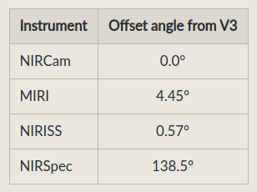
JWST Coordinates and Position Angles
Celestial Declination
Definitions
Aperture PA (APA)
🡪 Each instrument PA
V3 PA
🡪 Observatory PA
Celestial Right Ascension

Slide 25
When do you need to constrain the V3 Position Angle?
Imposing a PA constraint narrows your scheduling window. Here are a few cases where you need to constraint PA anyway:
NIRISS TSO - some PA cause too much field contamination (verify with the contamination tools in Pandexo or on the UdeM page under SOSS contamination)
NIRSpec MOS - optimizing slitlets selection requires to fix PA.
Mosaicking in imaging modes - constraining the PA enables to fix the orientation of each mosaic tile
Coronagraphy - giving PA ranges is important to prevent target companions from being occulted by masks or quarter phase edges.

Slide 26
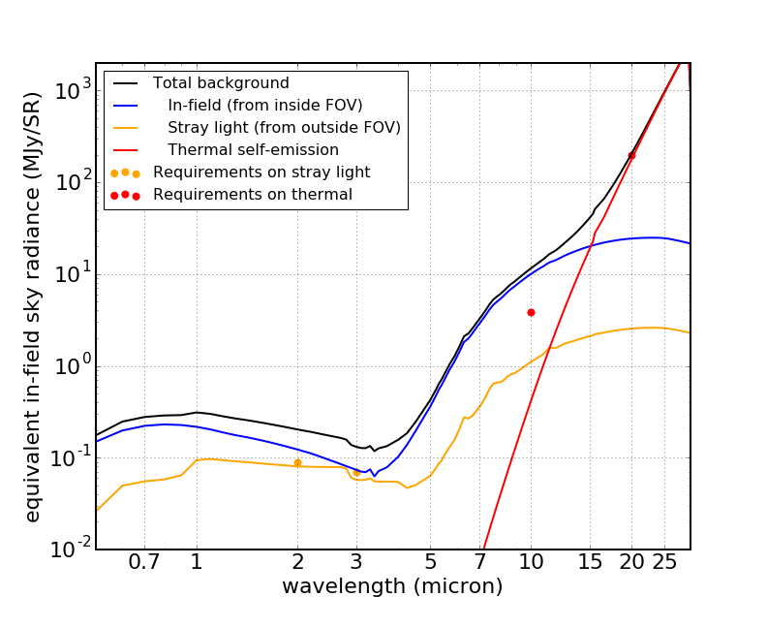
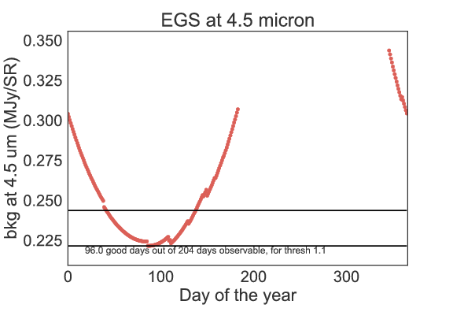
Sky Background
Zodiacal light is both dependent on date and ecliptic latitude.
Red = thermal light
Blue = zodiacal light

Slide 27
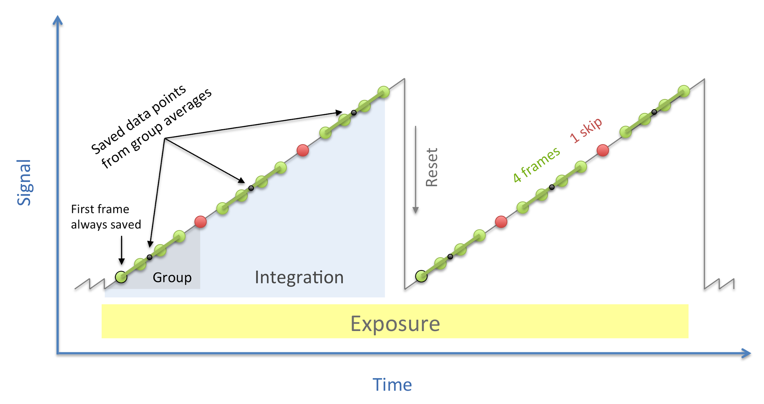
Detector Readout Schemes and Exposure Time
None of the instrument has a shutter - integration time is set by how fast an image (a frame) is read out.
IR detector pixels are read non-destructively (charges accumulate)
Up-the-Ramp Readout
Frame = one complete read of the detector or subarray
Group = a set of consecutive frames that are averaged (some may be skipped)
Integration = one non-destructive ramp
Exposure = a set of consecutive integrations at the same pointing
*** What is saved in a single FITS file is an Exposure

Slide 28
Detector Readout Schemes and Exposure Time
The flux in processed data is a linear fit to the flux vs. time
SNR improves with the number of frames read out and fitted
Strategy to set Ngroups:
Bright targets
Photon-noise limited. Watch for saturation (they will limit Ngroups).
Faint targets
Readout-noise limited.
Try maximizing Ngroups per integration.
With a limit of ~1500 sec (NIRSpec), ~1000 sec (MIRI) and ~900-1800 sec for NIRCam and NIRISS.
Cosmic ray hits will compromise longer integrations.

Slide 29
JWST Interactive Sensitivity Tool (JIST)
https://jist.stsci.edu/jist
JIST allows you to explore signal-to-noise values in real time by adjusting source flux density or telescope exposure time.
JIST uses a pre-computed grid of simple point-source calculations made with the ETC engine.

Slide 30
Call for Proposals and Policies

Slide 31
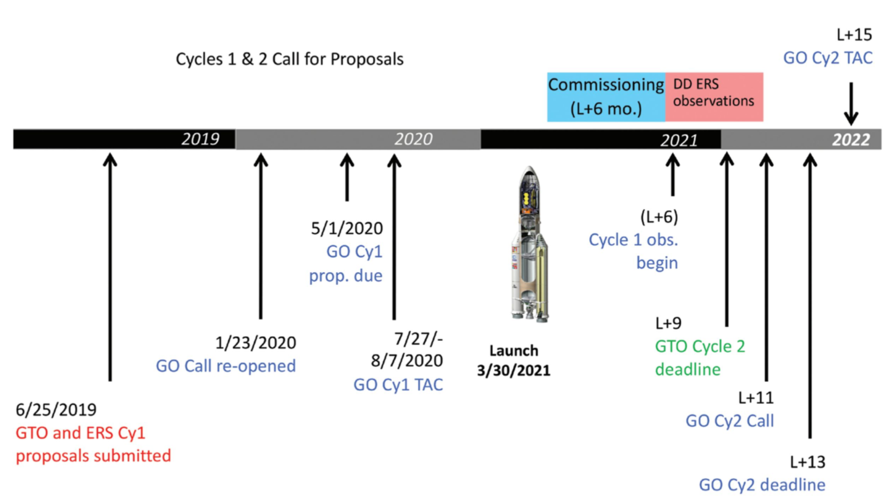
Timeline
NOW

Slide 32
Cycle 1 Call for Proposals
Anticipate receiving ~1000 – 1600 proposals.
Awarding ~300 proposals after TAC and Panel review.
~6000 hours of observing time.
Includes ~2000 hours of oversubscription to maximize observing efficiency.
Overflow will be observed in Cycle 2.

Slide 33
GO Proposal Categories
Also, there is an "Archival Proposal" category (to obtain funding to analyze existing data).
The Canadian Space Agency should announce financial support for accepted proposals.

Slide 34
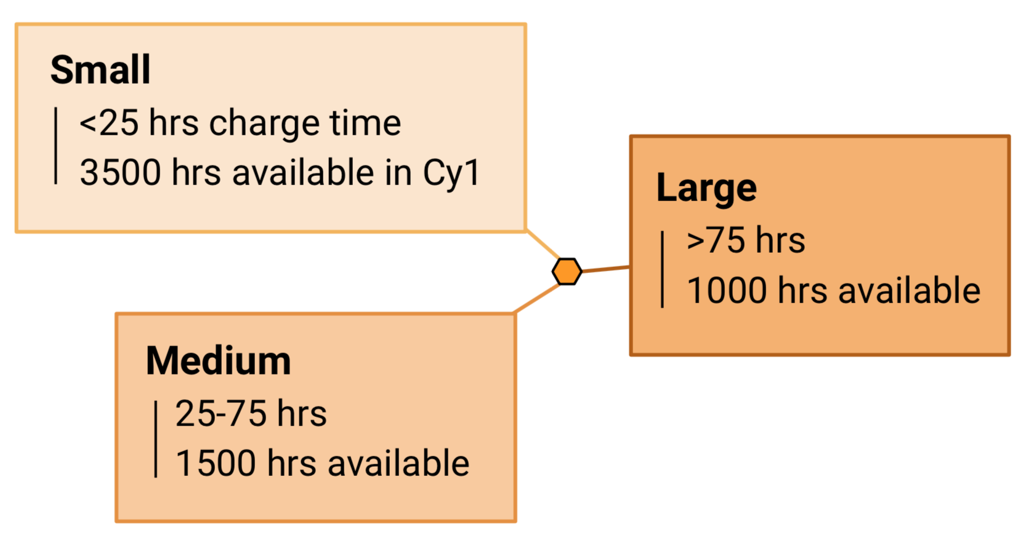
Proposal Size
>140
programs
<10
programs
20-60
programs
Reviewed by topical panel
Reviewed by TAC Chairs panel

Slide 35
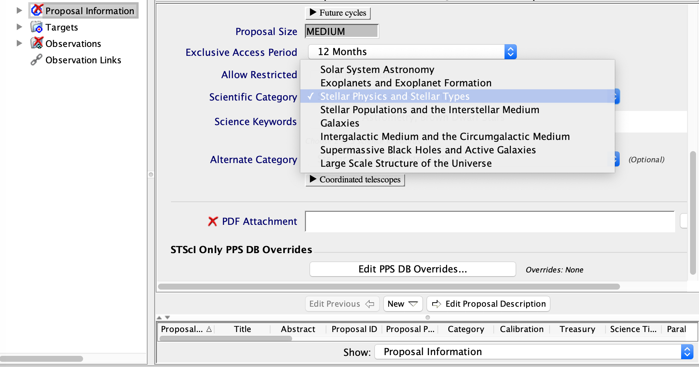
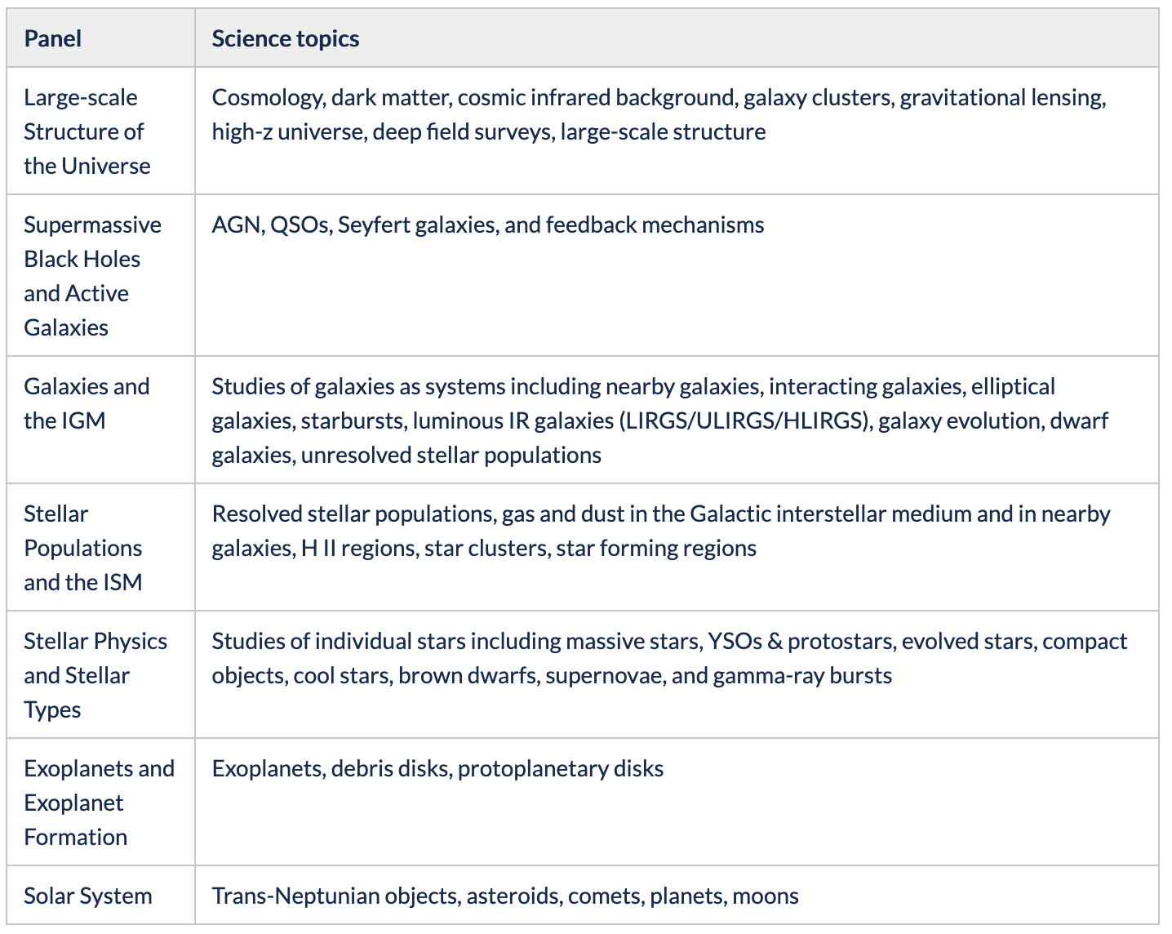
Topical Panels
Reviewers within each topical panel are chosen according to science keywords in APT

Slide 36
Proposal Review Process
TAC review will span 2 weeks (Jul 27-Aug 7, 2020)
Week 1 - Galactic, week 2 – Extragalactic
Each topical panel will meet Monday – mid-Wednesday to review SMALL, MEDIUM and ARCHIVAL – You need to write your proposal to have a broad appeal to all in that panel.
Panel chairs (solar system to cosmology) will review Large, Treasury, and AR Legacy proposals mid-Wednesday through Friday.
After acceptance proposals will require a technical review. Most reviews will take place in late-2020 to prepare the Cycle 1 Long Range Plan

Slide 37
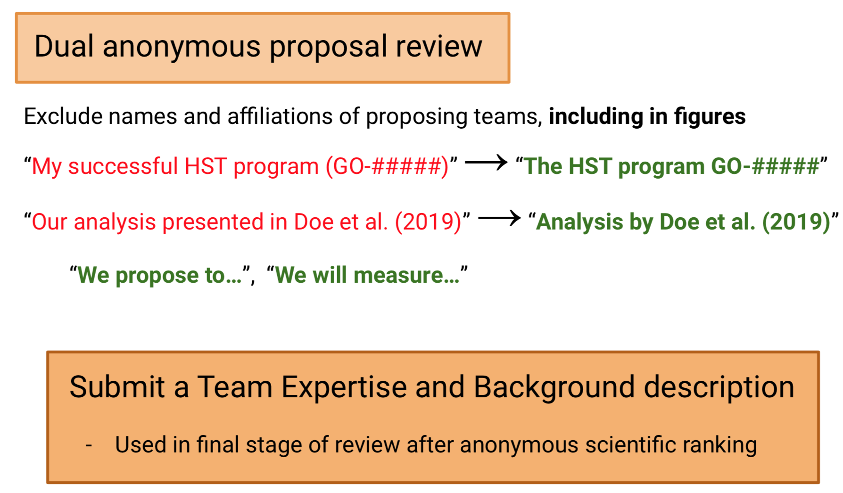

Slide 38
Dual Anonymous (cont'd)
Review based on scientific merit only, not on people.
Levelers are present in each room to help ensure guidelines are respected.
TAC review proposals without seeing author names nor Team expertise section.
After ranking, those are revealed and only under exceptional circumstances can the proposal be then downgraded.
For details, in the Jdox search box, enter jwst-cycle-1-anonymous-proposal-review

Slide 39
Check for Duplication
Can not observe the same target or field as GTO/ERS with the same instrument + mode + filter within a factor of 4 in integration time.
Checking is the responsibility of the PI.
Details here: https://jwst-docs.stsci.edu/jwst-duplication-checking
Duplication can be checked in MAST archive. See example slides. https://mast.stsci.edu/portal/Mashup/Clients/Mast/Portal.html

Slide 40
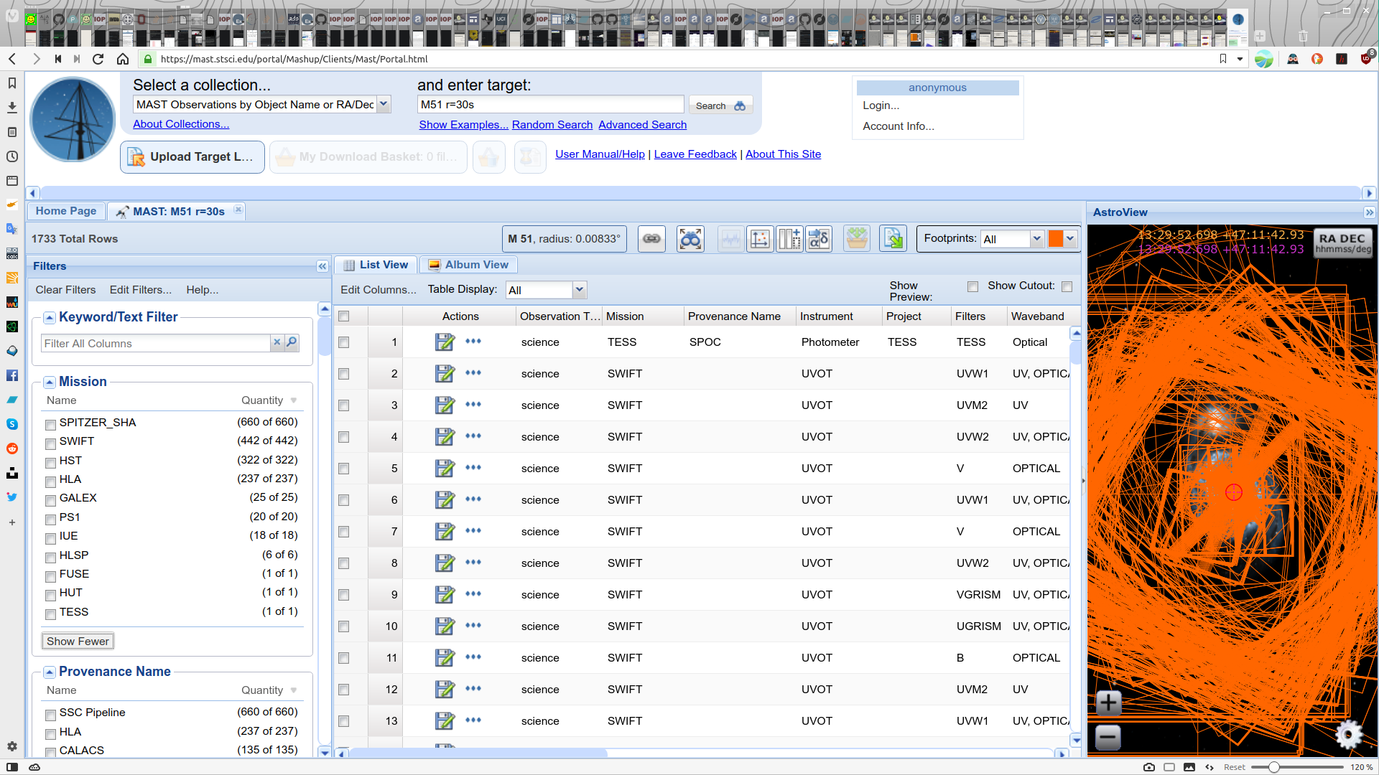

Slide 41
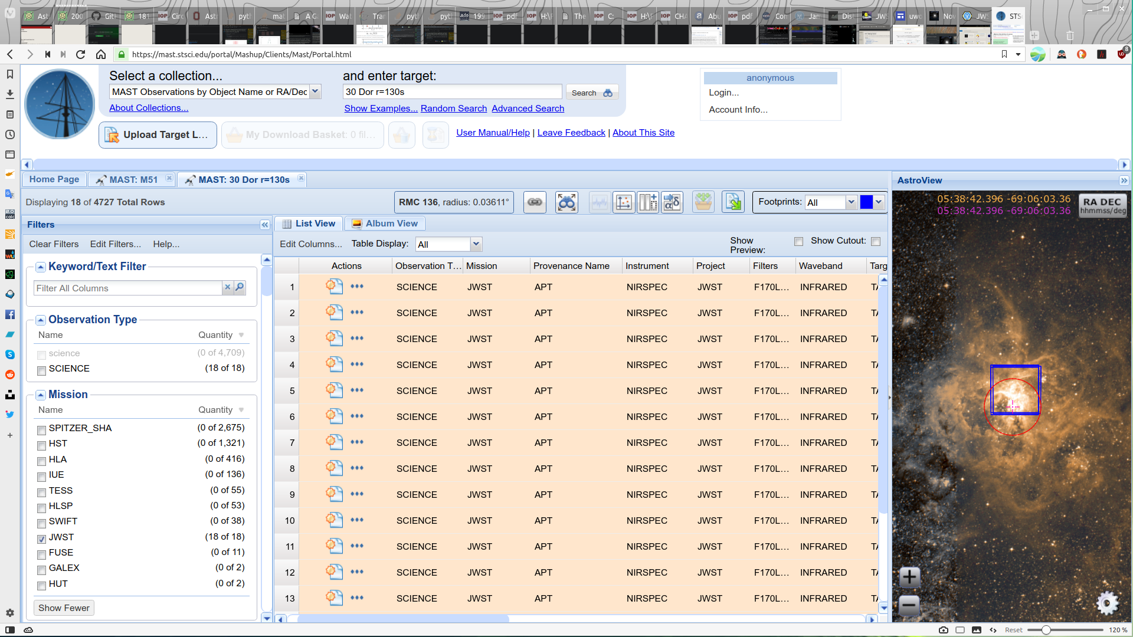

Slide 42
Tips from Antonella Nota
Associate Director of ESA at STScI, who has participated in such TAC panels:
JWST Proposals are complex - start early (now!)
Get familiar with the documentation (Jdox, CfP guidelines).
Comply with dual anonymous guidelines.
Make it easy for the reviewers to review.
Write your proposal for astronomers but not necessarily experts in your field.
Notes:
Start early → Start now!

Slide 43
Additional (non exhaustive) tips for your proposal
Technical Justification
Do you have any special requirement in the APT? If so justify why.
Is there any remaining warning in the APT? If so, justify.
Why can’t you do the same science from the ground or with another observatory?
Why in Cycle 1?
Why use this instrument and mode rather than another one?
How are you impacted if Cycle 1 starts later? Preemptively describe mitigation in that case.
Is there duplication with existing GTO ERS observations? Actually mention that in the science justification.
Science Justification
Do’s
State what you are doing in the first paragraph.
Watch anonymity!
Give proper credit for discoveries or ideas
Proof read! (give time for another set of eyes to read proposal)
Make sure there’s a “big picture” explanation (better at start)
Include enough information in figure captions, and watch layout
Close with a summary section/paragraph
Don’t
Don’t Use abbreviations without explanation
Don’t throw shade on colleagues or projects
Don’t go too deep in the details of your own field

Slide 44
Afternoon Session
TSO
Long-SLit Spectroscopy
IFU
Individual Exercises + Q/A

Slide 45
Time Series Observations

Slide 46
Available Instruments for TSO
NIRSpec BOTS: Uses the 1.6’’x1.6’’ square aperture (S1600A1, R~100-2700)
NIRISS SOSS (R~700)
MIRI Slitless LRS (<12 μm, R~100)
NIRCAM Grism time series (R~1500) & imaging time series
Main TSO characteristics:
Very long exposures (>10000s)
Staring on target (no nodding/dithering) for stability
Subarrays
Fast readout modes

Slide 47
NIRISS SOSS
Two spectral orders:
1st: 0.8-2.8 um - R=650
2nd: 0.6-1.4 um - R=1300)
Defocused over 22 pixels along spatial direction
3 image sizes: 256x2048, 96x2048, 2048x2048
Some orders overlap can be mitigated using F277W observation
Typical strategy:
Target Acquisition
Long single-exposure sequence with GR700XD
Optional (but recommended) F277W short exposure

Slide 48
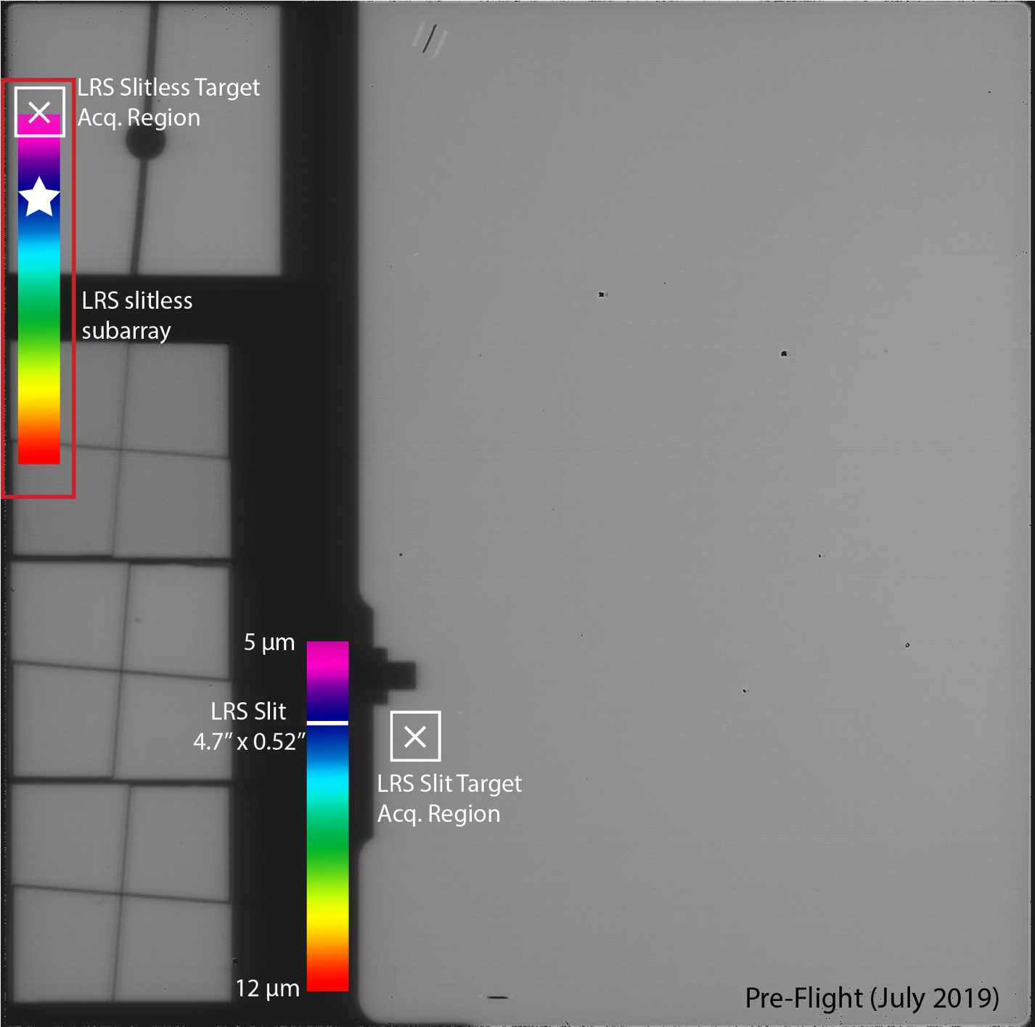
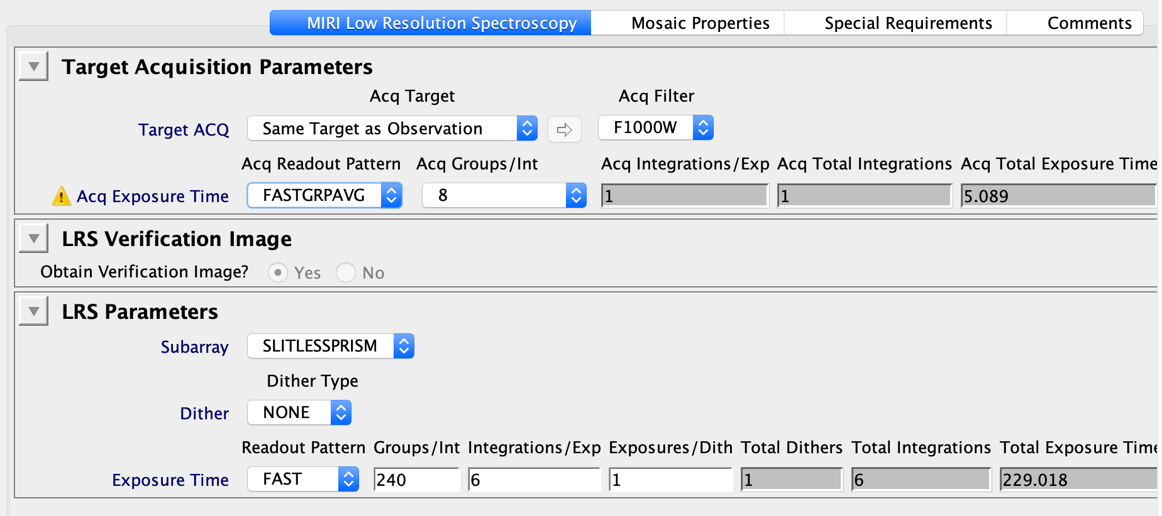
MIRI LRS
Slitless prism
R=40-200
5-12 microns
Requires Target acquisition
In APT, selected by choosing subarray = SLITLESSPRISM

Slide 49
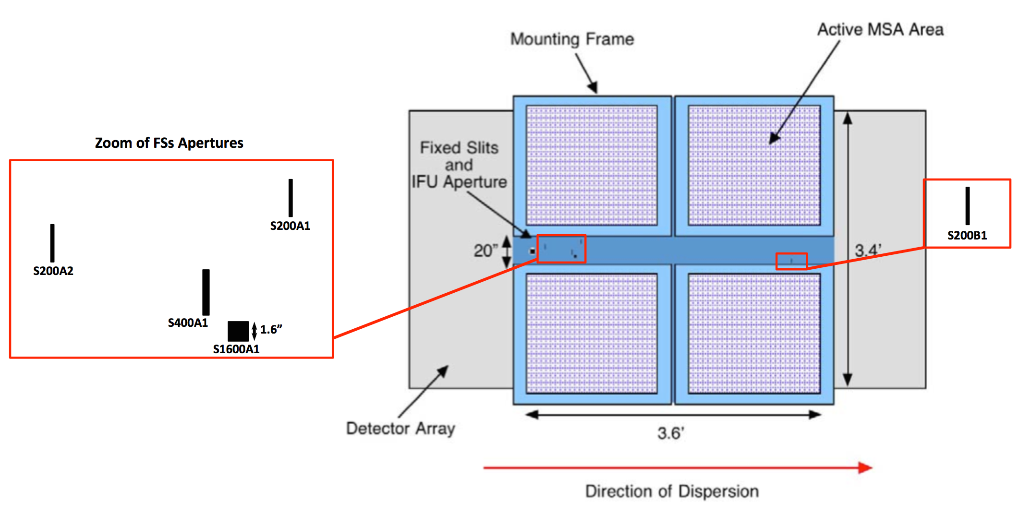
NIRSpec BOTS
Bright Objects Time Series
Uses a S1600A1 aperture (1.6” square) with prism or grating
Requires WATA target acquisition
Can be used with different subarrays for saturation constraints
Prism has a trace length of ~500 pixels, R<150
Gratings cover 0.6-5.0 um in 3 ranges at R~1000, R~2500

Slide 50
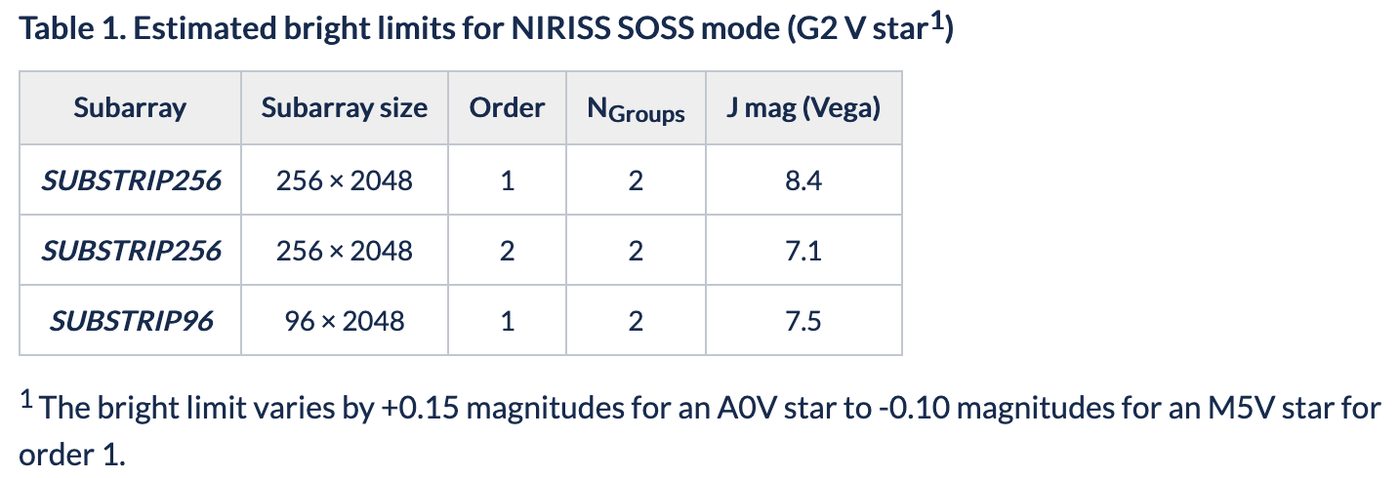
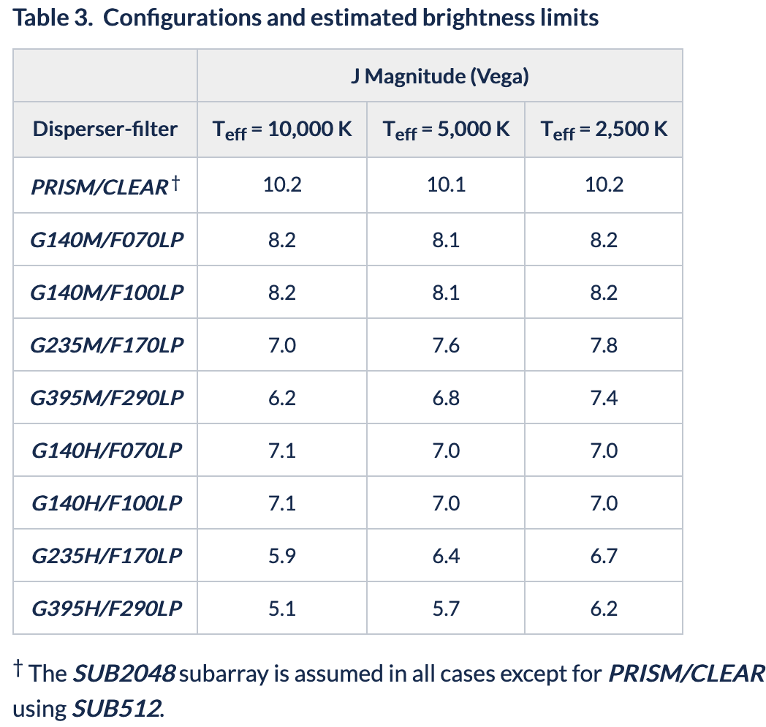
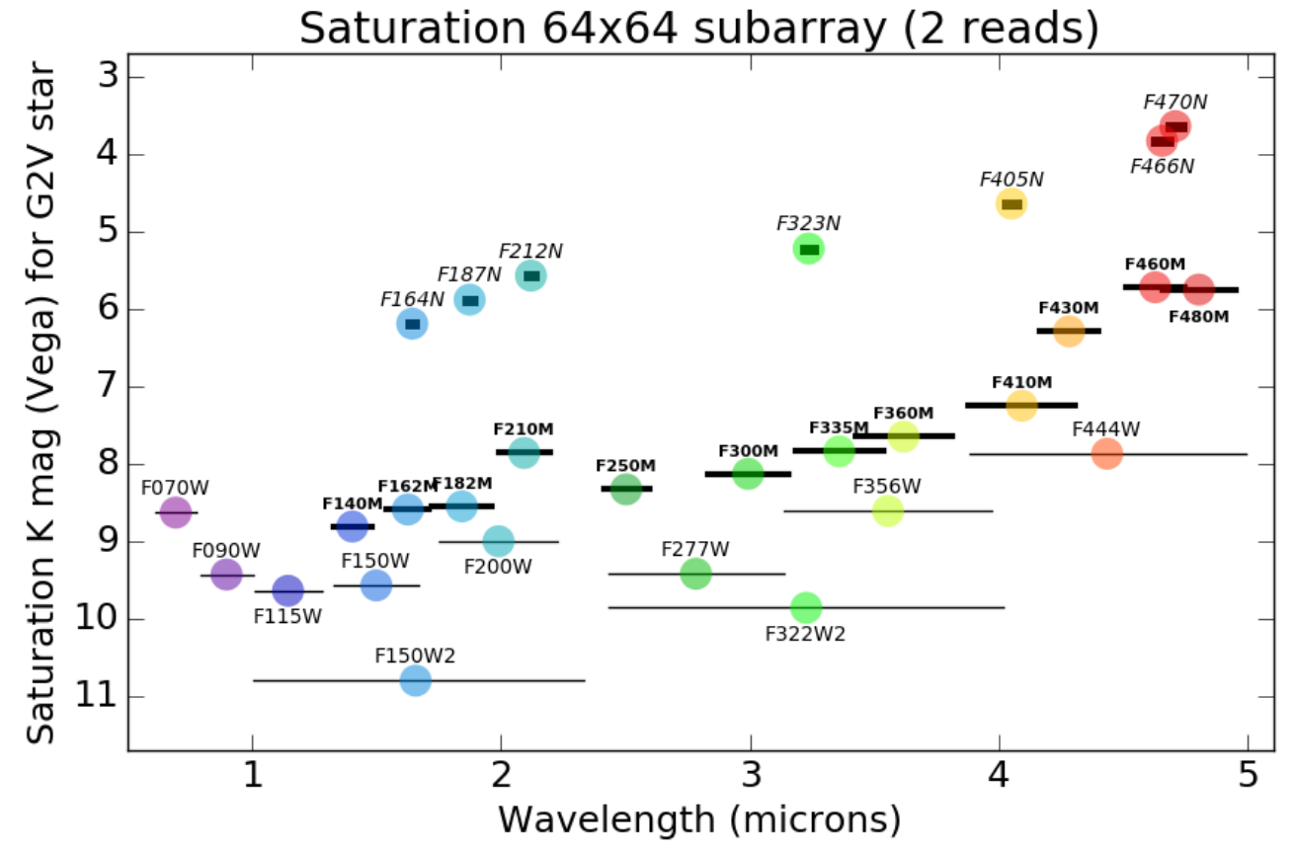
Saturation Limiting Magnitudes
NIRISS/SOSS
NIRSpec BOTS
NIRCam/Imaging

Slide 51
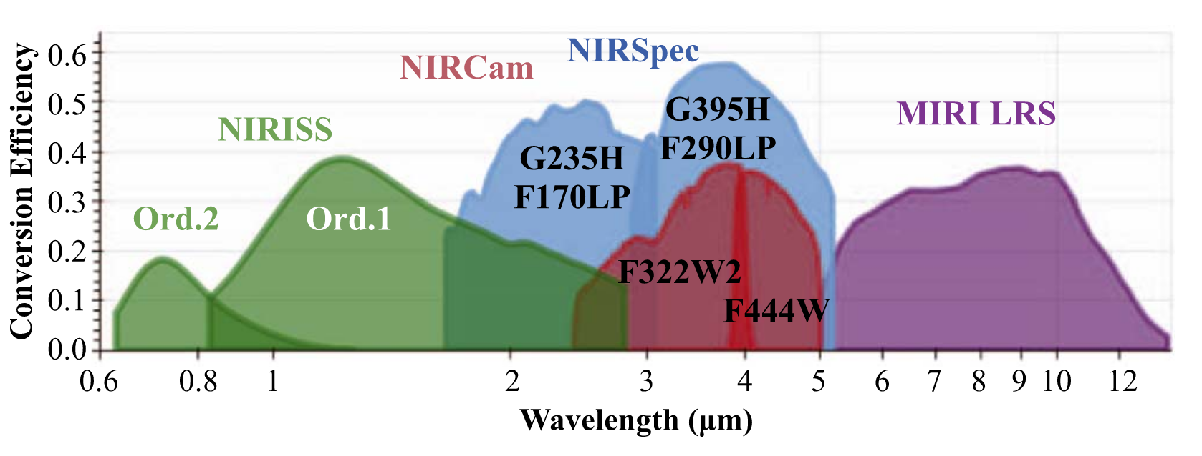
Relative Merit of TSO modes
Bean et al. 2018

Slide 52
Stabilization and Baseline
Out of transit baseline is important for SNR considerations. Default should be a ratio of one-for-one.
For Cycle 1, we advocate an additional stabilization time of 30 minutes.
Plus add padding on the left to not incur the 1h Direct Scheduling Overhead when timing constraint is <1h.

Slide 53
Target Acquisition
Mandatory for all SOS modes
Specific TA modes in ETC
NIRSpec (20mas centroid accuracy):
WATA via the S1600A1 aperture (recommended without PA constraint)
NIRISS:
SOSSBRIGHT for objects with M<6.1mag
SOSSFAINT otherwise
NIRCAM: 1 option with any filter
MIRI: 1 option with 3 filters + 1 ND

Slide 54
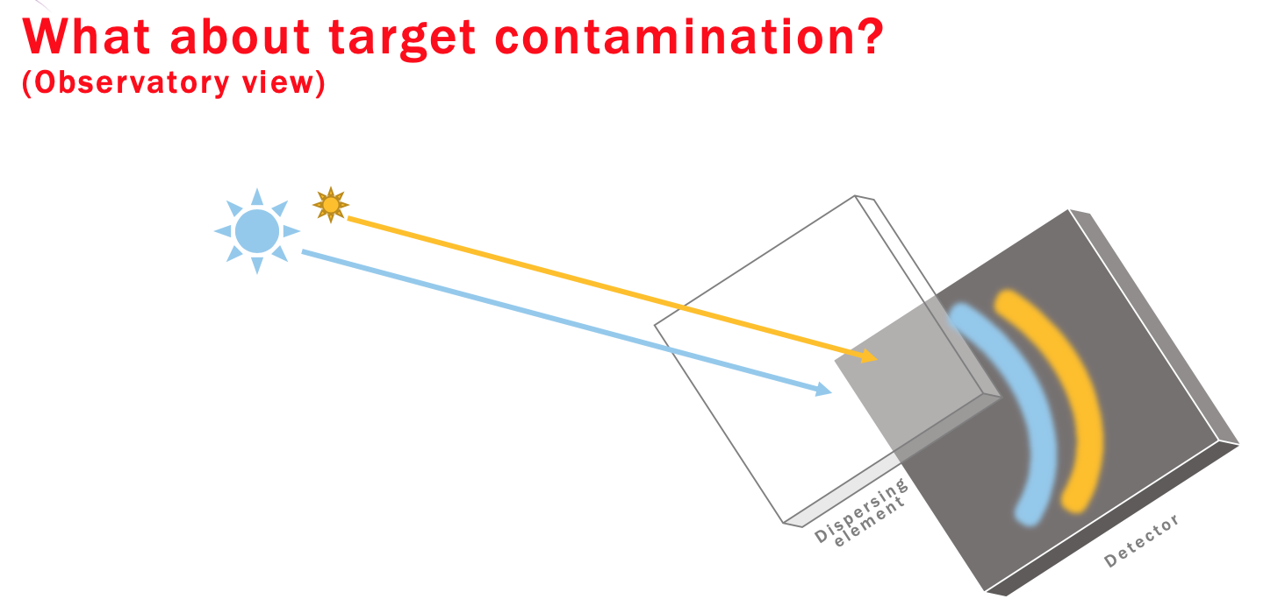
Field Contamination (Slitless)

Slide 55
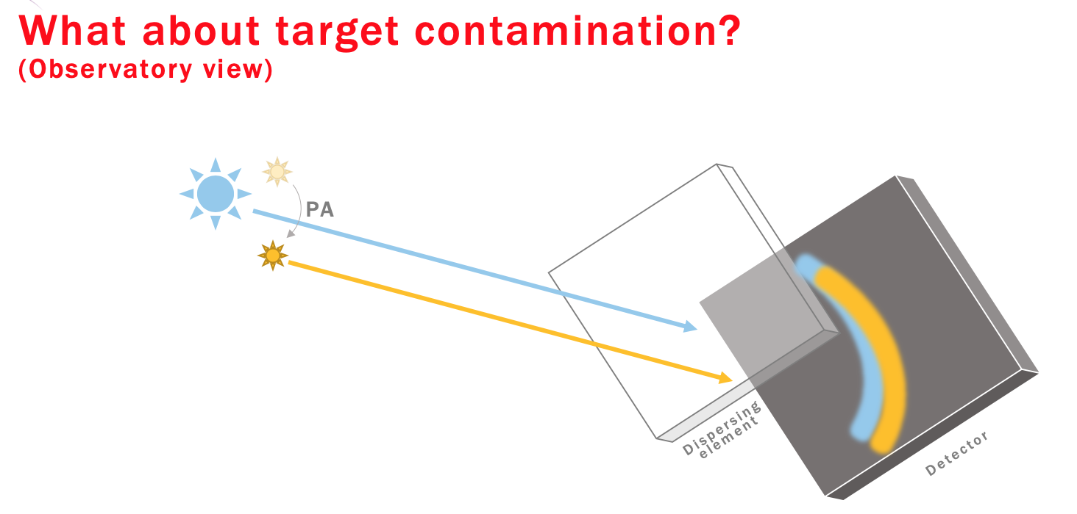
Field Contamination (Slitless)

Slide 56
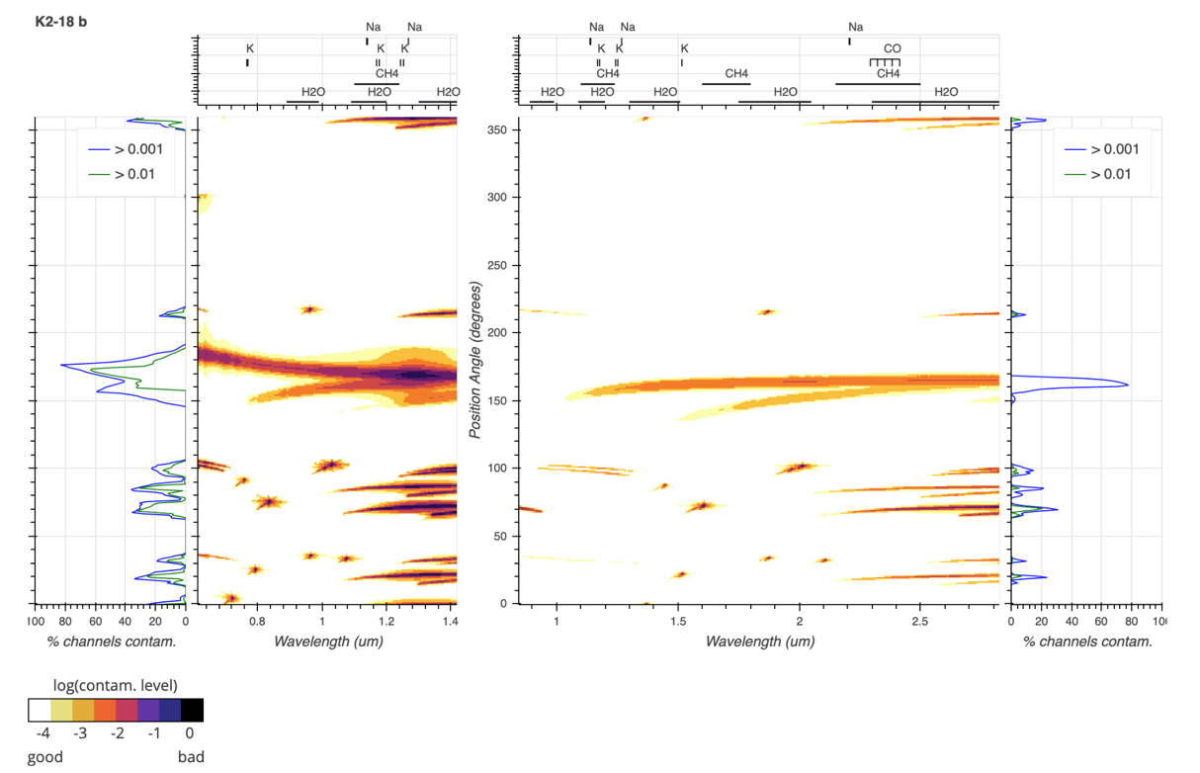
Field Contamination (Slitless)
Contamination tool available:
UdeM (http://maestria.astro.umontreal.ca/niriss/SOSS_cont/SOSScontam.php)

Slide 57
Special Requirements
PA constraints due to field contamination (NIRISS SOSS, MIRI LRS)
Timing constraints due to eclipse/transit event coordination
Direct Scheduling Overhead penalty of 1h if a scheduling constraint < 1h is needed. To bypass, set a looser time constraint but extend observation duration.

Slide 58
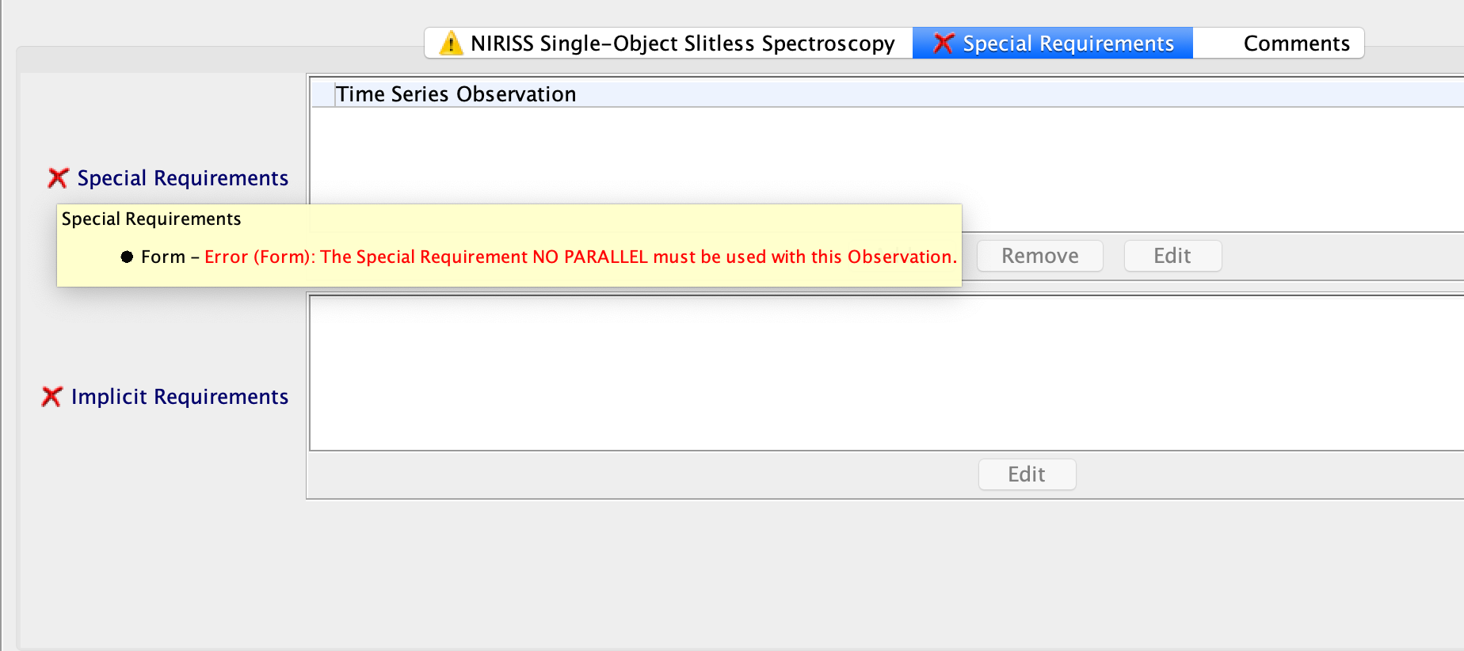
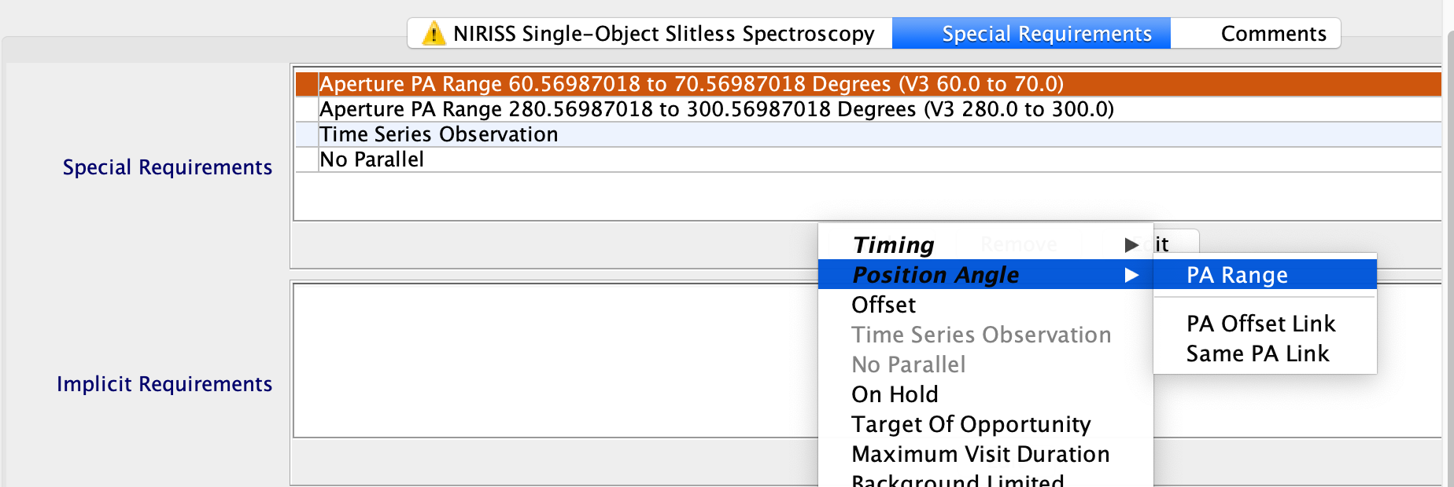
Special requirements - Position Angle

Slide 59
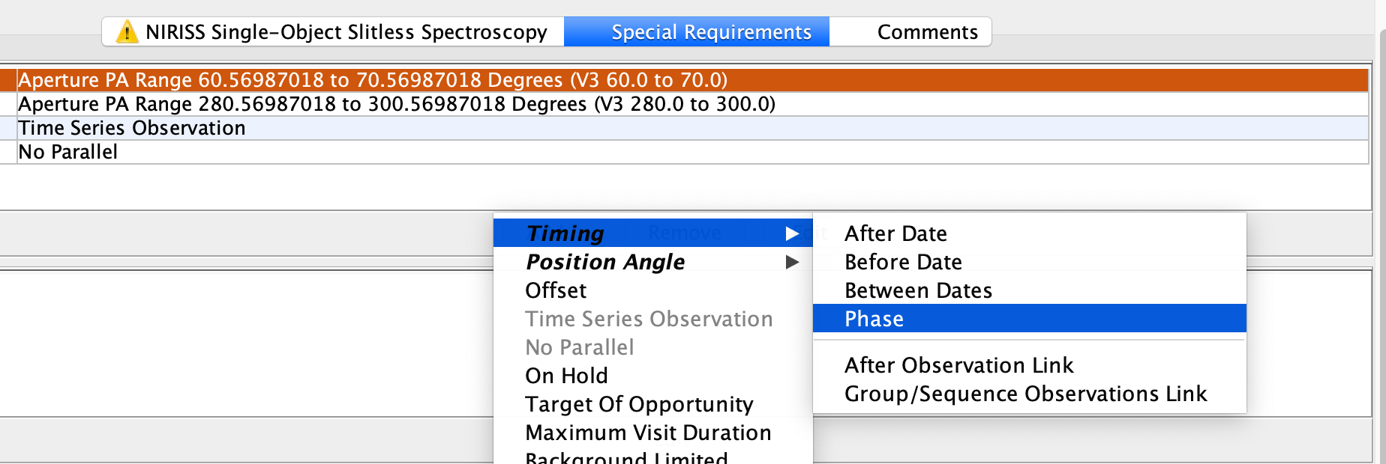
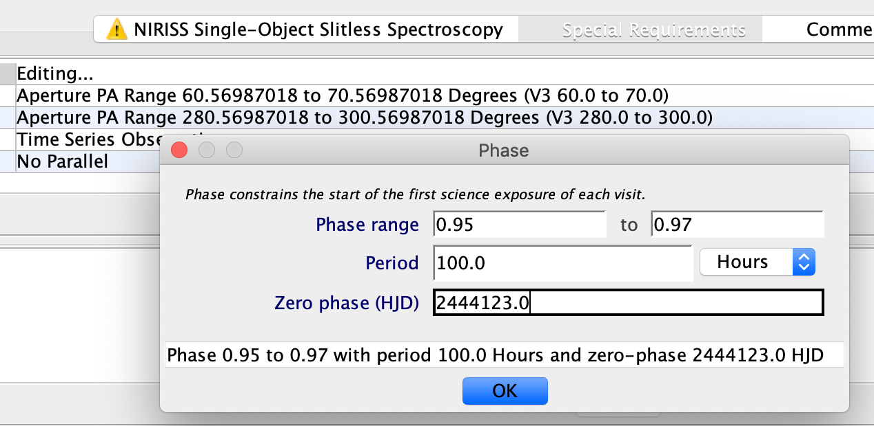
Special requirements - Phase Timing
Select phase relative to the event you want.
It is the phase at the start of the science exposure.
Here a slack of 3h is given so no Direct Scheduling Overhead charged.

Slide 60
Special requirements - Phase Timing
If the phase 0.965 to 0.97 for a period of 100h had been given, then...

Slide 61
Roadmap
Instrument selection based on wavelength + saturation limits
PandExo: planet atmosphere + star simulation, field contamination
ETC: Target Acquisition + Science Observation
APT

Slide 62
Simulations with PandExo
Quick Demo of PandExo
(https://exoctk.stsci.edu/pandexo/calculation/new)

Slide 63
TSO Exercise
Exercise is to go through the WASP-79b example found on Jdox:
https://jwst-docs.stsci.edu/near-infrared-spectrograph/nirspec-example-science-programs/nirspec-bots-observations-of-wasp-79b

Slide 64
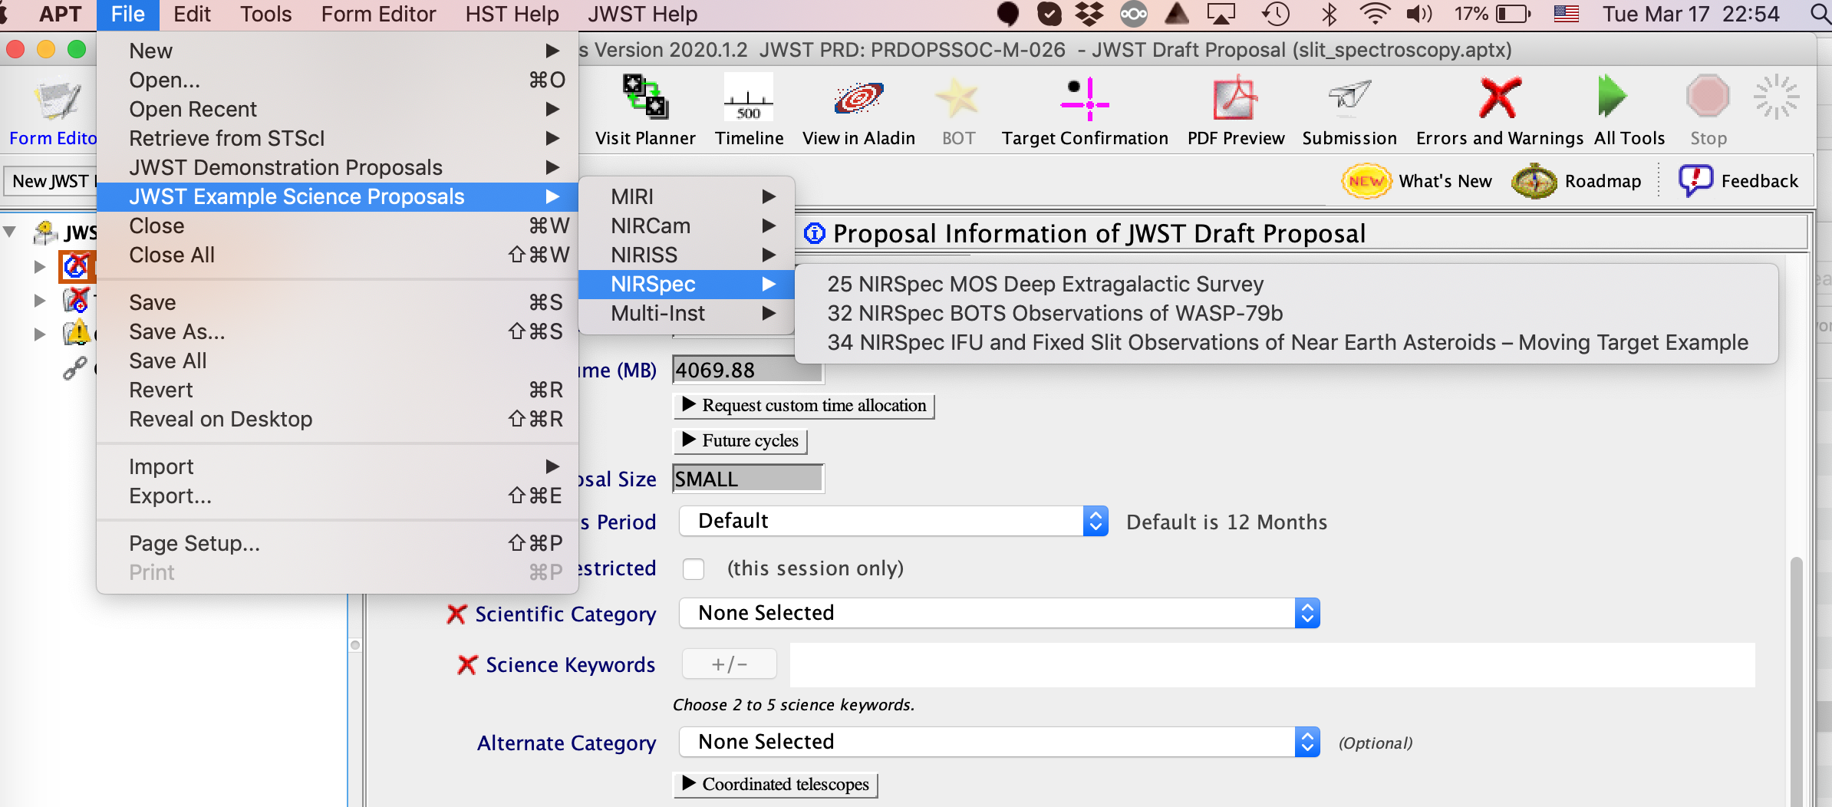
TSO Exercise - Answers

Slide 65
Exercises for IFU and Long-Slit Spectroscopy are here:
http://www.astro.umontreal.ca/~albert/JWST_UdeM_exercises.zip

Slide 66
JWST Slit Spectroscopy

Slide 67
NIRSpec FS Overview
NIRSpec Fixed Slit Spectroscopy
Wavelength coverage from 0.6 to 5.3 μm.
Low resolving power R=100, full wavelength coverage.
Medium resolving power R=1,000 across 4 filters.
High resolving power R=2,700 across 4 filters.
4 primary + 1 back-up slit available.
Each slit has a dedicated subarray + subarray for all slits.
Dithering primary dithers along the slit + subpixel dithers.
Note: At high resolving power there is a gap in the wavelength coverage due to the detector gap. Use the S200A1 and S200A2 option in APT to recover wavelength gaps for 0.2" slits.

Slide 68
NIRSpec Slit Locations

Slide 69
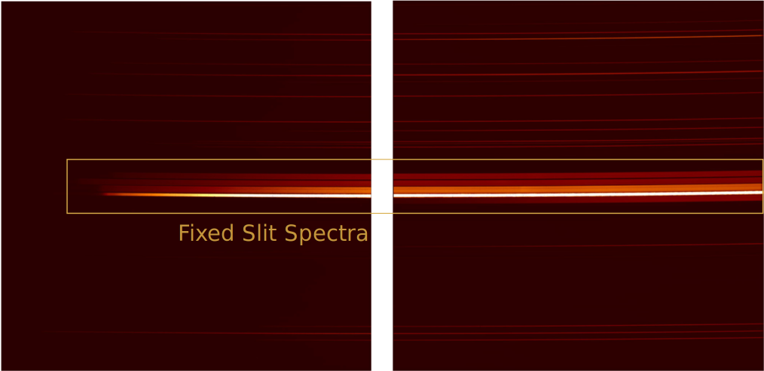
NIRSpec FS Observation

Slide 70
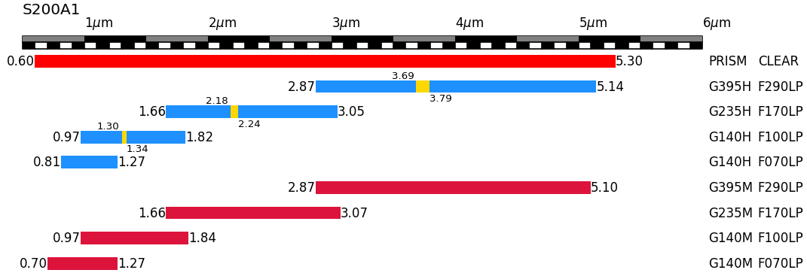
NIRSpec FS Wavelengths

Slide 71
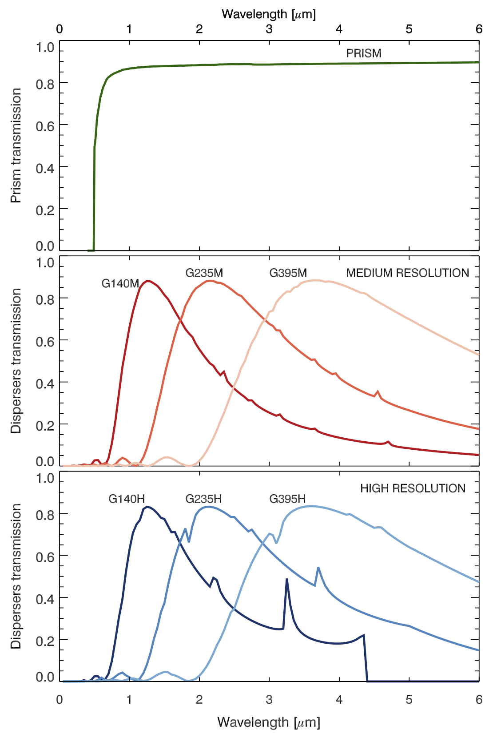
NIRSpec FS Throughput

Slide 72
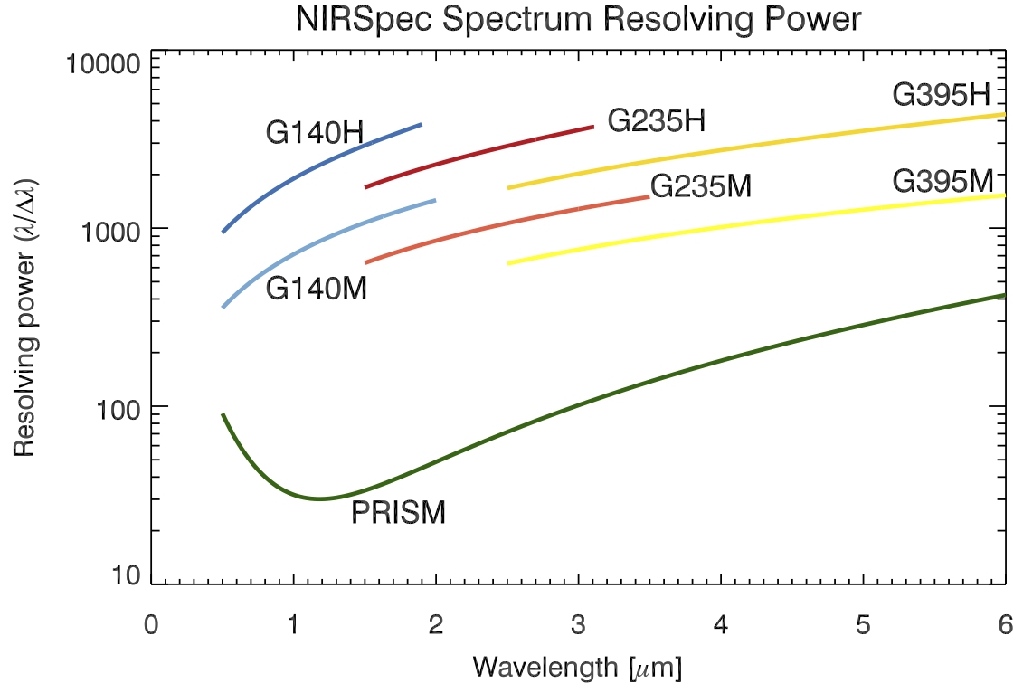
NIRSpec FS Resolving Power

Slide 73
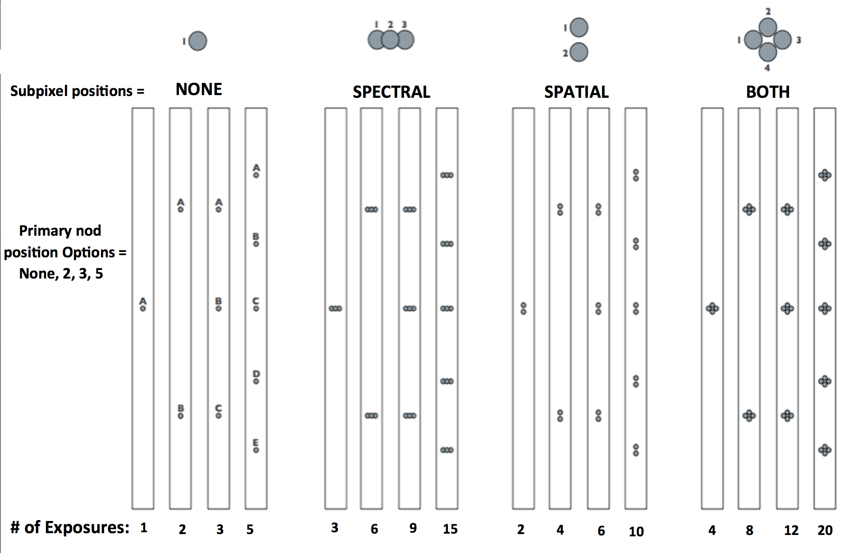
NIRSpec Dither Patterns

Slide 74
NIRSpec Strategies
Recommended Strategies & Limitations:
For subarrays only the NRS and NRSRAPID readout modes are available. NRSRAPID is preferred unless data volume becomes an issue.
The maximum recommended integration length is 1,500 s. Integrations longer than 3,000 s are strongly discouraged because of cosmic ray contamination.
Target Acquisition should normally be performed.
The S1600A1 aperture is optimized for TSO observations and has additional subarrays to observe brighter targets.
Exposures must be < 10,000 s.
Note: Decision trees are available on the NIRSpec recommended strategies pages for readout modes, subarray choice and dithering.

Slide 75
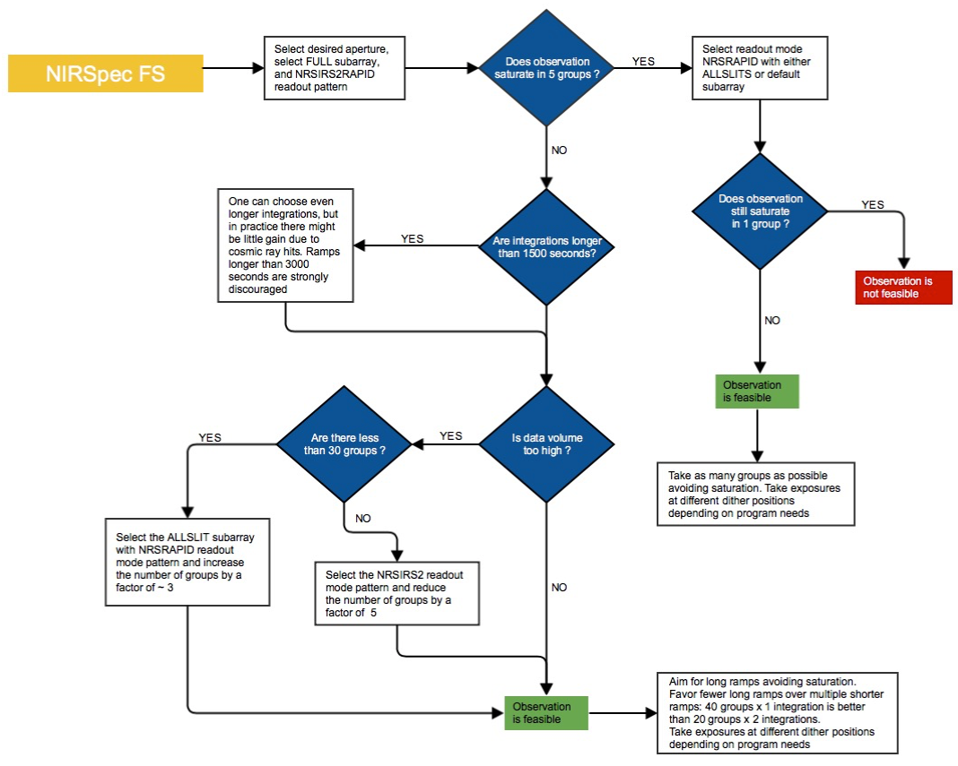
Decision Tree
https://jwst-docs.stsci.edu/near-infrared-spectrograph/nirspec-observing-strategies/nirspec-detector-recommended-strategies

Slide 76
MIRI LRS
MIRI LRS Slit Spectroscopy
Wavelength coverage from 5 to 12 μm.
Resolving power R=100 at 7.5 μm, variable ~40-200.
Slit size 0.5"x4.7".
Dithering ALONG SLIT NOD or MAPPING.
Also available in slitless mode.
Note: In APT slit/slitless is selected through the chosen subarray:
With slit = FULL subarray.
Without slit = SLITLESSPRISM subarray.
Notes:
Mention higher resolving power available with the MRS R=1,500-3500.

Slide 77
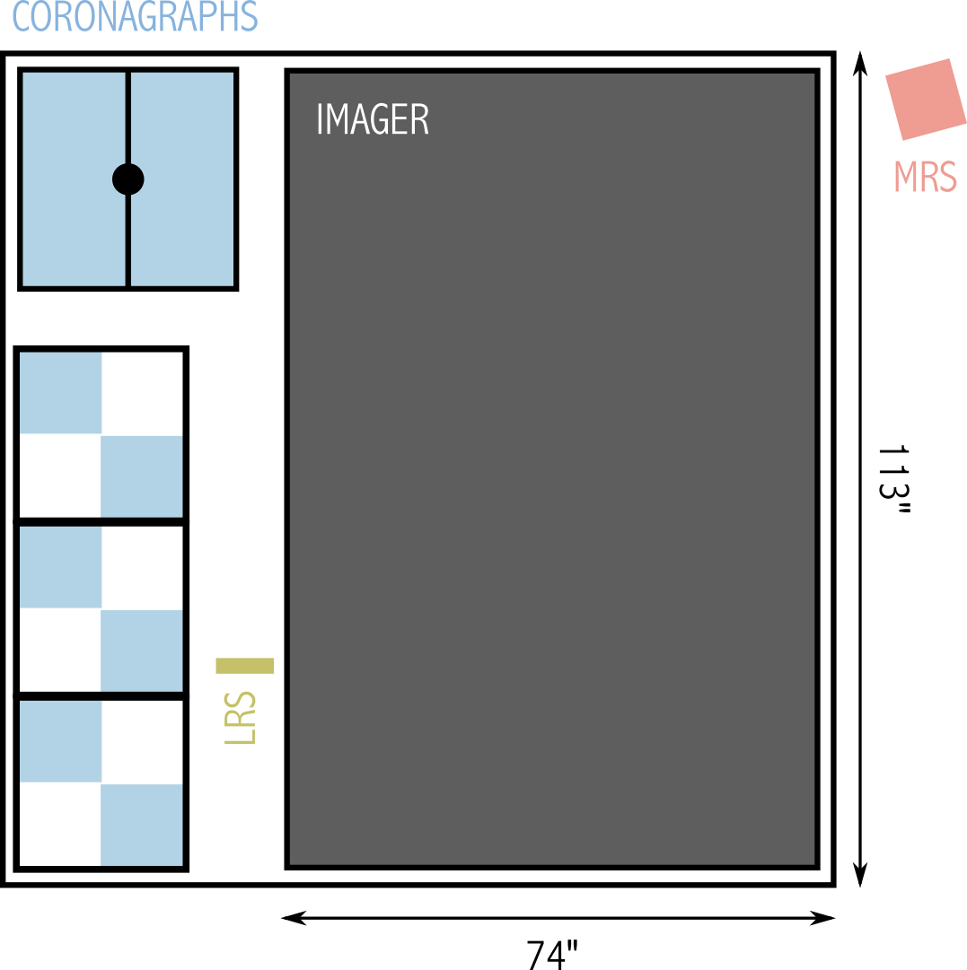
MIRI LRS

Slide 78
MIRI LRS Dither Patterns
Along Slit Nod - Primary pointing + 2 pointings at 30% and 70%.
Mapping - User defined steps along the spatial and spectral directions for covering an extended source.

Slide 79
MIRI LRS
Recommended Strategies & Limitations:
FAST readout mode is preferred unless data volume becomes a concern.
Dithering should be performed, for extended sources use the MAPPING option.
TA is highly recommended for point sources.
Background for point sources is one through nodding, for extended sources a dedicated background exposure should be included.
Exposures must be < 10,000 s.

Slide 80
Integral Field Units/Spectroscopy

Slide 81
Integral Field Spectroscopy with JWST
NIRSpec
Integral Field Unit (IFU)
MIRI
Medium Resolution Integral Field Unit (MRS)

Slide 82
Image Slicing
NIRSpec IFU and MIRI use Slicers
Slices are dispersed in wavelength
Signal recorded on detector
Pipeline constructs cubes from slices
Image credit: N. Luetzgendorf

Slide 83
NIRSpec IFU
Detector
MSA+IFU

Slide 84
NIRSpec IFU Wavelength Coverage
Gratings
High resolution:
G140H, G235H, G395H
Medium resolution:
G140M, G235M, G395M
Low resolution:
PRISM
Filters paired with gratings
e.g. F170LP/G235H

Slide 85
MIRI Medium Resolution Spectroscopy (MRS)

Slide 86
MIRI MRS Wavelength Coverage
Wavelength sub-bands
Short: 1A, 2A, 3A, 4A
Medium: 1B, 2B, 3B, 4B
Long: 1C, 2C, 3C, 4C
Need 3 exposures to cover all 3 sub-bands

Slide 87
MIRI MRS Wavelength Coverage
Wavelength sub-bands
Short: 1A, 2A, 3A, 4A
Medium: 1B, 2B, 3B, 4B
Long: 1C, 2C, 3C, 4C
Need 3 exposures to cover all 3 sub-bands
For each exposure have to choose between short/medium/long
Select a primary channel but get all channels (1 - 4)

Slide 88
NIRSpec IFU Target Acquisition

Slide 89
NIRSpec IFU Target Acquisition

Slide 90
MIRI MRS Target Acquisition

Slide 91
NIRSpec IFU Dithers
Nod = large offset for point/small source separation (used by pipeline to subtract background)
2-point nod
4-point nod
Dither = small offset for detector defect mitigation
4-point dither
Cycling = for psf and detector sampling
1 - 60 point pattern
Small, medium or large spacings

Slide 92
MIRI MRS Dithering
All MRS observations must be dithered
MIRI is a factor 2 spatially undersampled
Pattern determined by Primary channel selected and whether point or extended source selection in APT
If primary channel selected is Channel 4 dither will move source out of channel 1 FOV
Direction (positive or negative) rotates pattern 43 degrees for point source
2-point dither pattern
4-point dither pattern
4-point ALL preferred for point or extended sources

Slide 93
Mosaics and Target Groups
Mosaics
Small region
Overlap or no overlap
May be used for backgrounds
Target groups
Multiple, linked pointings
Stay within visit-splitting distance
Useful for offset backgrounds

Slide 94
Offset background observations
NIRSpec IFU
Not all observations require offset backgrounds. Check with ETC
Offset backgrounds suggested for faint extended targets
Use target groups or mosaics within visit-splitting distance to avoid variable background and non-repeatable grating settings
MIRI MRS
Most extended source observations require offset backgrounds. Check with ETC
Isolated point source observations may not require offset backgrounds

Slide 95
NIRSpec IFU Exposure Parameters
Readout:
ISR²
NRSIRS2 (5 frames per group) reduce data volume
NRSIRS2RAPID (1 frame per group) recommended
Traditional
NRS (4 frames per group)
NRSRAPID (1 frame per group) for bright sources
Groups per integration:
2 or more recommended for accurate calibration
Integrations:
< 1500 seconds recommended to mitigate cosmic rays
Exposures
Number must be the same for all detectors
No explicit limit on exposure time
Link: https://jwst-docs.stsci.edu/near-infrared-spectrograph/nirspec-observing-strategies/nirspec-detector-recommended-strategies

Slide 96
MIRI MRS Exposure Parameters
Readout:
SLOW mode
Fewer detector artifacts and slightly lower noise
Limits data rate when including NIRIM or parallels
FAST mode
Current default for MRS
Available for bright targets
May be advantageous for expected high cosmic ray rates
Groups
5 or more recommended for calibration
Integrations
1 integration recommended to maximize groups and best slope fitting
< 1000 seconds recommended (due to cosmic rays)
Exposures
Number must be the same for all detectors

Slide 97
NIRSpec Leakage
IFU observations may be affected by MSA light leaks
Stars in open MSA shutters or bright star print-through
Print-through from diffuse backgrounds (<3-10%)
Guidance on when leakcal observations are necessary
Depends on source vs spoiler signal
Print through important for stars > 500x brighter than target
Crowded stellar field
Bright structured background (e.g. nebulae)
Mitigation Strategies
Orient constraints
Dithering (at 4 or more points) to reject stellar leaks
Single Leakcal at one position to remove diffuse leakage
Full set of leakcals at every pointing is expensive (full or shorter exposure)

Slide 98
MIRI MRS Simultaneous Imaging
Default operation mode for the MRS, not a parallel imaging mode!
Why is it useful?
Improved the astrometric accuracy of the MRS observation
Used to obtain additional science observations in an adjacent field of view
Should only be turned off if there are very bright targets in the imager FOV
Simultaneous imaging will not be available for the MRS time series observations

Slide 99
NIRSpec IFU Checklist
Target Acquisition
Are filter, readout, and exposure time right (S/N > 5 and unsaturated)?
For MSATA or Verify-Only, is there an ON-HOLD for orient special requirement?
Do ference star positions have sufficient accuracy and proper motions (2MASS, GAIA, or pre-imaging?)
Bright-source checking - are bright sources blocked by MSA configuration?
Parallels
Do parallels exceed data rate limitations?
Are parallel and NIRspec exposures and dithers in sync?
Verify-only TA not allowed with parallels
Dithers, Nods, Mosaics
Is TA necessary?
Can mosaics be executed at any orient?
Backgrounds - Are offset background measurements linked (target groups)?
Leakcal - Are leakcal exposures necessary to correct for MSA print-through?
Exposure Parameters
Is IRS2 readout used as recommended?
Is there unnecessary switching between IRS2 and IRS readout patterns?

Slide 100
MIRI MRS Checklist
Target Acquisition
Proper motions should be entered for all objects (very important)
Are moving targets properly specified?
No TA on extended sources
Dithers
Is DITHER=None selected anywhere? If so, is it justified?
Is a dither type selected in the exposure parameters panel?
If the dither is an extended-source pattern, is there a dedicated sky observation linked to the exposure?
If the MRS EXTENDED property is set to ‘YES’ or ‘UNKNOWN’ in the target editor pane, is an EXTENDED source dither pattern used?
If the number of pointings in the4e dither pattern is < 4, is it justified?
Mosaics
Is the extended source dither pattern optimized for ALL channels? If not, FOV of channels 1 and 2 may not overlap.
Is mosaicking used to circumvent dither patterns? If so, is it justified?
Backgrounds - Are dedicated backgrounds properly linked to the science observations?
MRS wavelength sub-bands - if more than one wavelength sub-band (*A/B/C) is requested, are they correctly specified?
Exposure parameters
Is FAST mode readout used? If not, is it justified?
If the number of groups is <5, is it justified?
Will exposures cause saturation in any active modes?
Is simultaneous imaging specified, using FULL array? Does the estimated data volume exceed limits?

Slide 101
IFU slides from UdeM webinar 2017/2018 series - for inspiration only - they need facts re-checking.

Slide 102
Wavelength coverage from 0.6 to 29.8 μm
via 16 configurations
 | NIRSpec IFU | MIRI MRS
Wavelength | 0.6-5 μm | 4.88-28.55 μm
Resolution | 30-3600 | 3250-1550
FoV | 3’’x3’’ | 3.7’’x3.7’’/7.7’’x7.95’’
Sampling | 0.11’’ | 0.196’’-0.273’’
Notes:
2 slits + 1 aperture on nirspec
Slit or slitless lrs on miri
Nircam and niriss are slitless

Slide 103
Modes and Resolutions
1A
1B
1C
7 configurations
0.7-28.5 μm
R~1600-3600
2A
2C
2B
3A
3C
3B
4B
4A
3 configurations
0.7-5 μm
R~500-1300
4C
1 configuration
0.6-5 μm
R~30-300
0.6
1
2
3
4
5
7
10
20
©P. Ferruit
Notes:
Full wavelength coverage: 2 settings at low resolution, 7 setting at high resolution

Slide 104
MIRI MRS complex design
4 IFUs (channel 1, 2, 3, 4)
Simultaneous coverage in all channels
(=>same exposure length)
All channels have concentric fields of view
Choose a channel or all to drive the dither and
mosaic edges
4.88-7.70 μm
3.4’’x3.7’’
7.47-11.77 μm
4.1’’x4.8’’
17.60-28.55 μm
7.0’’x7.9’’
11.49-18.09 μm
5.9’’x6.2’’
©Law

Slide 105
MIRI MRS complex design
2 detectors (MRS_Short, MRS_Long)=> same readout param. on ch1+2 & 3+4
3 sub-bands (A,B,C) provide full 5-29 μm coverage
(can have ≠ settings at cost of higher overheads)
©JDox

Slide 106
MIRI MRS+Imaging simultaneously
Imaging will have to follow the dither pattern of the MRS
An Imaging exposure cannot be longer than the MRS exposure
74’’
MIRI MRS
113’’
Imager

Slide 107
NIRSpec IFU shares MOS detectors
IFU spectra
Mind the gap.
R>2700 spectra span both detectors (dead regions, up to 0.1μm)
© Lutzgendorf
Slit exclusive spectra area
Notes:
Leakage: option to take reference MSA spectra

Slide 108
NIRSpec IFU shares MOS detectors:
MSA leakage from failed open shutters
IFU spectra
MSA leakage
©Ferruit et al. (2012)
Notes:
Leakage: option to take reference MSA spectra
Important if bright background source (galaxy, cluster) important at low res
Ok if emission line

Slide 109
NIRSpec IFU shares MOS detectors:
MSA leakage from failed open shutters
MSA leakage
©Ferruit et al. (2012)
Notes:
Leakage: option to take reference MSA spectra

Slide 110
Nodding/Dithering for pixel sampling, cosmetics and background estimates
Nodding (especially for MIRI) for background:
- at least one pointing away (>3’’ if extended, dithering not mandatory at the nodding point)
Dithering:
- MIRI MRS and NIRSpec IFU undersampled (or at the limit) over the entire wavelength coverage
- Large steps for background obs. with small/pt sources
Notes:
MIRI MRS and NIRSPEC are undersampled
Dithering is mandatory to pixel sampling

Slide 111
MIRI MRS pre-defined dithering patterns
Optimized for ALL, Ch1, Ch2, Ch3, or Ch4
2-pt :
Large offsets (<5’’) for pt source separation > 1’’
½ integer sampling in all channels (but not optimal)
4-pt (default for pt/compact source):
Small additional offsets mitigate sampling issues due to optical distortion
4-pt ‘Extended’
Small offsets for use with extended sources and mosaics.
½ integer sampling in all channels
extended
ch1
ch2
ch3
ch4
©Law

Slide 112
NIRSpec IFU pre- and user-defined
dithering patterns
-1.6’’ away
-Pt/compact source (<0.3’’)
-1.6’’/0.4’’ on a side
-Improved sampling (dither)
-Bkg subtraction for
pt/compact source (nods)
Drawn from gauss distr.
Up to 60 points
Small (0.25’’)
Medium (0.5’’)
Large (1.0’’)
©N. Luzgendorf
Notes:
Cycling small 4 point = dither 4 pt

Slide 113
Target acquisition possible
Point and shoot allowed (not for MIRI MRS on APT 25.4.1) at
the absolute precision of FGS (~0.45’’)
MIRI MRS (90mas required accuracy):
- with the imager with a choice of 3 filters and a neutral density
- on target or suitable off-axis point source <50’’
7’’

Slide 114
Target acquisition possible
Point and shoot allowed (not for MIRI MRS on APT 25.4.2) at
the absolute precision of FGS (~0.45’’)
NIRSpec IFU (on target):
- NONE
- VERIFY_ONLY (take a post visit image for analysis,
no correction done)
- MSTA via MSA on reference stars with 5-50mas accuracy (standard but not for very extended objects)
- WATA via the wide-aperture slit (standard for bright pt source)

